Slide 1
Moving toward equity through bold commercial tobacco control policies

Slide 2

agenda
Public Health Law Center background.
The tobacco industry targeting then and now.
Preemption is a health equity issue.
Equity-focused policy options.

Slide 3

The Public health law center

Slide 4























Commercial Tobacco ControL team

Slide 5
Legal technical assistance
Legal Research
Direct Representation
Policy Development, Implementation, Defense
Publications
Trainings
Lobby

Slide 6

Photo credit: Sam Bradd https://drawingchange.com/gathering-wisdom-visuals-for-a-healthy-future/

Slide 7
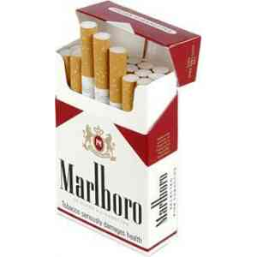


commercial vs. traditional
Source:
http://www.glitc.org/
forms/Tabacco/
tabacco-booklet-web-.pdf

Slide 8

Marie Evans
The sad history of industry targeting

Slide 9
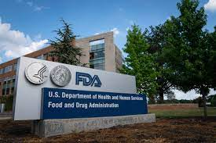
The Act: State and Local Authority
The FDA
YES: Product standards
  Nicotine yields
  Ingredients, constituents
  How constructed
NO:
  Smoke-free
  Tax
  Ban a class of products (e.g., all cigars)
States/Locals
NO: Product standards
YES:
  Smoke-free
  Youth access
  Taxes and pricing
  Sales & distribution
Notes:
In the meantime, while we’re all waiting for the FDA to act, many states and local communities are exerting their authority to regulate e-cigarettes on their own. This chart summarizes the federal government’s regulatory authority over tobacco products, including e-cigarettes, and the authority of states and many local governments.

Slide 10

Elements of a strong policy
Strong findings section
Clear, consistent definitions
Comprehensive
Enforcement provisions
Cessation support
Anti-preemption language for state laws
Evaluation is essential.

Slide 11
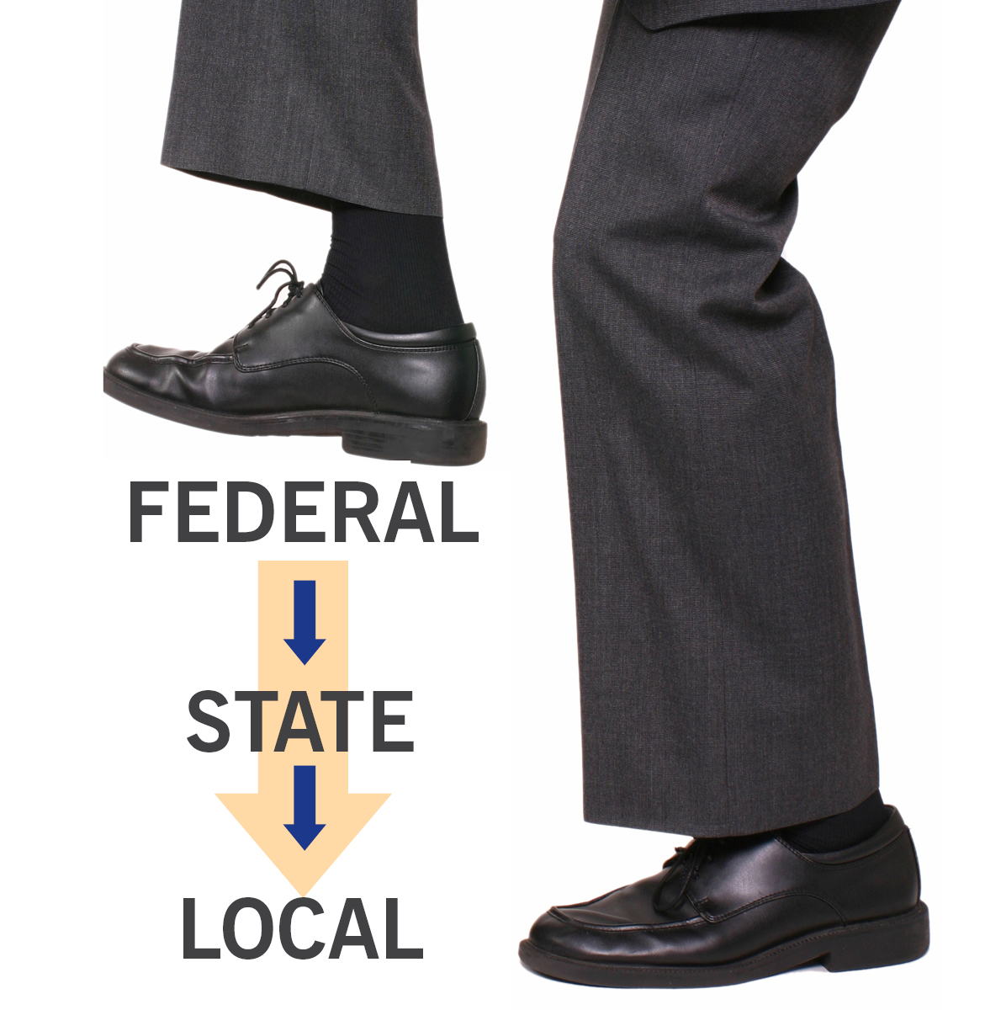
What is preemption?
“Higher” level of government eliminates or reduces authority of a “lower” level of government.
Tobacco industry weaponized it 35 years ago.
grassrootschange.net

Slide 12
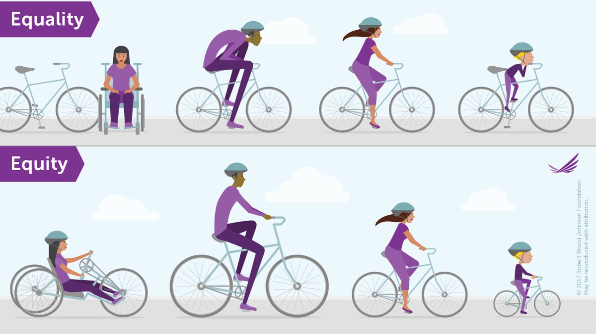
PReemption a fundamental health equity issue
Locally tailored policies are the best policies for addressing health disparities.
Preemption locks in the status quo and inhibits policy innovation.
Community involvement helps to develop more thoughtful policies.
It’s difficult to repeal, but some recent successes.

Slide 13
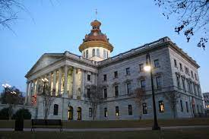

“Ominbus” Tobacco Enforcement Act of 2023
Local governments are preempted from laws “…pertaining to ingredients, flavors, or licensing, beyond a general business license.”
. Scope is not completely clear.
Does NOT include:
  smoke-free/tobacco-free laws; or
  land use/zoning laws.

Slide 14
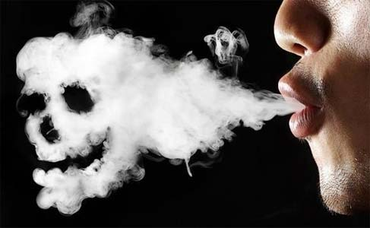
Smoke-free laws a powerful first step
According to DHEC, 40% of South Carolinians live in communities with comprehensive smoke-free laws.
Foothills Brewing v. City of Greenville clarified local authority in 2008.
Huge opportunity for comprehensive laws – workplaces, outdoor spaces, and housing.

Slide 15
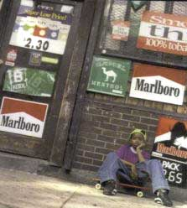
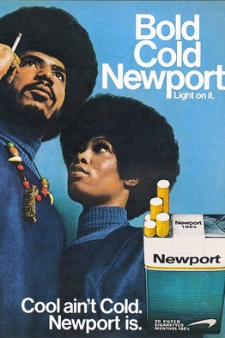
Menthol a sordid history
Industry targeting African-American communities:
  Increase in use from 5% in 1950’s to about 85% today.
  45% of African-American smokers would try to quit if menthol weren’t available.
  75% of African-American smokers in favor of banning menthol cigarettes.
Source: Truth Initiative

Slide 16
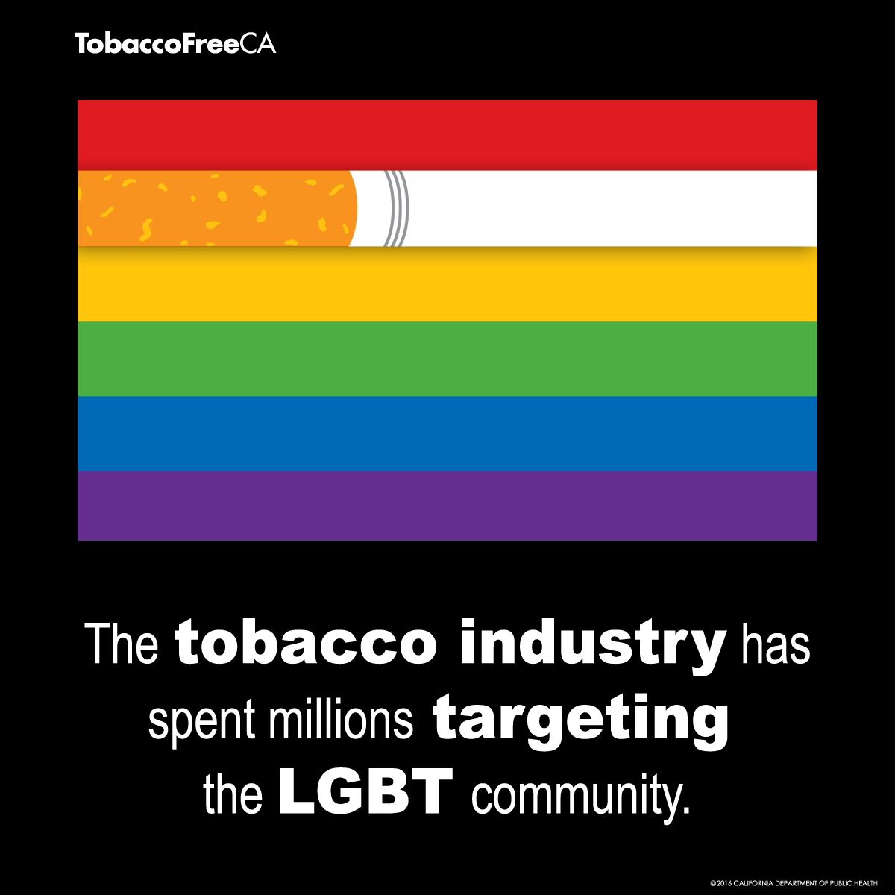
Targeting the LGBTQ+ Community
  20.6% of LGBTQ+ adults and 35.5% of transgender adults smoke cigarettes compared to 14.9%.
      Source: Truth Initiative
  LBGTQ+ menthol cigarette use is also significantly higher (36% of smokers).
      Source: Fallin A, Goodin AJ, King BA, Am. J. Prev. Med.

Slide 17
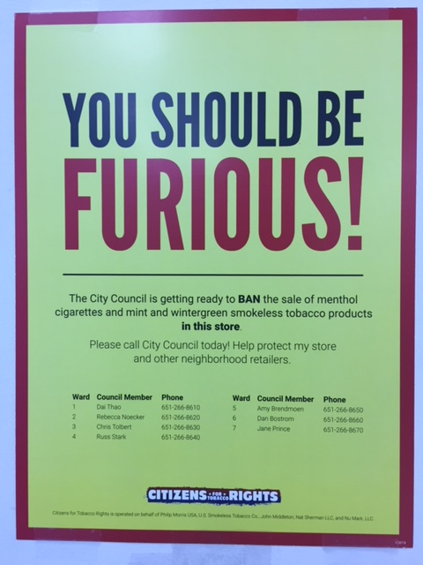
Capturing the kids
  81% of youth initiate tobacco use with flavored products.
      Source: Truth Initiative
  Menthol increases initiation, decreases cessation, exacerbates disparities.
      Source: Campaign for Tobacco Free Kids

Slide 18

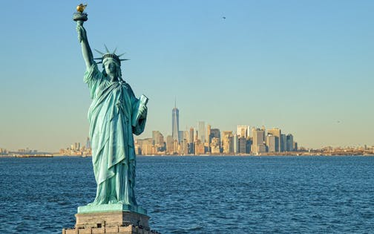

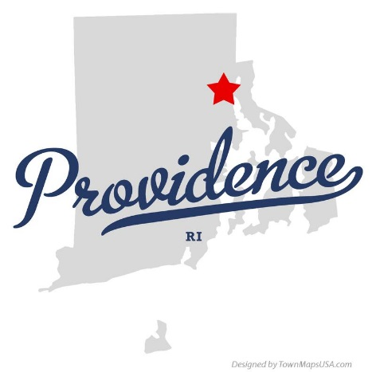

Flavored tobacco restrictions the evolution

Slide 19

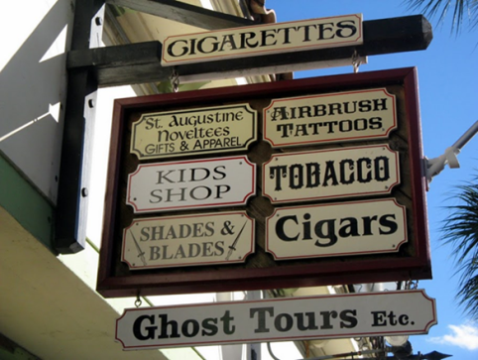
Location/types of retailers
Beyond TRL
Restricting Retailers
  Location
    Near schools
    Residential areas
  Density
    How close to each other
  Quantity
    Total number overall
  Type of Retailer
    Adult-only retailers
    Pharmacies

Slide 20
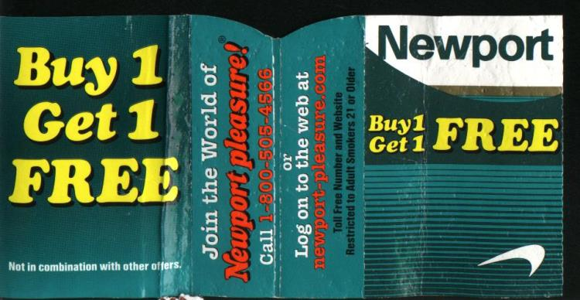
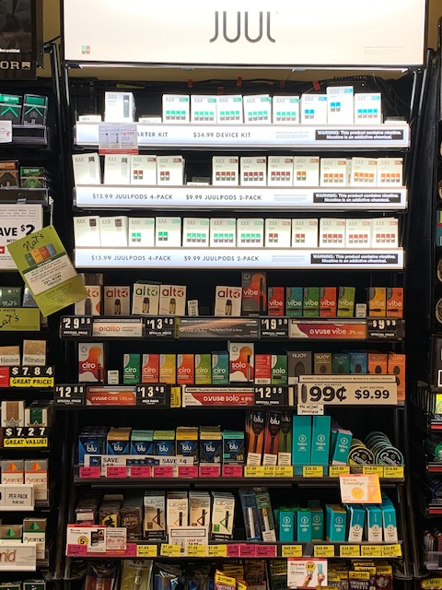

Tax and pricing
Increase tax and expand to e-cigarettes.
Research shows that tobacco is often the cheapest in lowest income communities and in pharmacies.
Restricting redemption of coupons.
  No “sale” prices.
Price floors – often combined with minimum pack size.

Slide 21
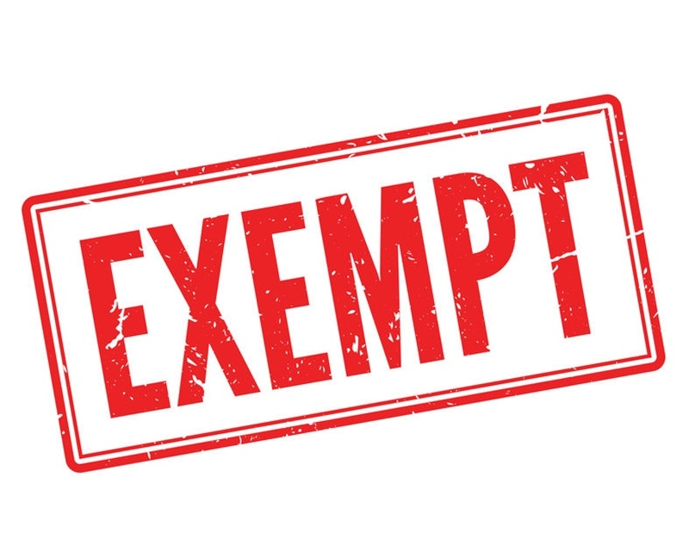
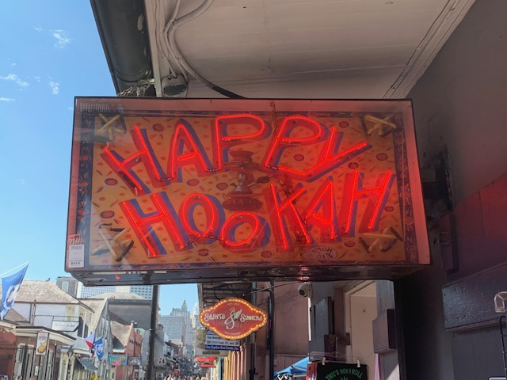
exemptions are they worth it?
No.
Will inevitably increase disparities.
No public health benefit.
Increased likelihood of litigation.

Slide 22
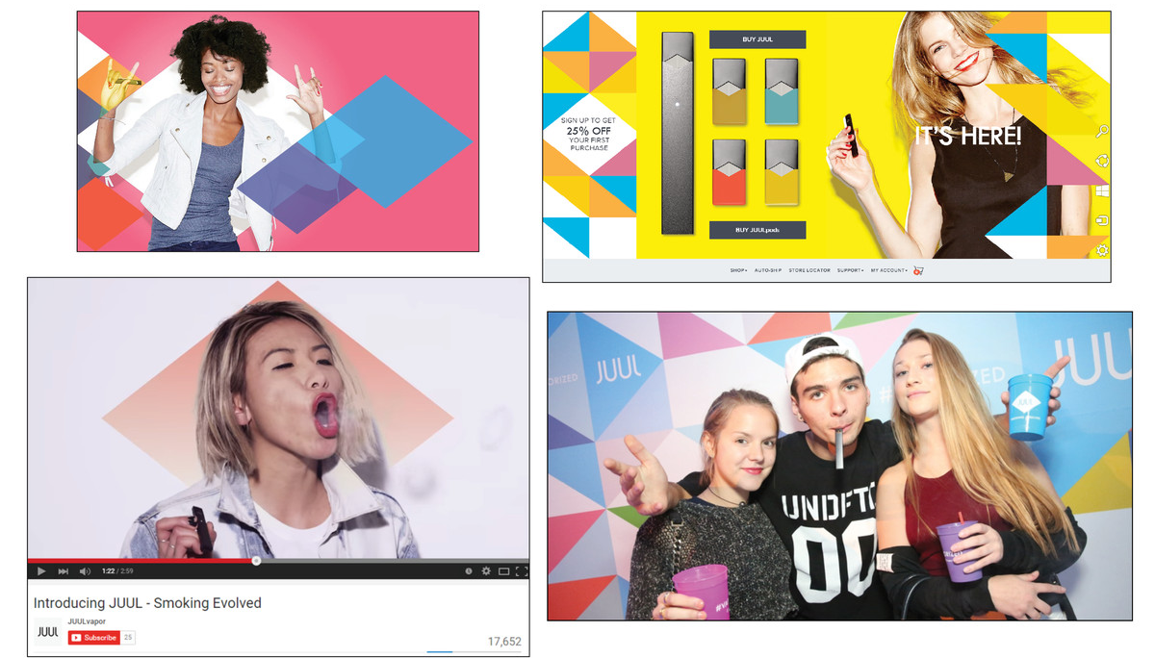
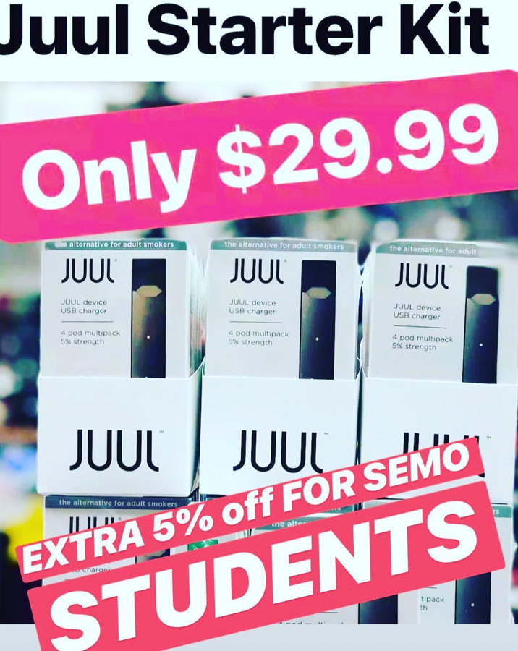
Equitable penalties
Youth use hasn’t increased by accident
Industry documents show targeting of kids since 1950s for “replacement smokers.”
Tobacco industry “education programs” in 1980s and 1990’s led to similar efforts by JUUL.
Industry targeting of youth:
  Industry spends $9.5 billion a year on marketing, vast majority in the retail environment.
  90% of youth report exposure to cigarette ads, 80% to e-cigarette ads.

Slide 23

Equitable Penalties
Punitive Purchase, Use, and Possession (PUP) laws are not effective at addressing addiction.
Removed from South Carolina’s state law.

Slide 24
Discrimination in enforcement
Black youth, youth of color, indigenous youth, and youth with disabilities are disproportionately penalized in the school environment and legal system.
Prosecutorial discretion leads to increased interactions with police.

Slide 25
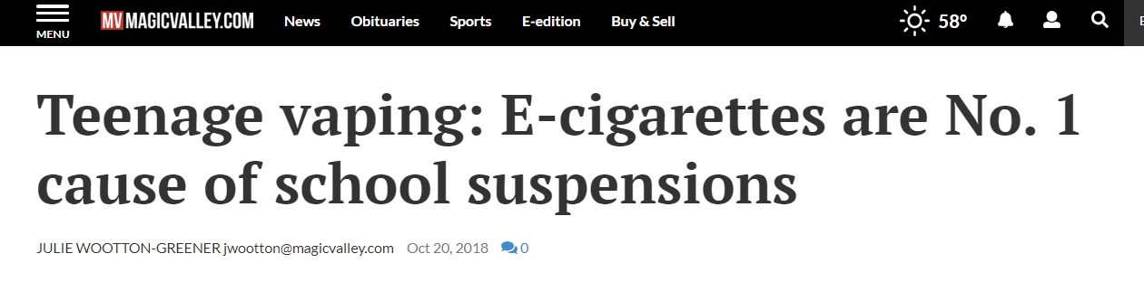
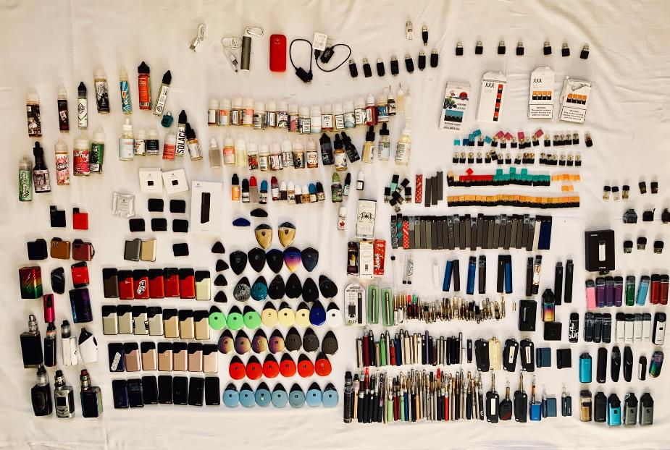
School penalties suspensions and expulsions aren’t effective
Notes:
This Idaho newspaper reported that "[e]-cigarettes are the no. 1 cause of school suspensions" in October of last year.
Suspension is effective in [2]: o Removing a problematic student from school. o Providing temporary relief to frustrated school personnel. o Raising parental attention to their child’s misconduct.
BUT

Slide 26

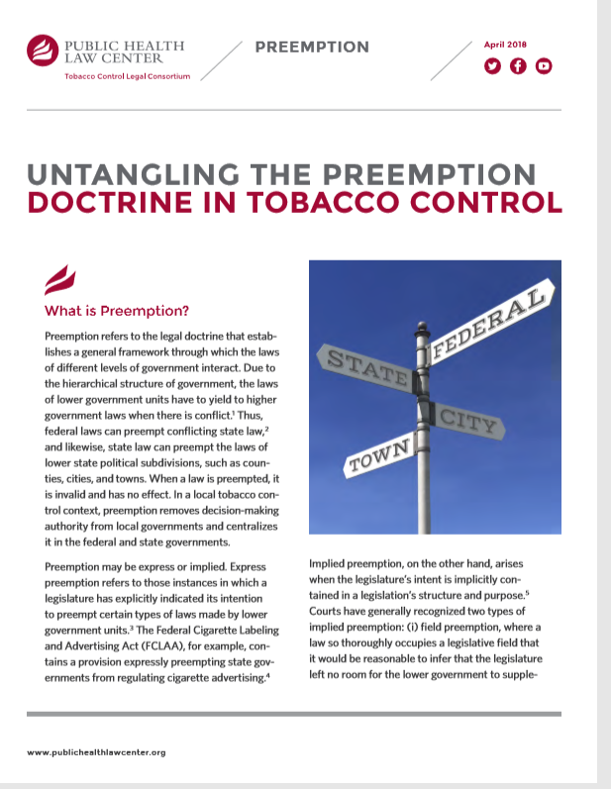
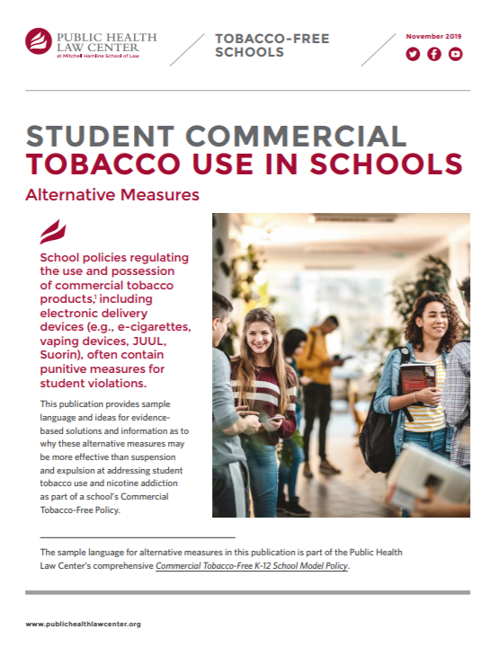

Slide 27





CONTACT US
651.290.7506
publichealthlawcenter@mitchellhamline.edu
www.publichealthlawcenter.org
@phealthlawctr
facebook.com/publichealthlawcenter

