Slide 1
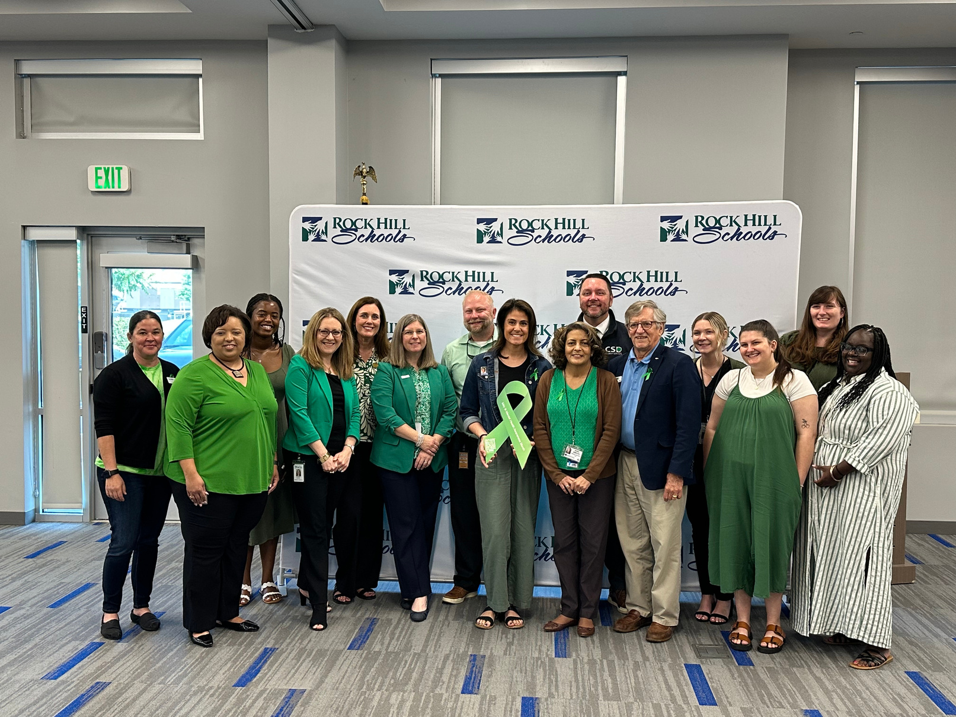
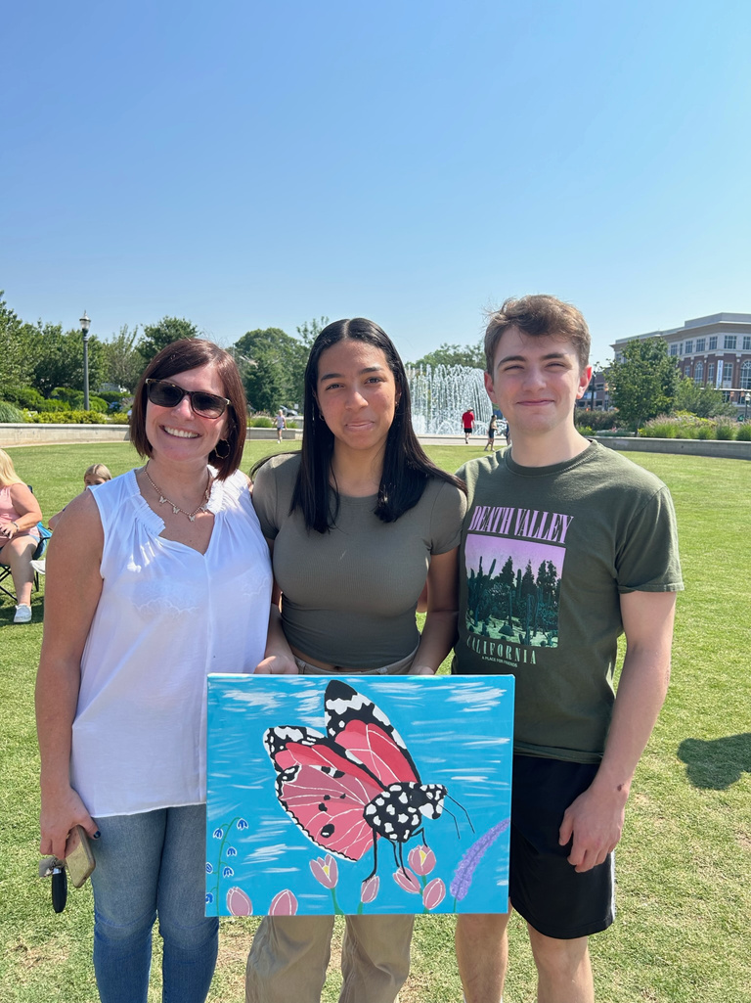


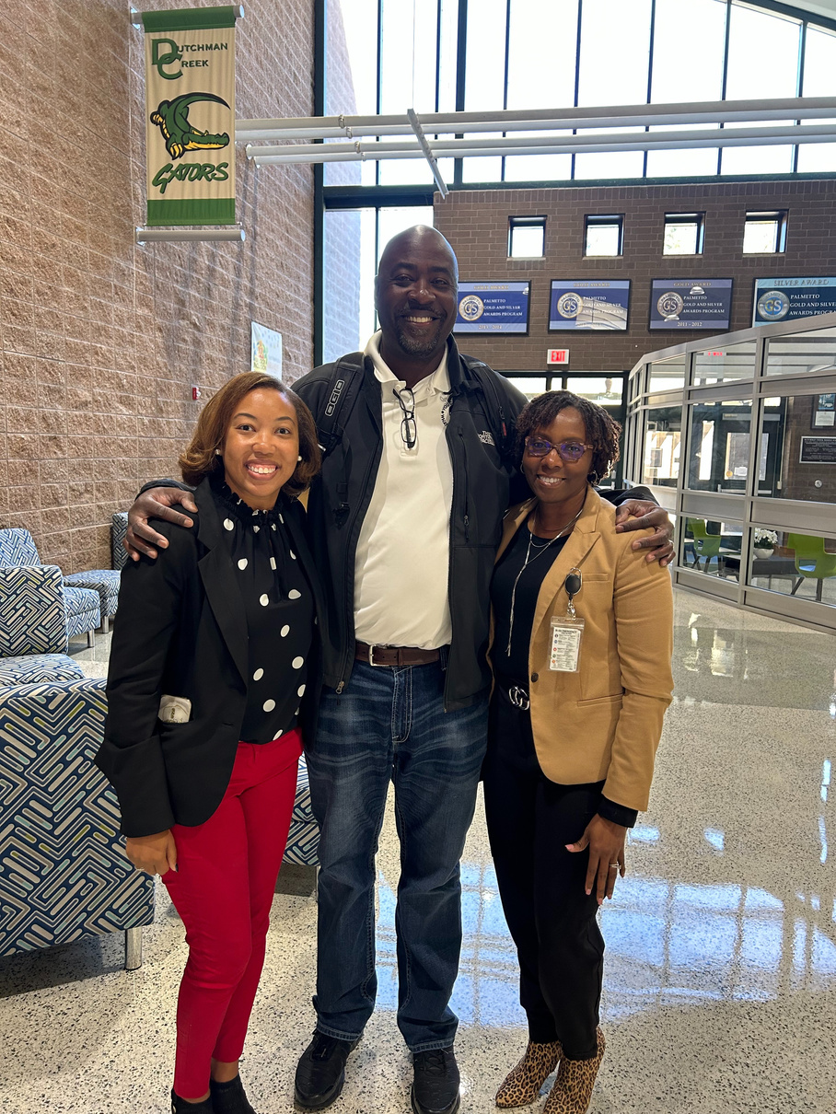


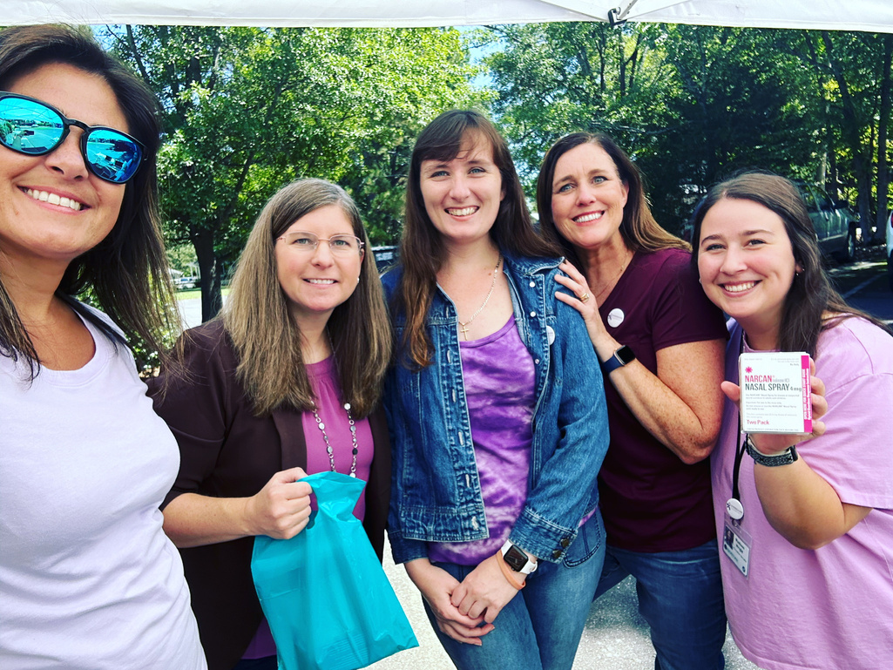
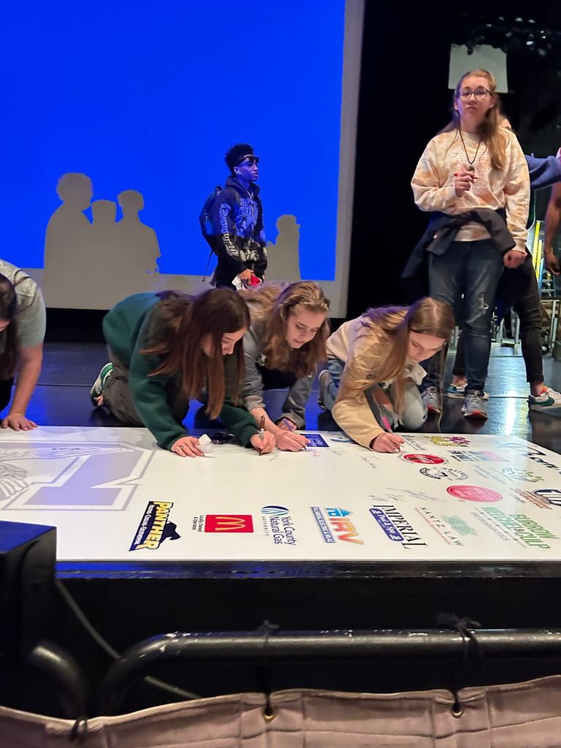

Slide 2
YORK COUNTY ALL ON BOARD’S MISSION: PREVENT YOUTH SUBSTANCE USE IN YORK COUNTY
OUT OF
THEIR
HANDS
(OOTH)
ALCOHOL
ENFORCEMENT TEAM
YCHOPE
TFYCC
OPERATION
MEDICINE
DROP
RAPS
AYOB
LEGISLATIVE
ADVOCACY

Slide 3
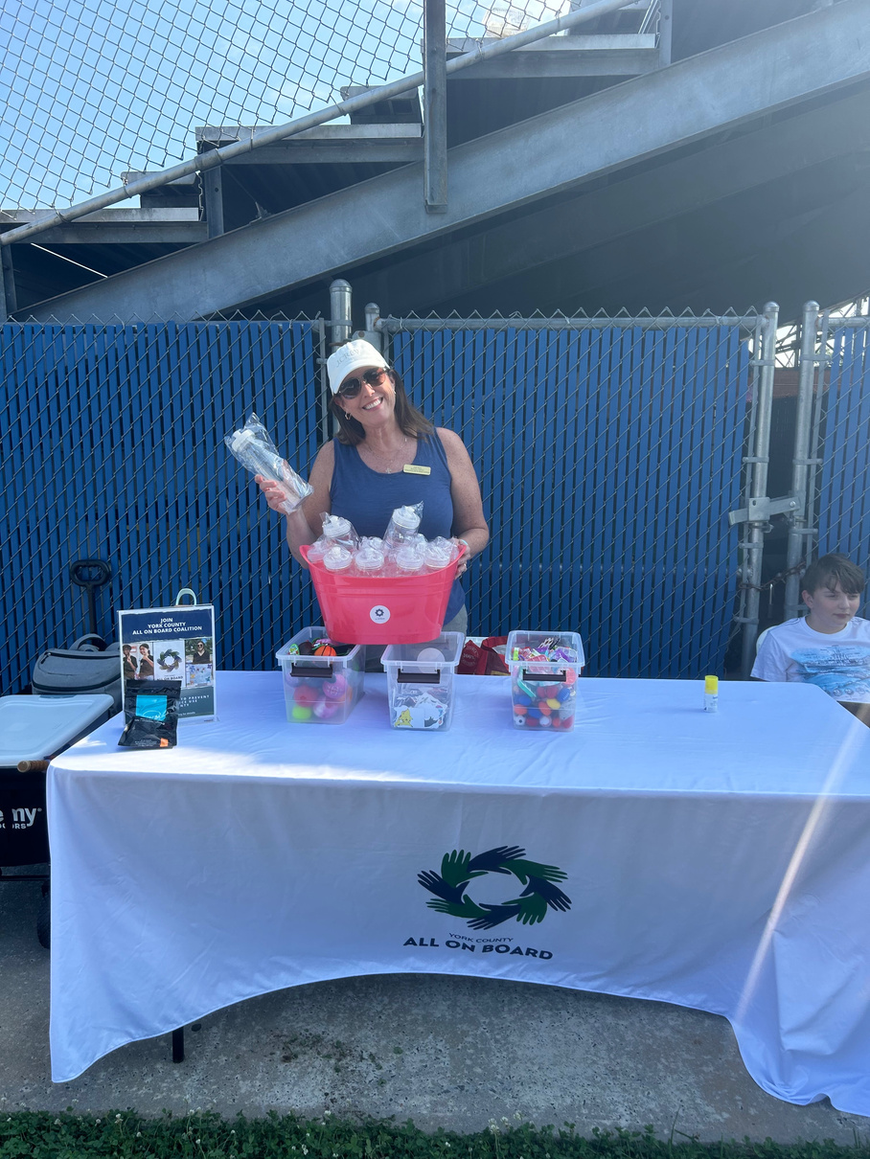
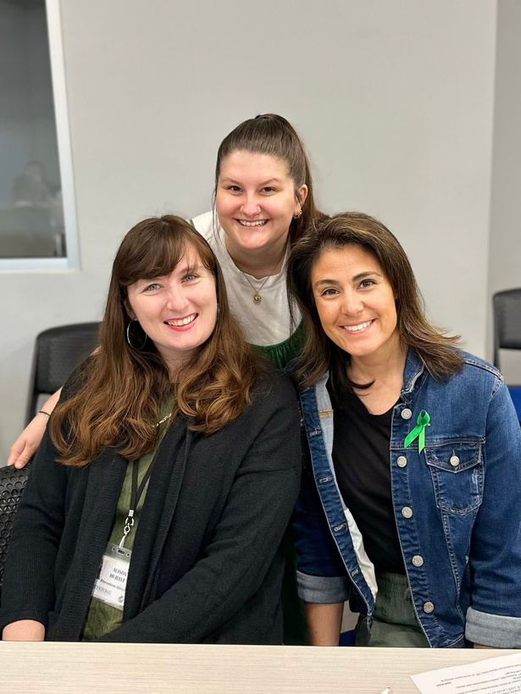
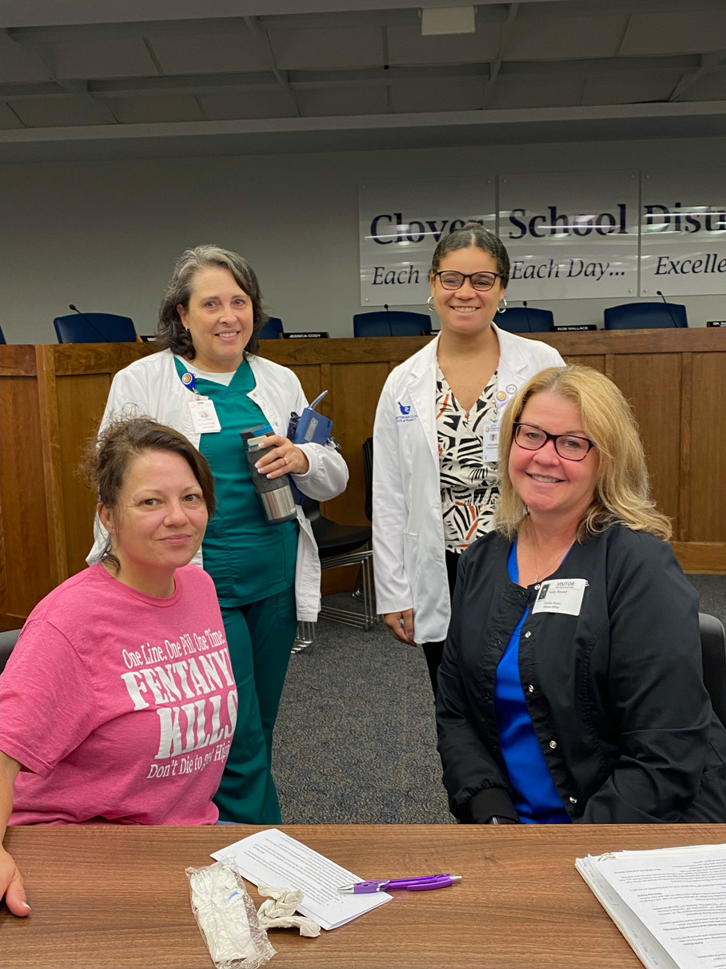
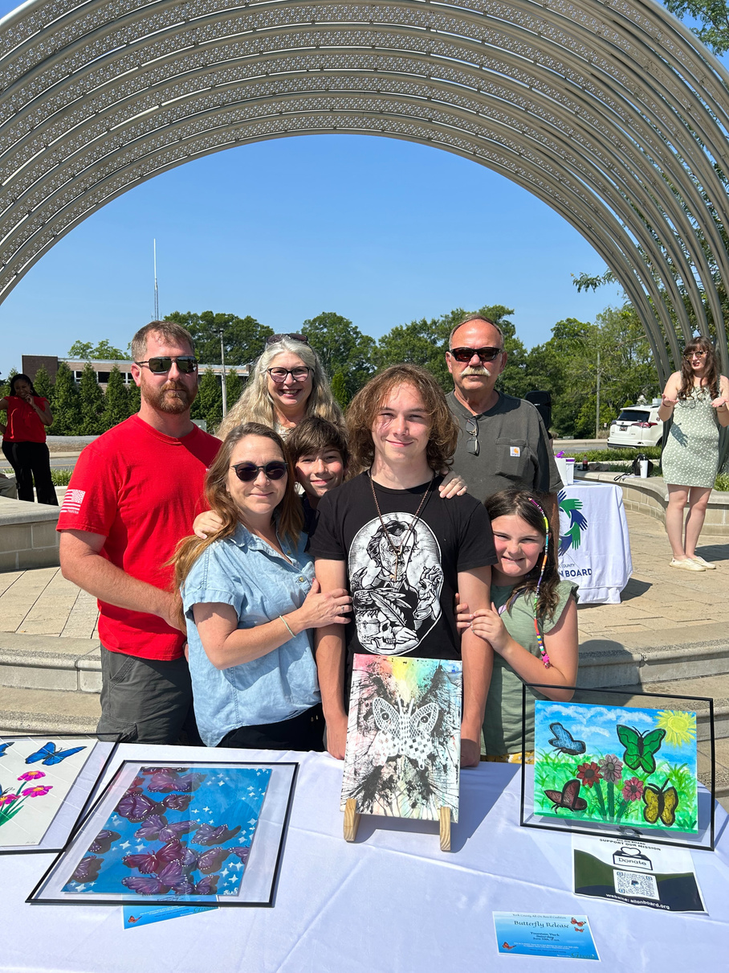

COMMUNITY ENGAGEMENT

Slide 4
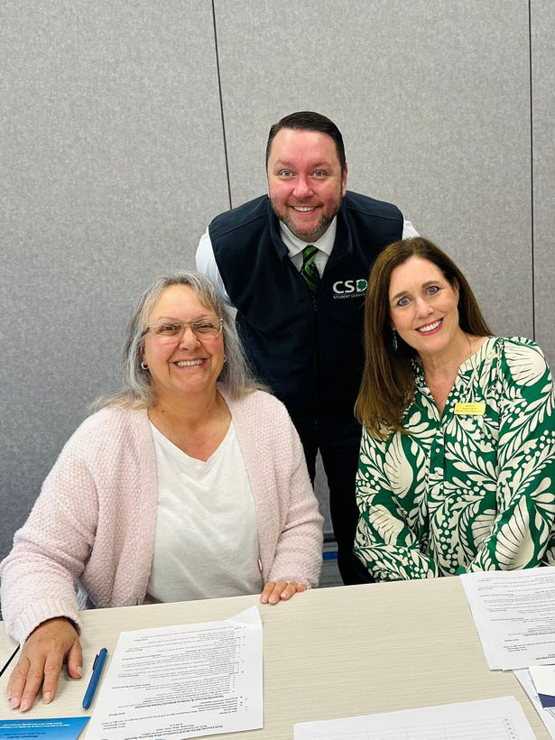
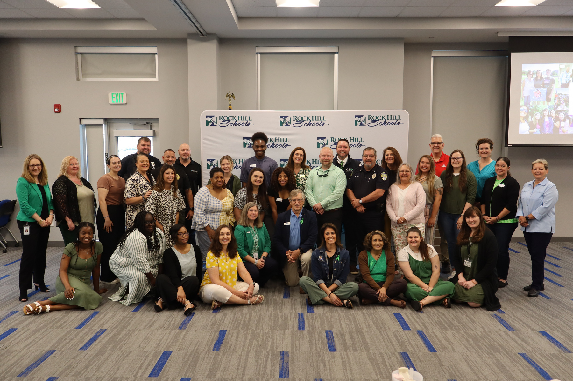
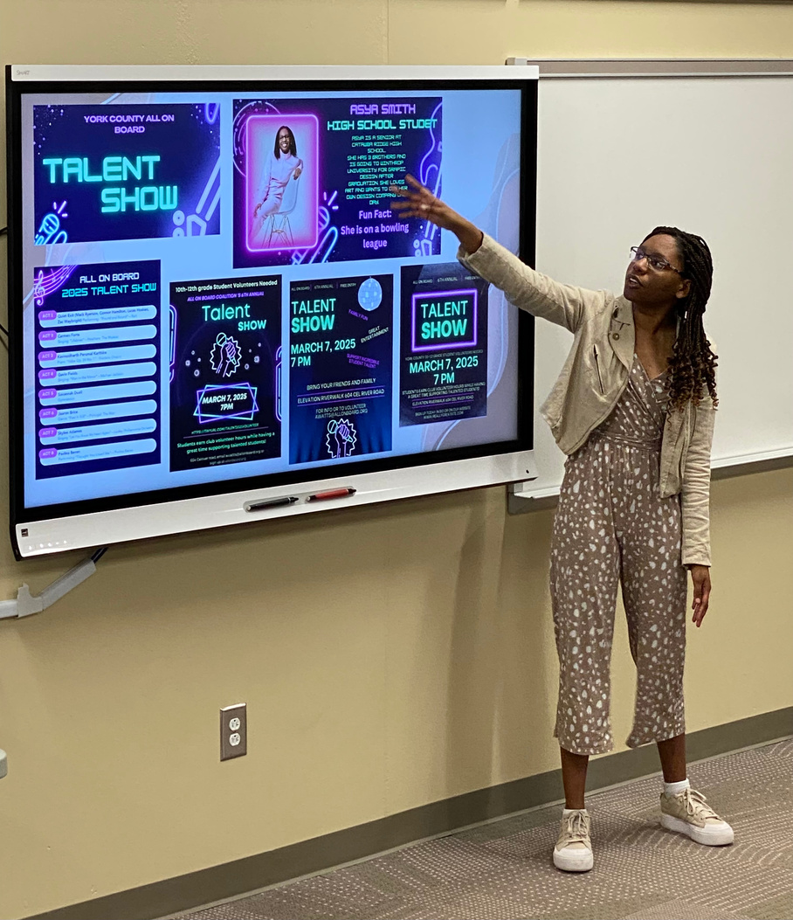
MONTHLY COALITION MEETINGS

Slide 5

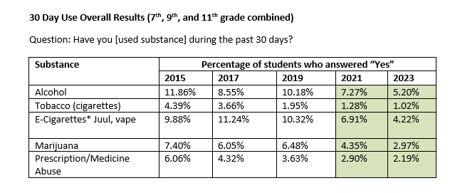
York County 7th, 9th and 11th grade students are surveyed every other year. Result of the 5,232
7th, 9th and 11th grade students surveyed in 2023:

Slide 6

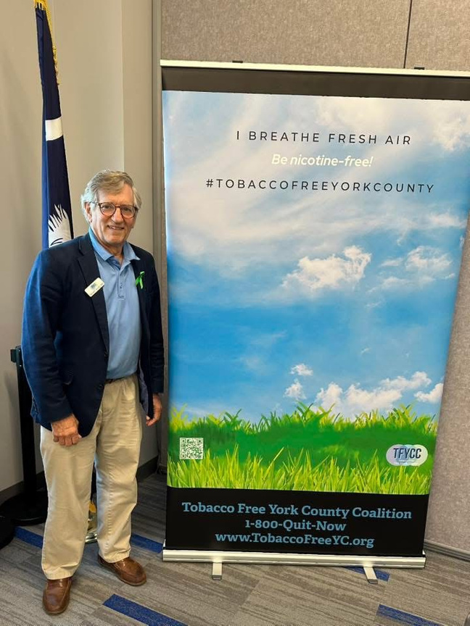

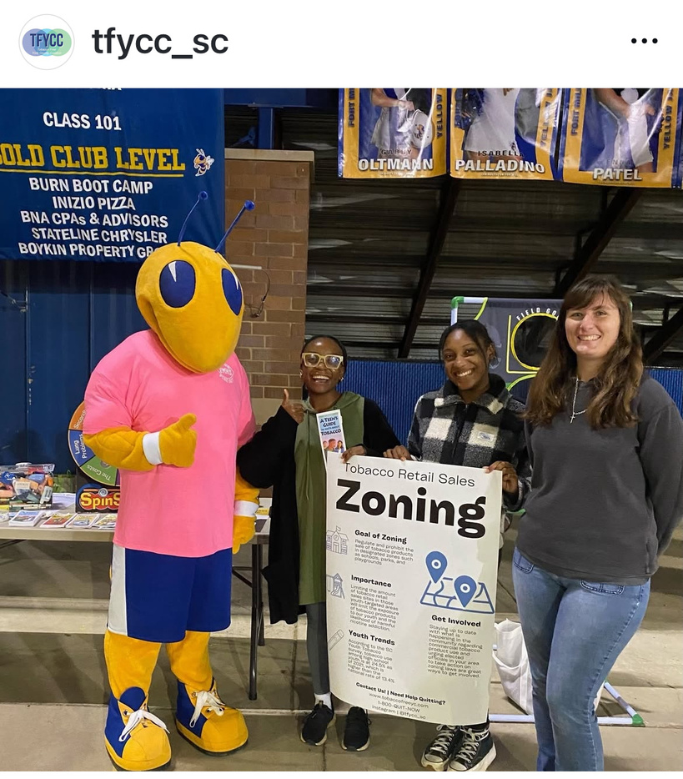

Slide 7
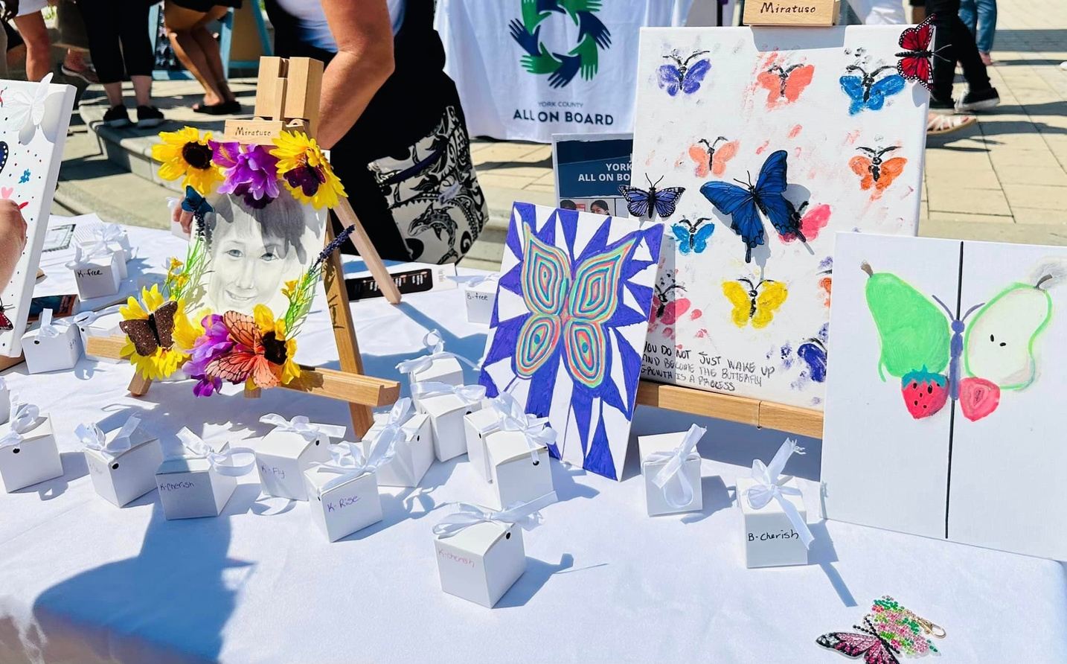
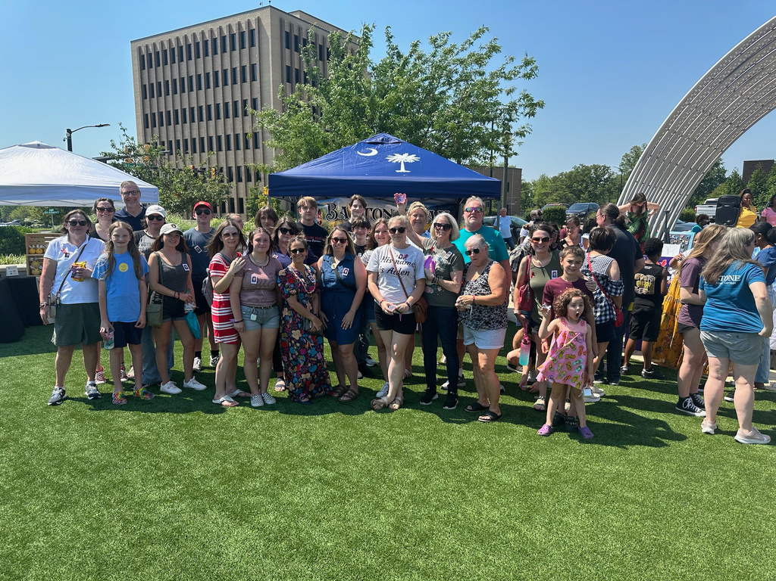

WHAT IS HAPPENING LOCALLY?
York County Coroner’s Office reported 118 overdose fatalities in 2023.
While we still have work to do to save more precious lives, the encouraging news is that in 2024 the number of overdose fatalities was reduced to 83.
YCAOB has collaborated with our partners to provide in the last school year:
  Prevention Education to 8,759 community members with 5,470 being youth under 18
  Substance Use Prevention education at 54 meetings, events or trainings
  17 Prom Pledge assemblies which educated 4,847 students about the risks of substance use- no underage crashes or fatalities on Prom nights
  Partnered with Winthrop, Fort Mill Schools, Rock Hill Schools, and Clover students to create and share prevention posts on social media with 41,303 insights noted on these posts.

Slide 8




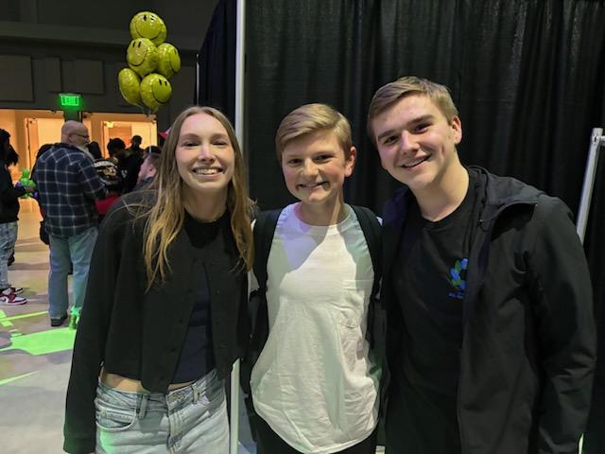


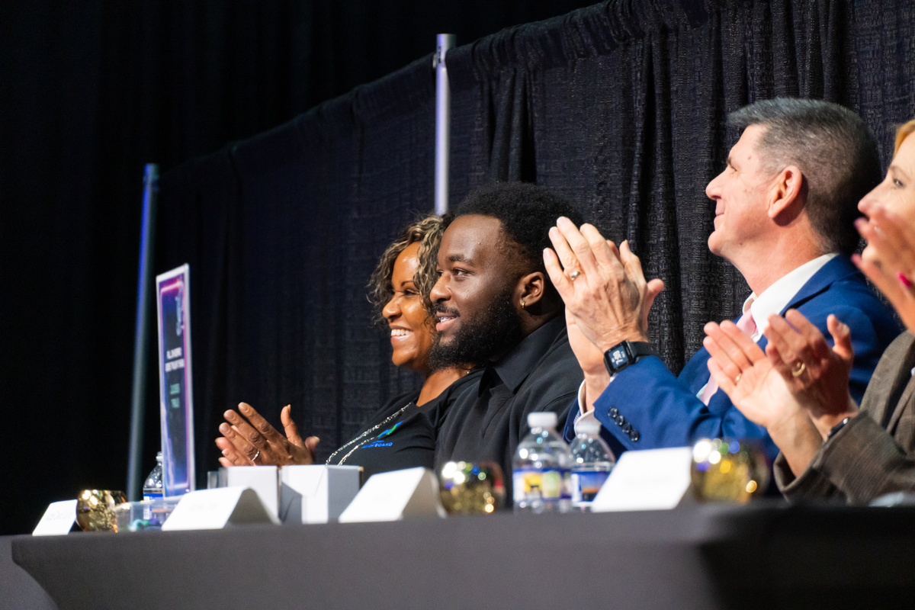


Slide 9
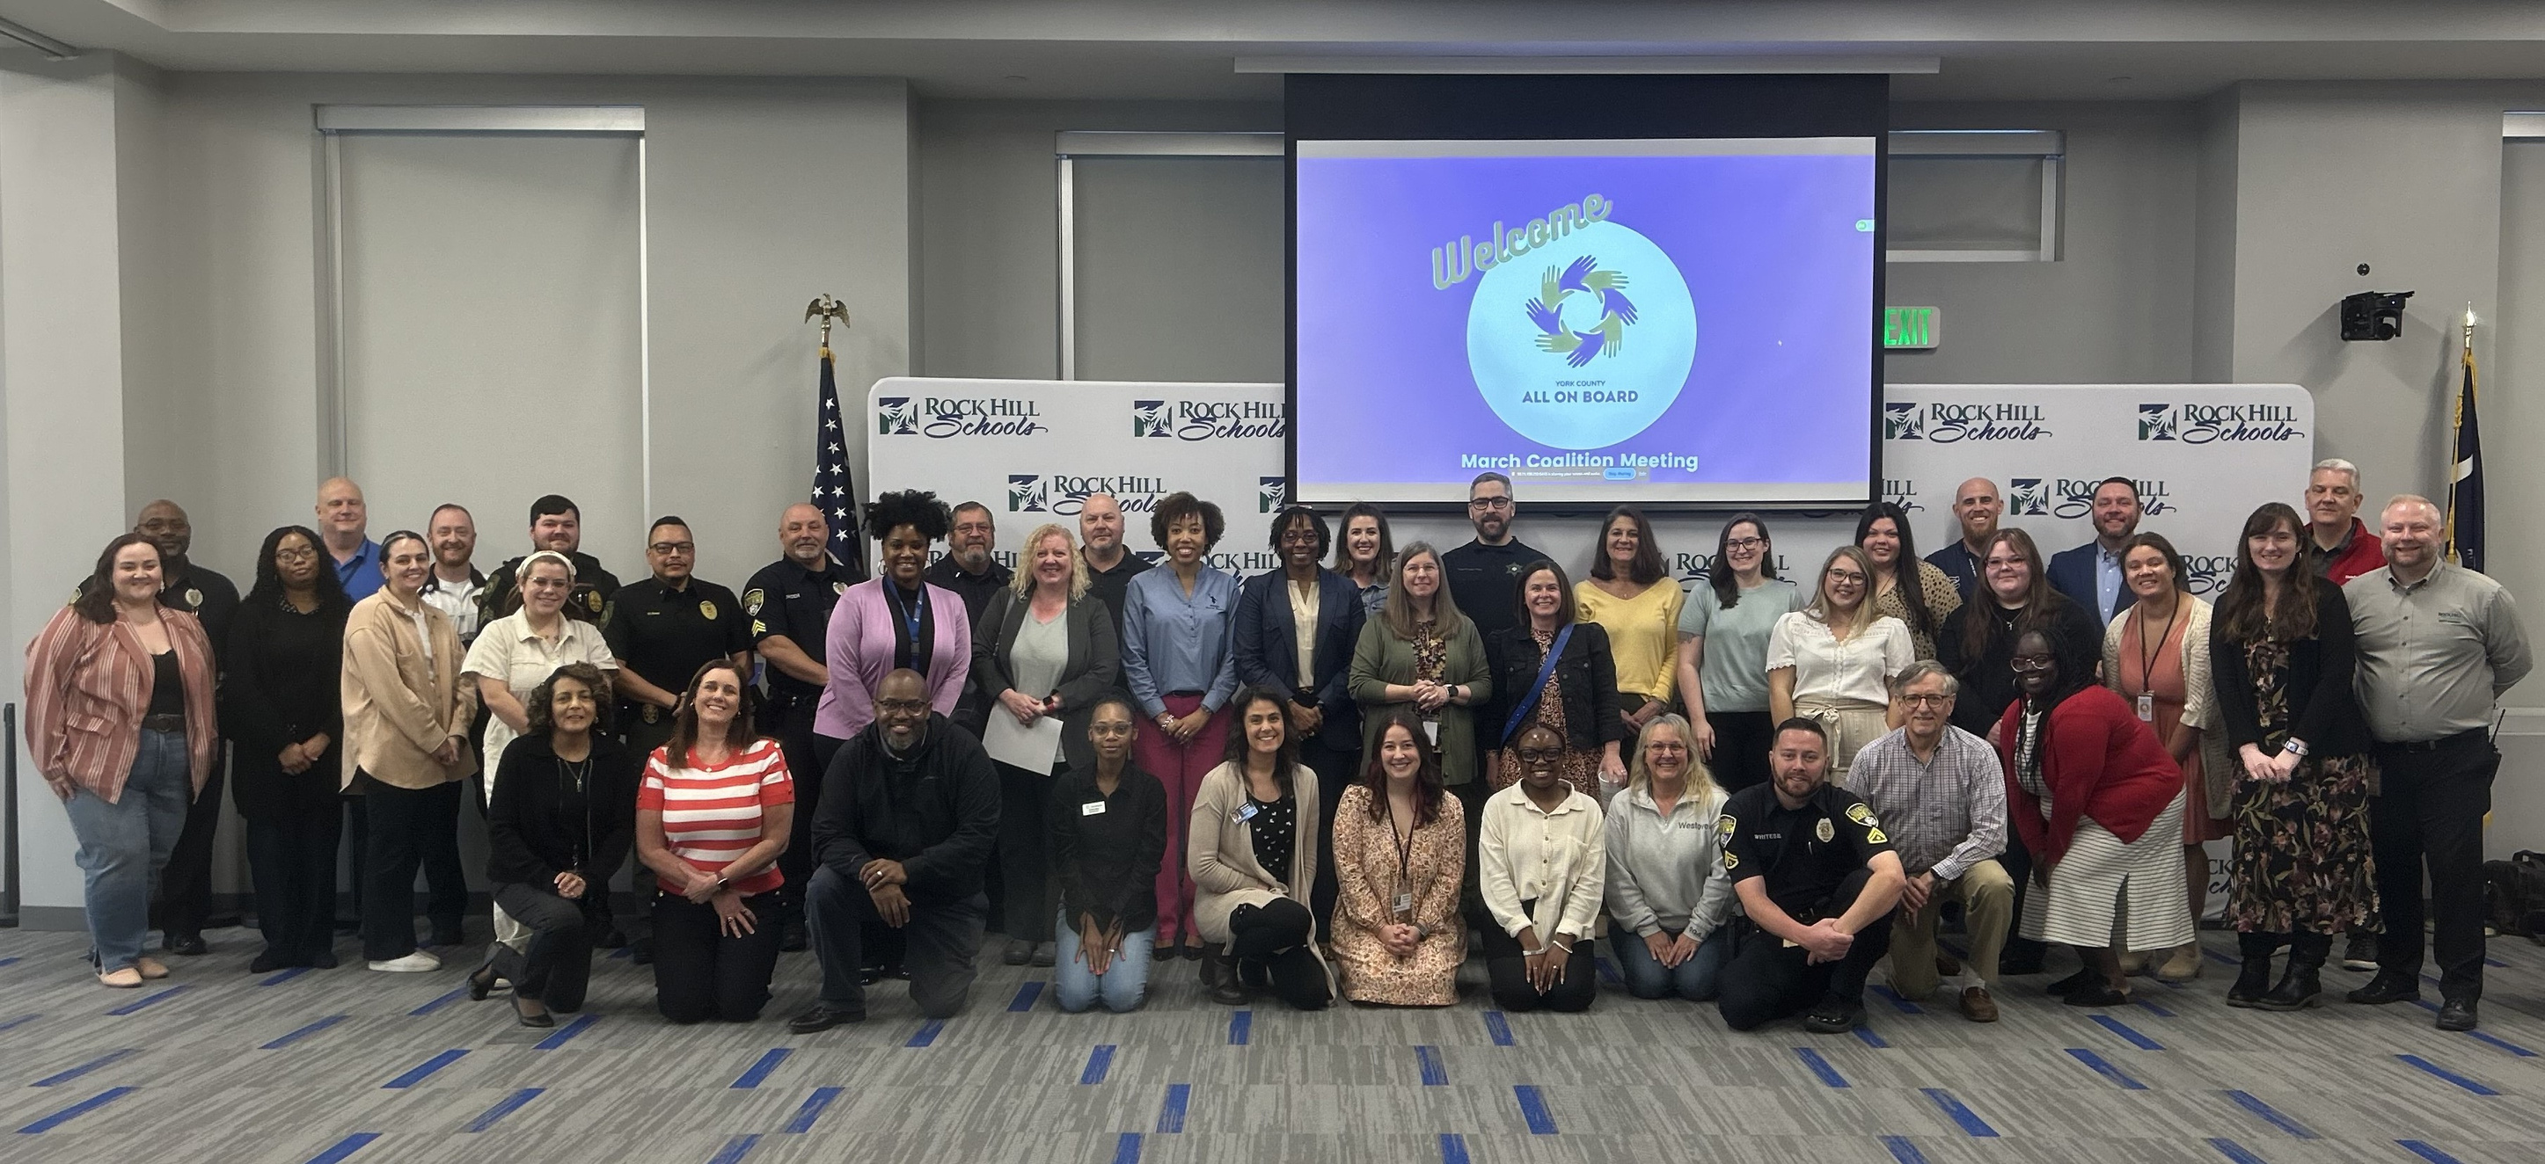
Questions?
Want to join our efforts at All On Board Coalition?
allonboard.org

