Slide 1
OffOffice of Chronic Disease policy & prevention
Tobacco Prevention & Control Team
June 2023

Slide 2
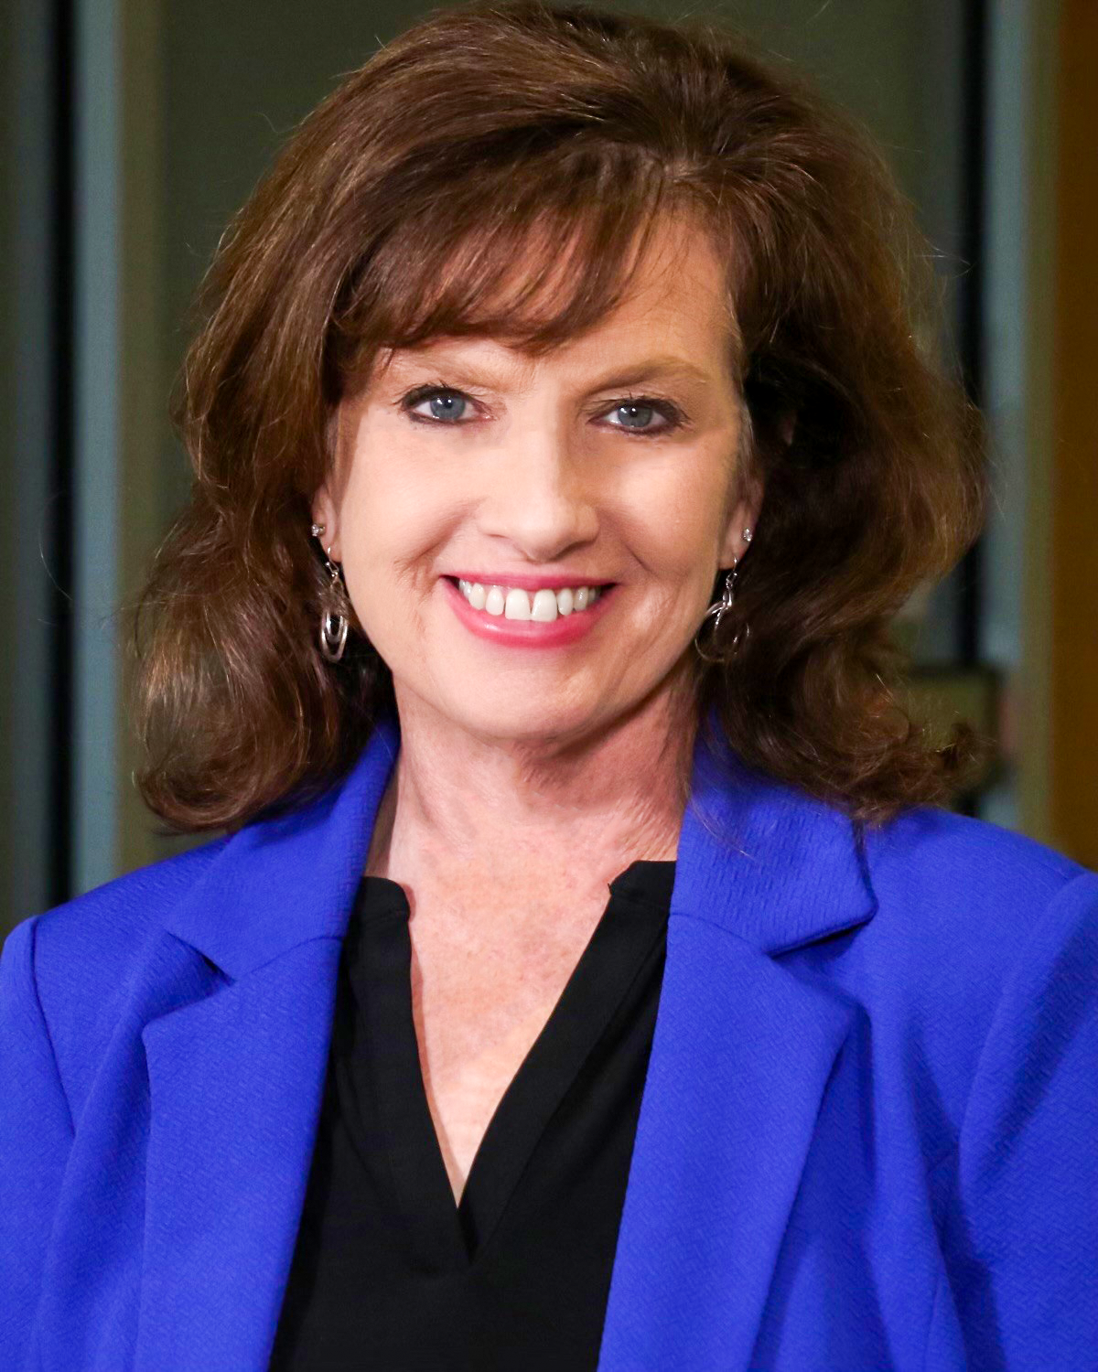
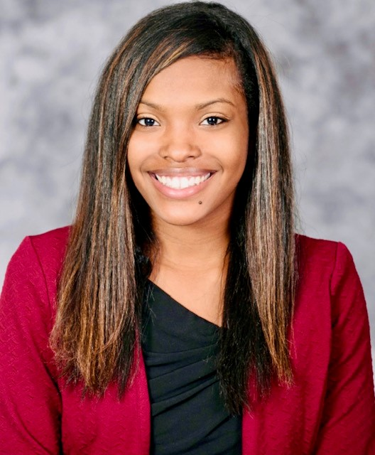
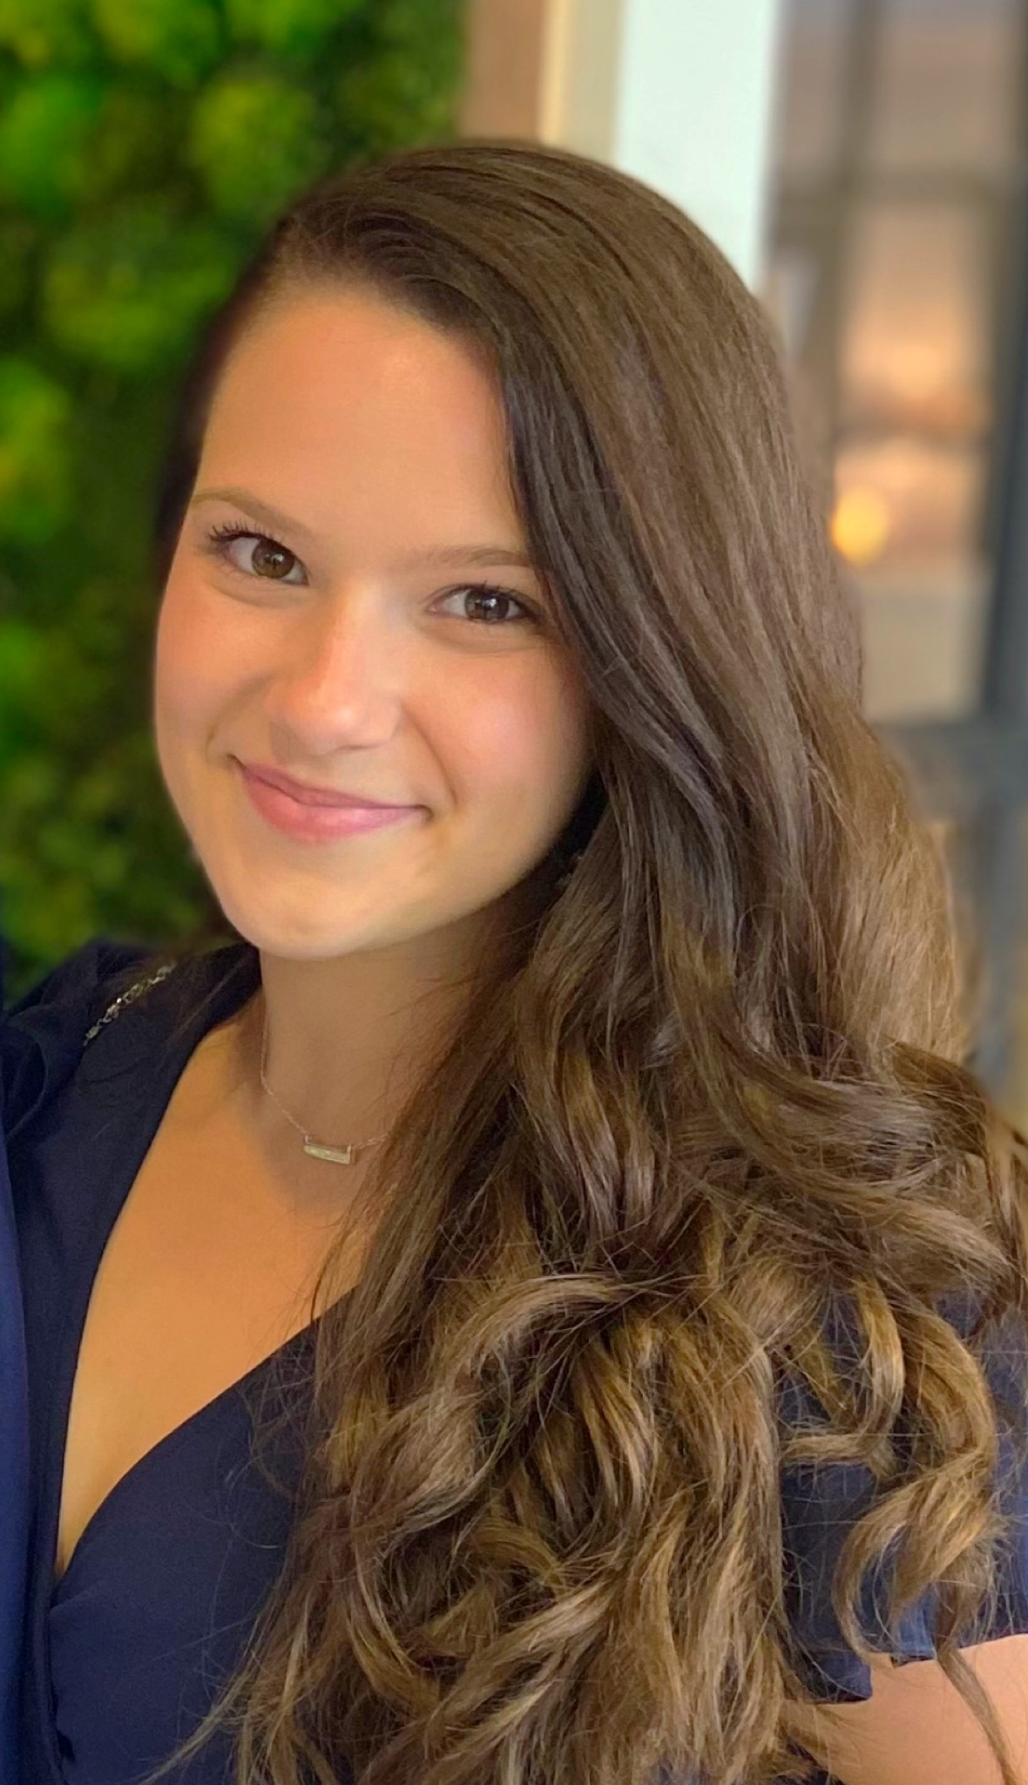
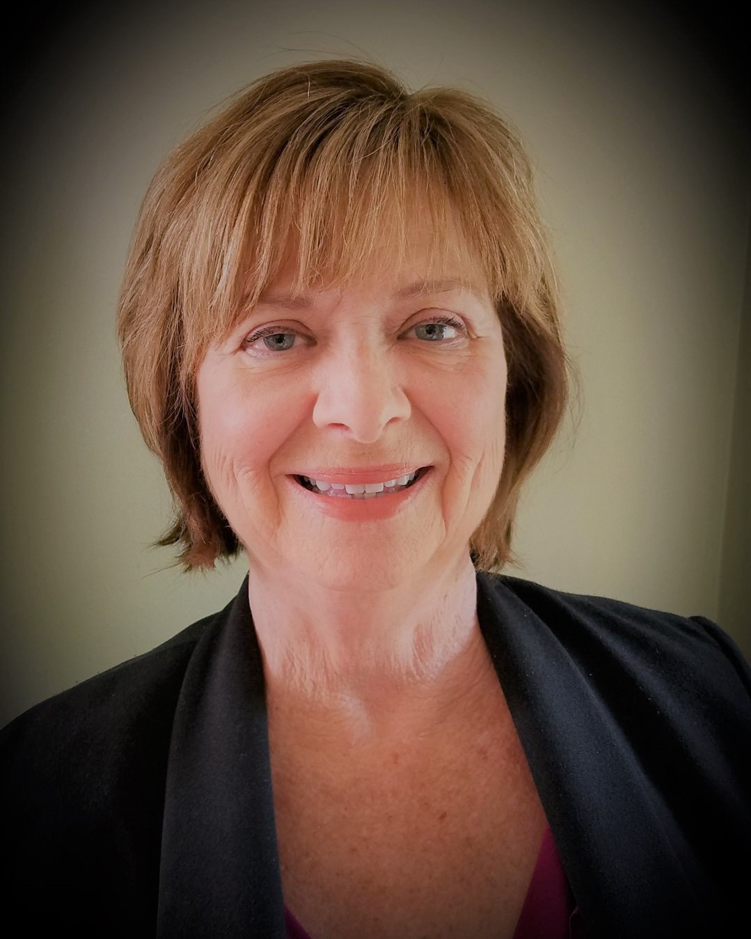

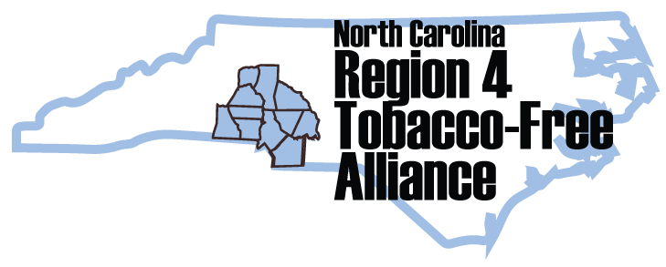
Meet the Tobacco Prevention and Control Team
Kim Bayha, CTTS
Tobacco Prevention & Control
Program Supervisor
Jasmine Simmons, MSHSA, NCTTP
Tobacco Control Coordinator
Carleen Crawford, TTS
Region 4 Tobacco
Control Manager
Irini McCarthy, TTS
Tobacco Prevention Coordinator

Slide 3
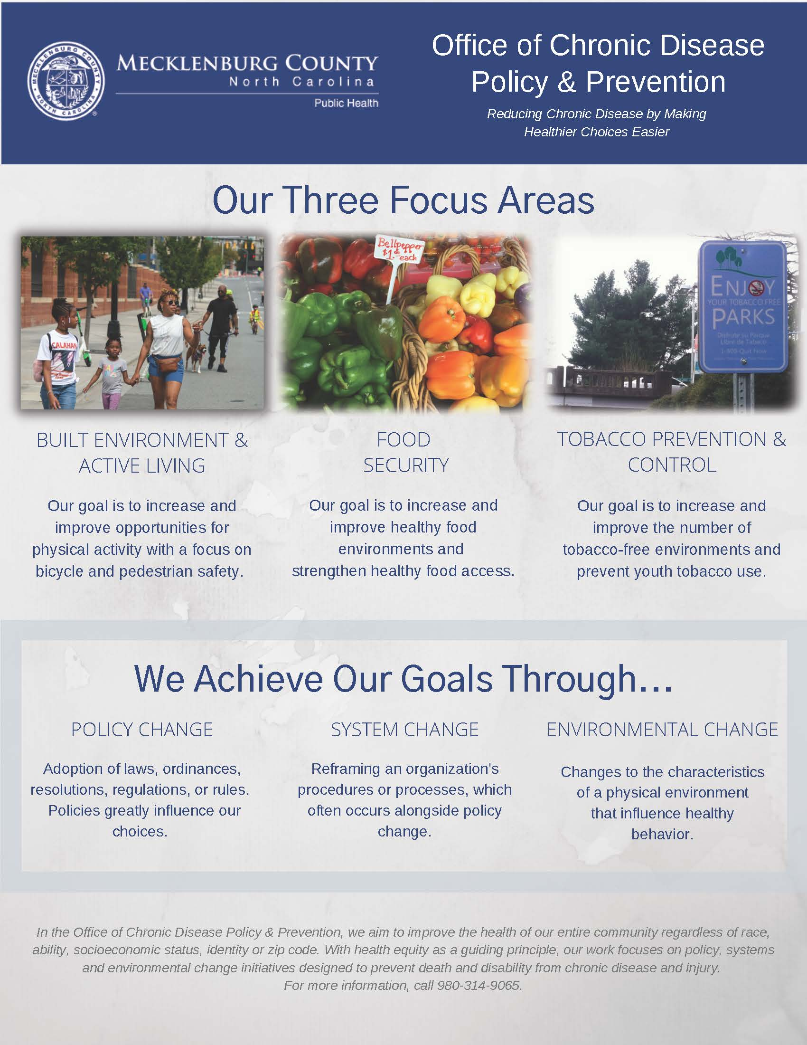

Office of
Policy & Prevention
Reducing chronic diseases by making healthier choices easier

Slide 4
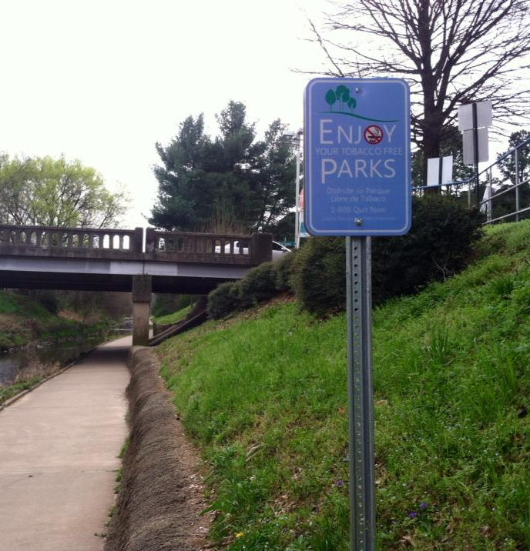
Tobacco Control Team Goals
  Reduce Exposure to Secondhand Smoke and E-cigarette Aerosol
  Increase Tobacco-Free Environments
  Prevent Youth and Young Adult Initiation of Tobacco Use
  Address Tobacco-Related Health Disparities

Slide 5
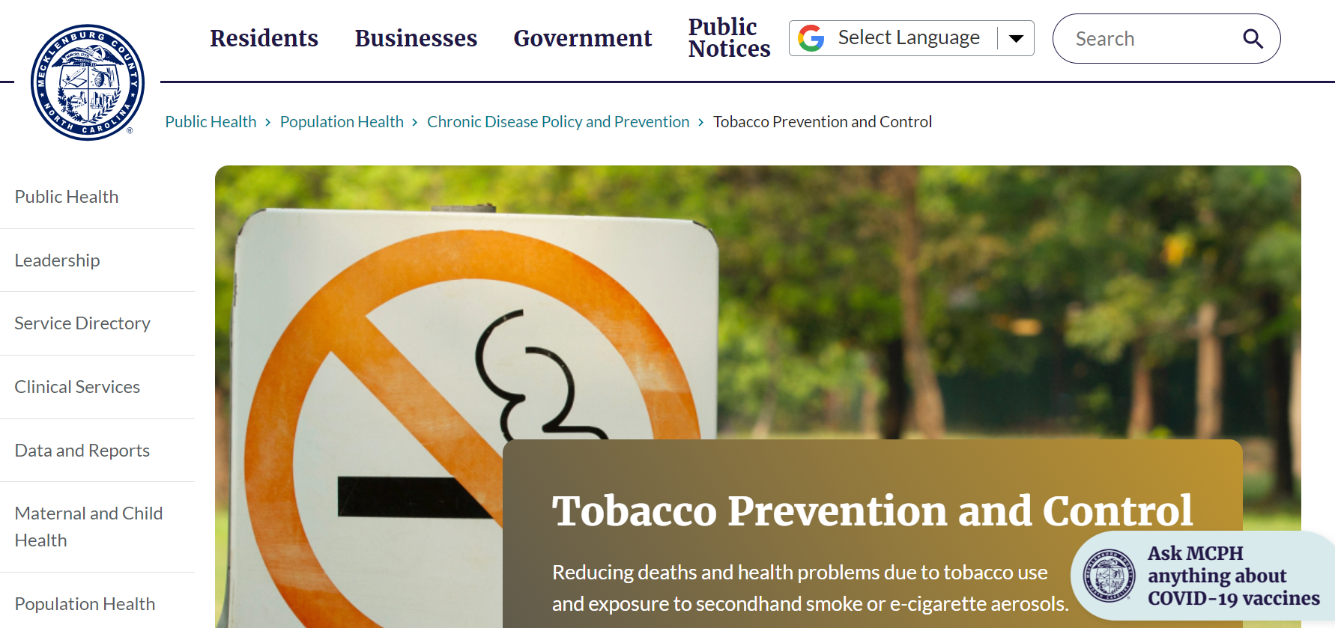
Visit
TobaccoFree.MeckNC.gov
Change for Life: Tobacco-Free Recovery
Quit Menthol Your Way
Quitting Tobacco Use
Region 4 Tobacco-Free Alliance
Tobacco-Free Policy
Youth Tobacco Prevention

Slide 6
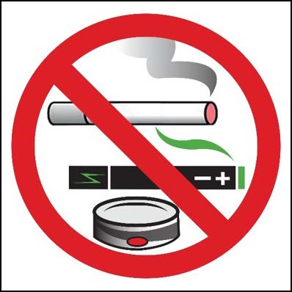
Local Governments
Multi-Unit Housing
Colleges and Universities
Behavioral Health Facilities
Tobacco-Free Policy
Worksites
Indoor Public Places
Health Region 4: Alexander, Cabarrus, Catawba, Cleveland, Gaston, Iredell, Lincoln, Mecklenburg, Rowan, Stanly and Union Counties

Slide 7
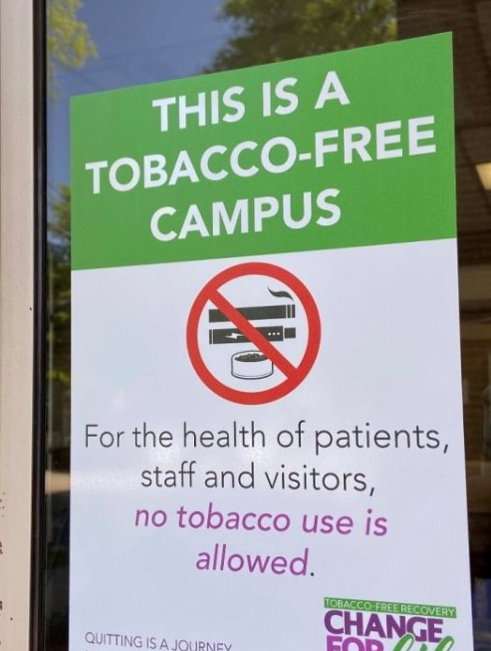
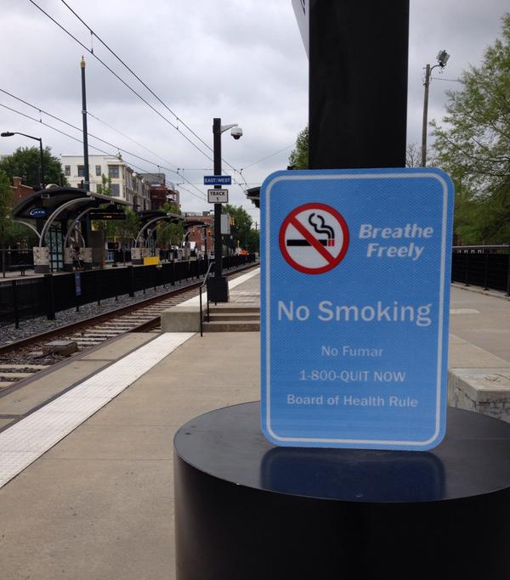

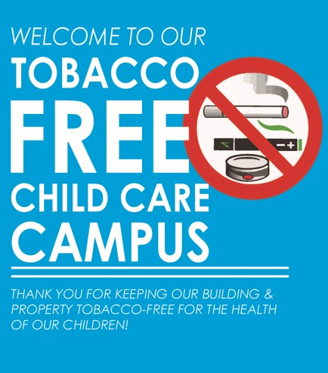
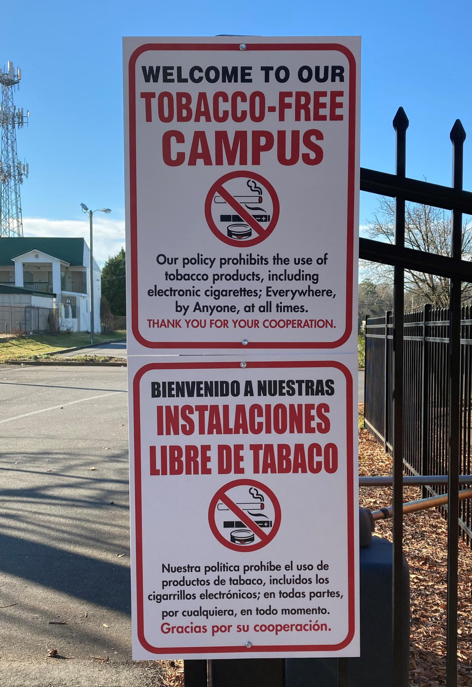

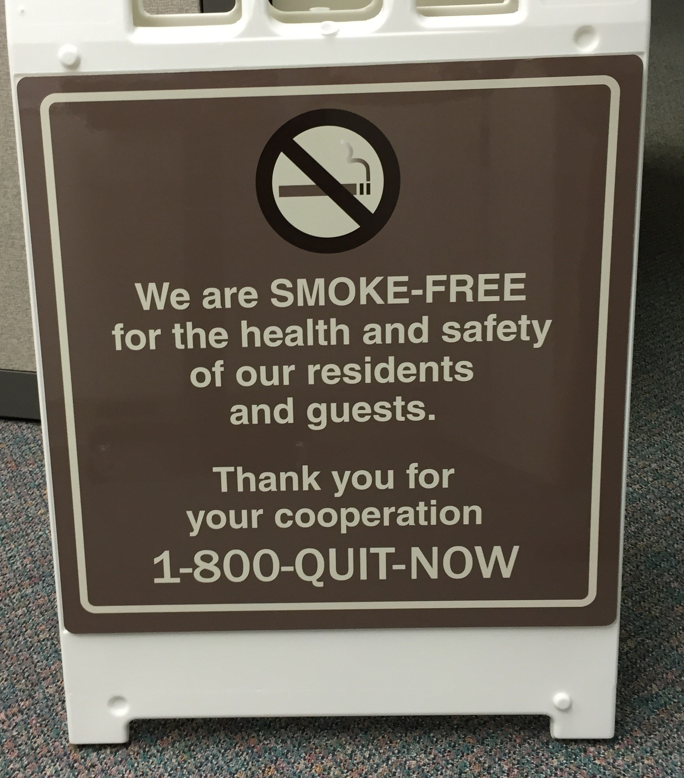
Tobacco Free Environments
Government property, parks, airport
Businesses (where public allowed indoors)
Public Transit
Multi-unit Housing
Workplaces
Heath Care
Community Service Agencies
Behavioral Health Agencies
Schools / Colleges/ Universities
Churches / Faith Communities

Slide 8
Trainings Mecklenburg County and Region 4
In-person & virtual platforms
Youth Tobacco Prevention
Tobacco Product / Use Trends
Tobacco-Free Worksites
Tobacco-Free Environments
QuitlineNC
Tobacco-Free Policy
Legal Authorities around Tobacco Policy
5-A's for Health Professionals
How Quit Tobacco Use
Tobacco Disparities
Tobacco Industry Practices
Tobacco Retail Environment (POS)
Tobacco-Free Behavioral Health
Integrating Tobacco Treatment
Smoke-Free Housing
To Support Policy, System & Environmental Changes
Notes:
Calendar year 2002: Provided 55 presentations/trainings to 2,600 community, school, youth, and behavioral health partners around
tobacco-free environments, tobacco impacts and tobacco treatment.

Slide 9
Change for Life: TF Recovery

Slide 10
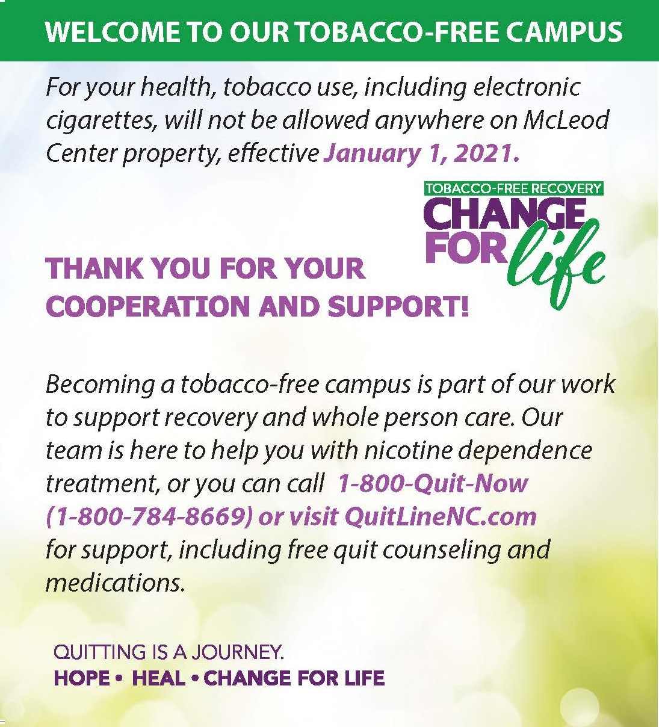
Change for Life: Tobacco-Free Recovery
Empowers behavioral health organizations to:
  Adopt and implement tobacco-free campus policies
  Integrate best practice tobacco treatment into services
  Employ motivational messaging using a whole person care approach that supports a tobacco-free culture
NC Medicaid tobacco-free policy requirement -
  April 1, 2024
Expanded to a regional coalition – 50+ participants
Communication collateral / Monthly Top 5 Email Blast
NRT Distribution
Series of Trainings – general / clinical staff

Slide 11

From January 2020 – May 2023
40 Behavioral Health and Ally Agencies Engaged
60 + Coalition Participants – table always open to all, with average of 30 at monthly meetings
2,000 + Behavioral Health Professionals Trained in the state
15 - Agency-wide Tobacco-Free Policies adopted by community-based BH agencies
Over 97,000 - Clients/Staff Impacted by Policy
Collective Impact – Change for Life: Tobacco-Free Recovery Coalition
Implement T-F Campus Policies, Integrate Tobacco Treatment and Promote T-F Living Messaging to Support Recovery
Notes:
From January 2020- December 2022:
Agency #Clients # Staff
McLeod 6,599 250
Charlotte Rescue 463 95
Anuvia 23,863 150
Harmony Health 225 15
Daymark 48,000 1000 (875 FT + contractors)
SFM 600 12
ARMS 700 58
Genesis 1,800 (20)
Hope Haven (Aug 22) 147 57
ICGH (July 22 230 30
Cognitive Connection 1,800 45
Catawba Valley HC 6,000 155
GHCCM 2946 15
Crossroads (2 NC sites) ______ _____
Hope Community Clinic 1350 35
Total : 96,660
Later:
Monarch – 4/1/24 – 30,000

Slide 12
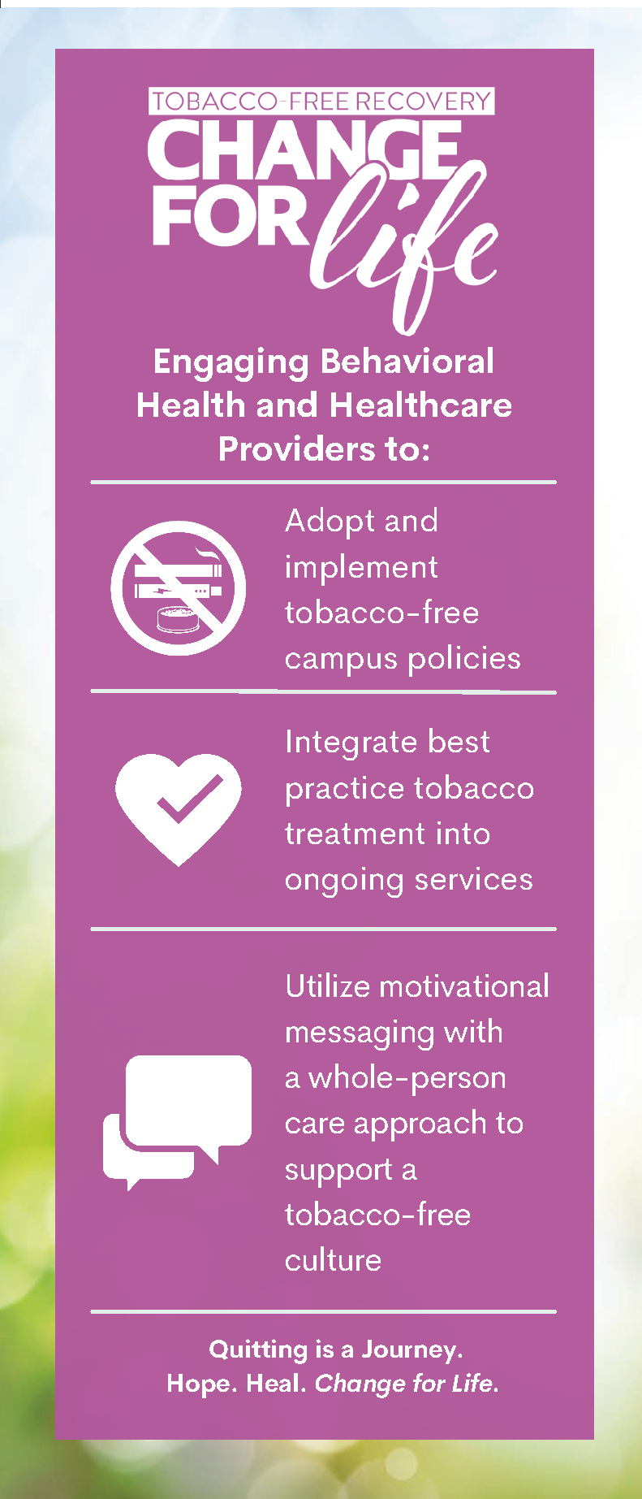
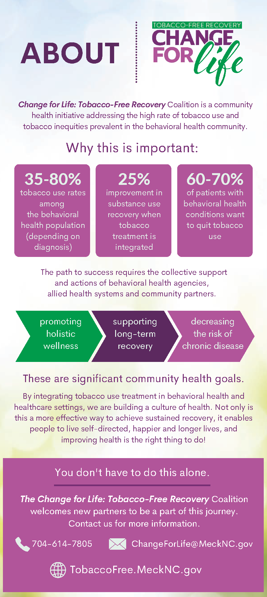
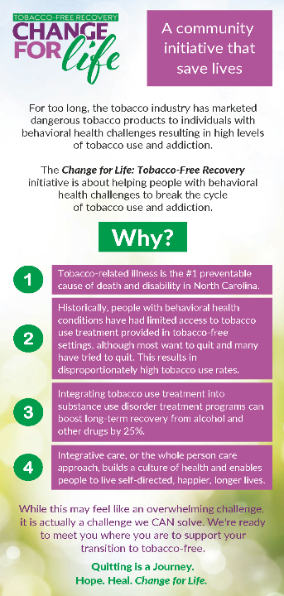
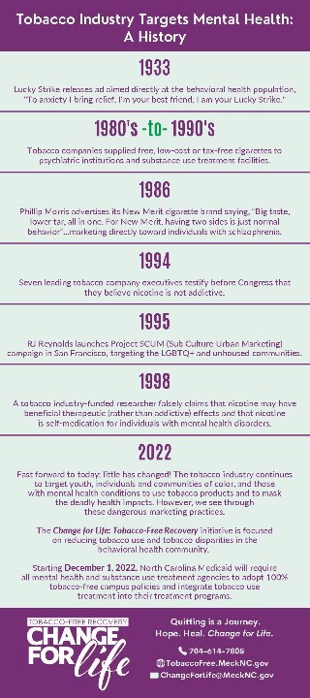
Rack Cards – Professional and Client/Residence Audience
Rack Card #1
Rack Card #2

Slide 13
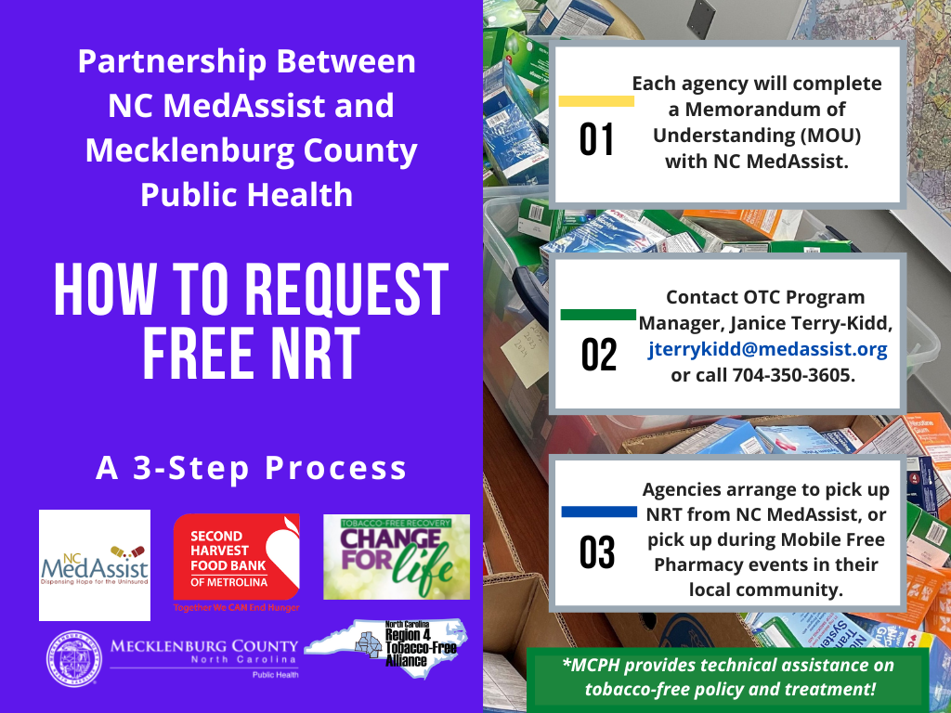
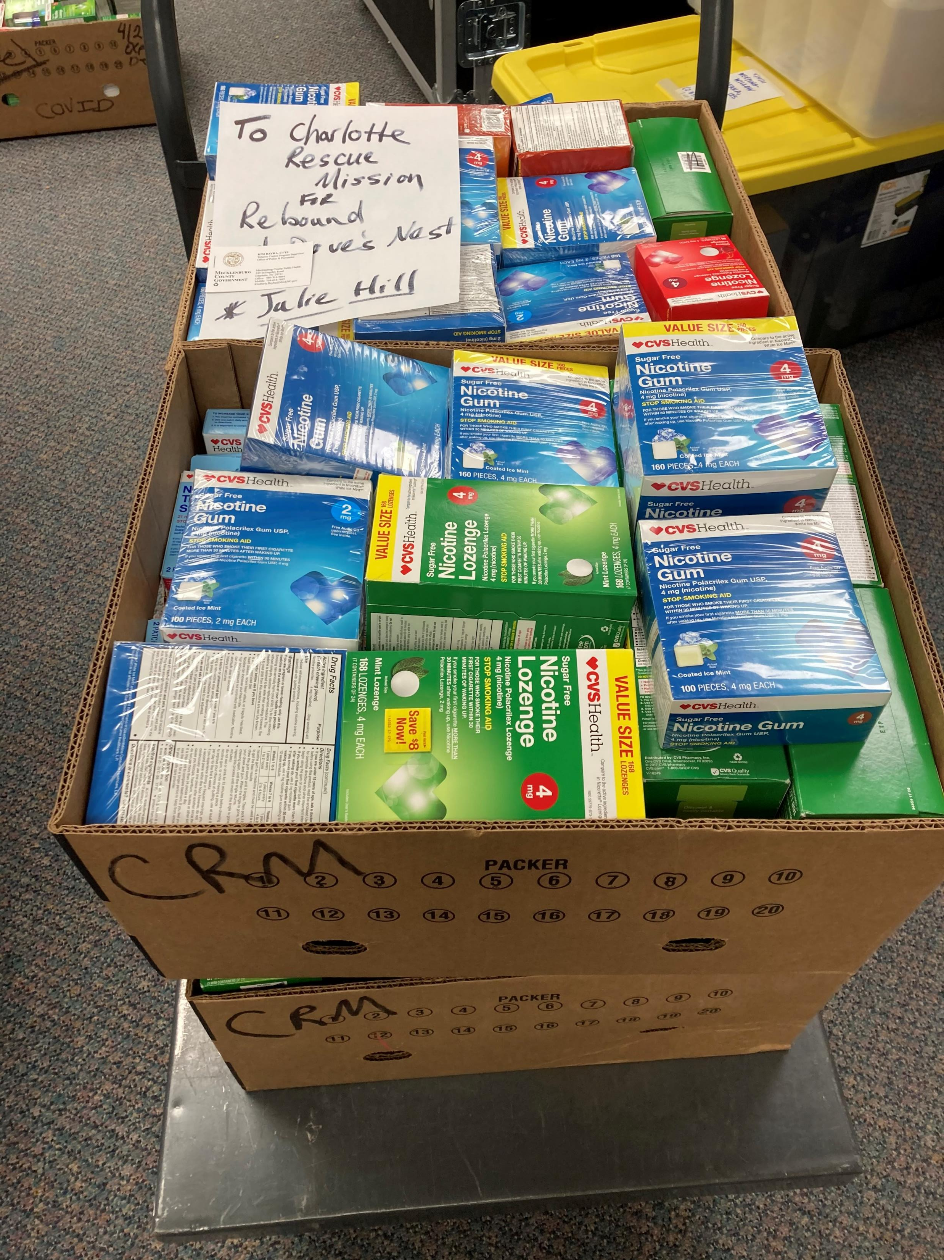

Slide 14
Quit Menthol Your Way

Slide 15
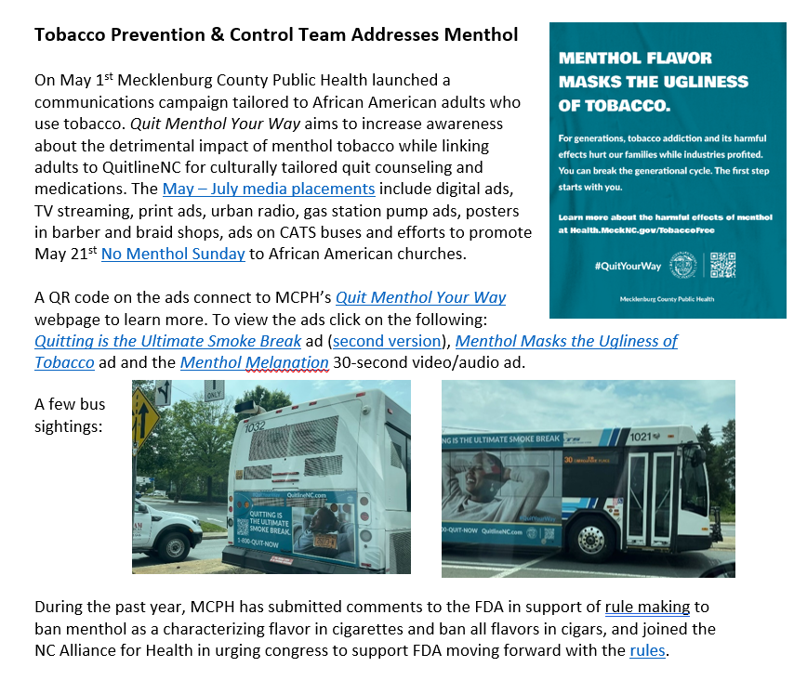

Slide 16

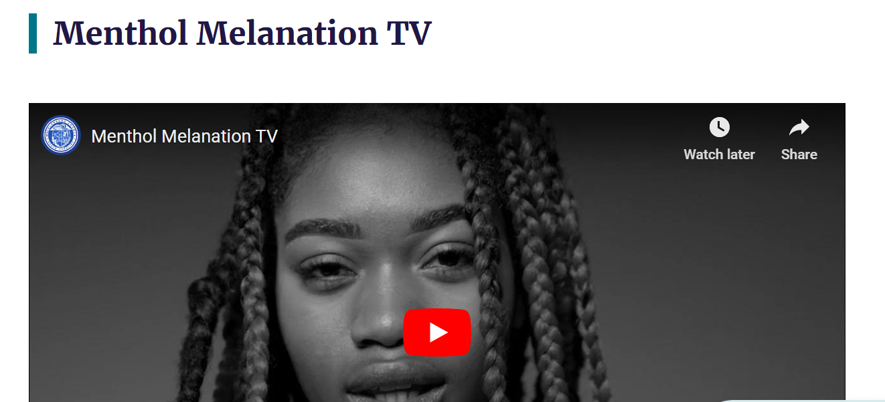
No Menthol Sunday Initiative
Church Fans, Flyers, Handouts
Goal of developing a Charlotte-Mecklenburg based multicultural tobacco control coalition

Slide 17
Quitting Tobacco Use

Slide 18

We Work With Various Populations
Village Heartbeat
  TF Church policies
  Freedom from Smoking series
LGBTQ+
  Sponsor for Charlotte Pride
  Digital / Ad in Pride Magazine
CDC Health Disparities Grant- launching 2-year communications campaign targeting –
  Tobacco cessation messaging for Black/African American adults
  youth vaping
  development phase
Notes:
We focus on promoting quit resources and building capacity for partners to integrate tobacco treatment services (we do not do direct service cessation) – technical assistacne and scholarships as budgets allow

Slide 19
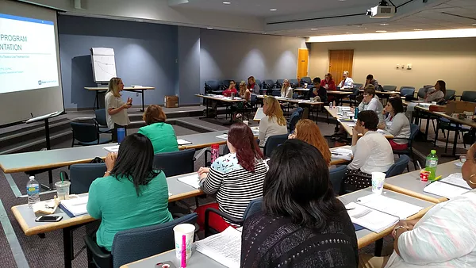


Duke – UNC Tobacco Treatment Specialist Course
July 17-25, 2023 (Mon-Tues)
For more information, visit:
www.dukeunctts.com
(919)668-3842
cttsprogram@duke.edu
Notes:
The primary aim of this program is to train and certify Tobacco Treatment Specialists to provide individuals in North Carolina and across the nation with the highest caliber treatment available for tobacco use and dependence.
This is a 4-day training that is offered three times a year and held in either Chapel Hill or Durham. To receive certification, the attendee must obtain at least 80% on the exam at the end of the training, acquire contact hours (240 for clinical and 480 for non-clinical professionals) within two years, and submit a basic case study of one client.
See Council for Tobacco Treatment Programs for more detail on standards at www.ctttp.org .

Slide 20
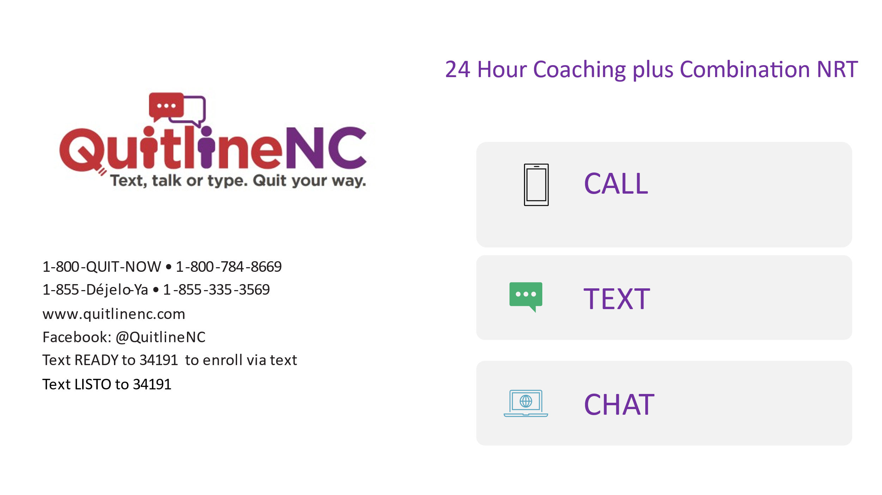
Notes:
An evidence-based telephone and digital tobacco treatment service with 24 hour coaching services and direct contact through call, texting or chat or combination of the three with a
Highly trained, professional Quit Coach
Combination Nicotine patches plus gum or lozenge mailed directly to eligible participants home.
Available free to all North Carolina residents
Accessible 24 hours a day, 7 days a week
English, Spanish and translation

Slide 21

Coaching and Meds QuitlineNC Services by Insurance
Insurance Type | Scheduled Sessions | Medication
Uninsured | 5 Sessions | 8 weeks nicotine patches + gum/lozenges
Medicare | 5 Sessions | 8 weeks nicotine patches + gum/lozenges
Medicaid | 5 Sessions | 2 weeks nicotine patches + gum/lozenges and standing order for 12 more weeks
Commercially Insured | 5 Sessions (no outbound) | 2 weeks nicotine patches + gum/lozenges
Notes:
u Because we get a limited amount of funding from the State, we try to use the money the best way we can and buy more services to those in greatest need such as those who do not have insurance or resources, those on public insurance like Medicare and Medicaid

Slide 22

QuitlineNC Special Services Regardless of Insurance
Program | Scheduled Sessions | Medication
Pregnancy Planning pregnancy in 3mo., pregnant or 12 mo. after birth | 7 sessions | 8 weeks nicotine gum or lozenge with a medical override
Youth | 5 sessions | None
Behavioral Health One or more behavioral health condition | 7 sessions | 12 weeks of nicotine patches AND nicotine gum OR lozenges
American Indian 1-888-7AI-QUIT 1-888-724-7848 | 7 sessions | 12 weeks of nicotine patches AND nicotine gum OR lozenges (Most coaches are American Indian)
Active Duty Military | 5 sessions | 8 weeks nicotine patches + gum/lozenges
Notes:
pregnant women, people who live with one or more mental health condition, young people under the age of 18, American Indians and active duty military

Slide 23
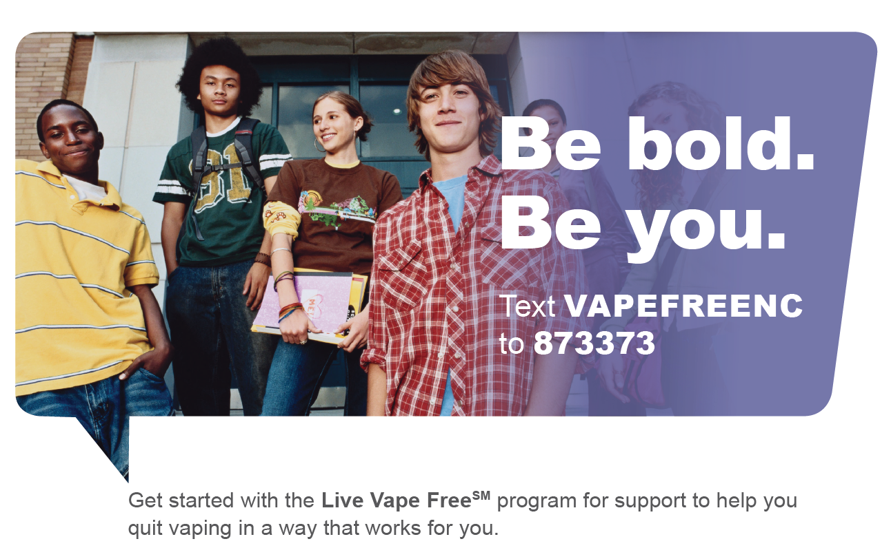
Be bold. Be you.
Text VAPEFREENC
to 873373
Get started with the Live Vape FreeSM program for support to help you quit vaping in a way that works for you.
Notes:
We now have a new program called LIVE Vape Free - tobacco e-cig or dual use cessation program for teens where teens will
Enroll in a multimedia experience that includes videos, quizzes, self-assessments, flip cards, audio and podcasts
Have access to a Quit Coach at anytime by texting the word “Coach”

Slide 24
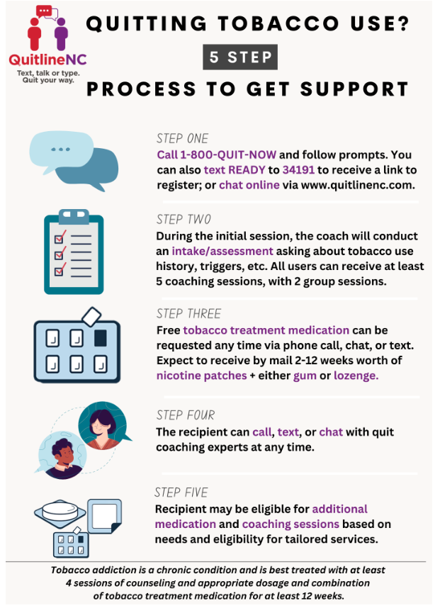

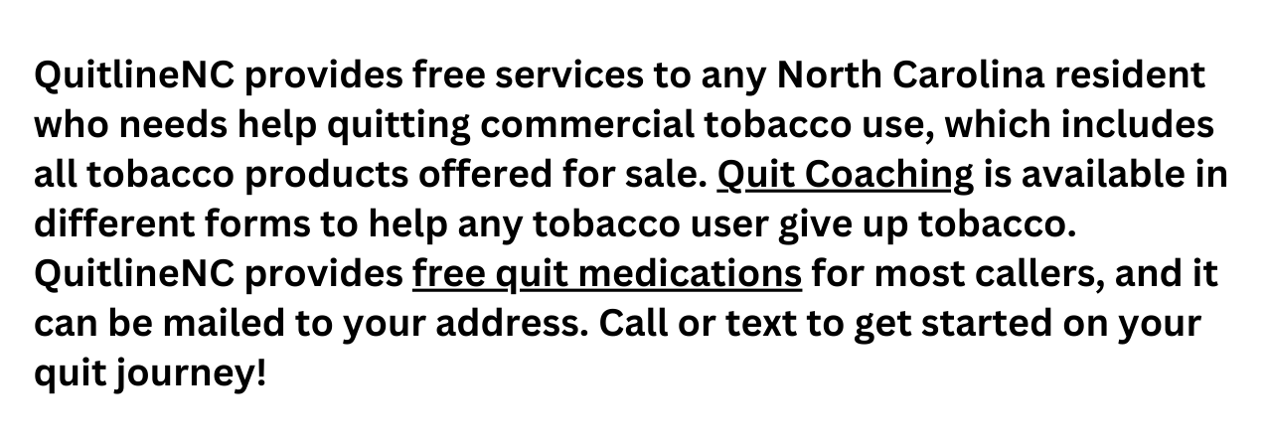

Slide 25
Tobacco-Free Policies

Slide 26

We’ve Made a Lot of Progress in Tobacco-free Environments in North Carolina
Hospitals
All 127 acute care hospitals in North Carolina have 100% tobacco-free campus wide policies.
State Operated Healthcare Facilities
All 14 State Operated Mental Health, Developmental , Alcohol and Drug Abuse Treatment Centers are 100% tobacco-free campus-wide
Prisons
State law prohibits any person from using tobacco products inside or on the grounds of a state correctional facility. There may be an exception for authorized religious purposes.
Public Housing
All public housing in North Carolina are now smoke-free indoors under HUD rule
UNC University System
State law authorizes the 16 campuses of the UNC system to prohibit smoking on their grounds--within 100 linear feet of a building:
UNC and ECU Medical Care Facilities authorized to prohibit smoking on all grounds.
Community Colleges and Private/Independent Colleges
Community colleges and private/independent colleges and universities may prohibit smoking and all tobacco product use in their buildings and on their grounds.
Public Schools K-12
State law requires local boards of education to adopt policies prohibiting the use of tobacco at all times
Child Care Centers
All childcare centers prohibit smoking and all tobacco product use on their campuses
Notes:
The culture has changed over the past 15 years in NC. We are seeing the power of Tobacco-Free environments.

Slide 27

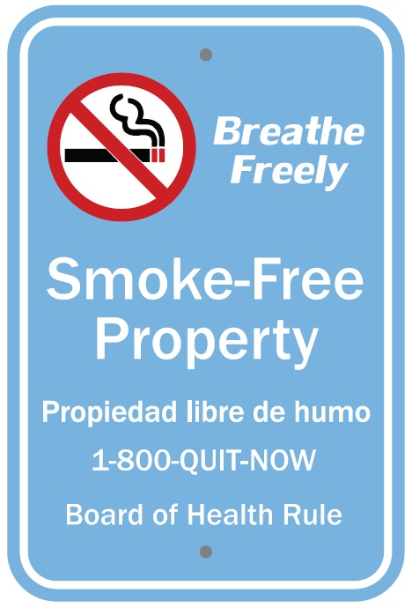
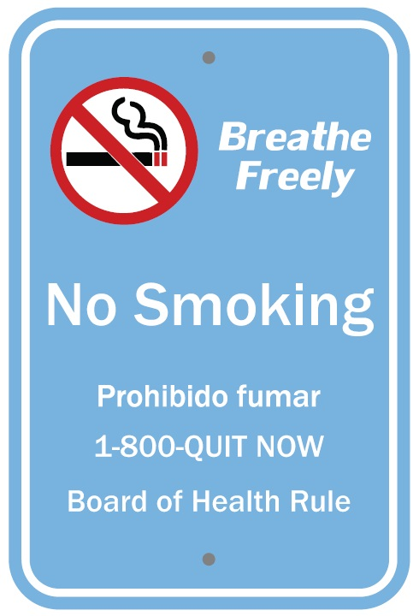
Mecklenburg County Tobacco Regulations (2015)
Improve to Gold Standard - Delayed
Tobacco-Free Parks Ordinance
Smoke-Free Government Grounds Board of Health Rule

Slide 28

Smoke-Free Multi-Unit Housing
Public, Affordable, Market Rate
https://www.greatercaa.org/smoke-free-certification

Slide 29
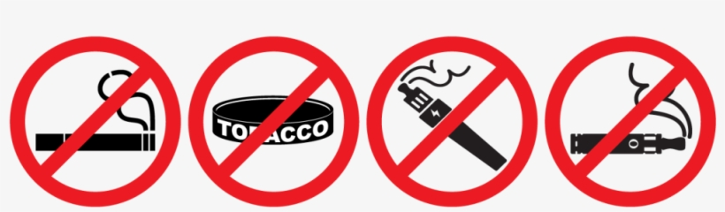
Colleges/Universities
UNC Charlotte (tobacco-free indoors plus 100 ft of doorways, as of June 1, 2017)
Queens University (100%)
Central Piedmont Community College (100%)
Johnson and Wales University (100%)
Johnson C. Smith University (100%)
Pfeiffer University at Charlotte (100%)
Northeastern University - Charlotte and other campuses (100%)
Davidson College (smoke-free, including e-cigarettes, within 20 ft of any building, as of August 10, 2021)

Slide 30
Youth Tobacco Prevention

Slide 31


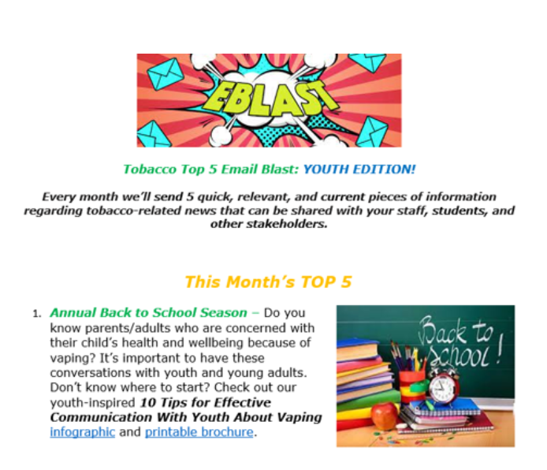
Youth Tobacco Prevention
Vaping and emerging tobacco product awareness-trainings, events, social media, etc.
  Livable Meck – October 26, 2021
  Re-engage schools and influence tobacco prevention + alt. to suspension curriculum
  Collaborate with youth partner organizations/adult influencer outreach
  Work with Mecklenburg Public Information team to provide comprehensive, data-driven social media content regarding tobacco/youth vaping information.
  Communication tools and messages

Slide 32


Youth Voices
Tobacco-Free Video Contest
Film Fest Slide Deck
February 1, 2023
One idea. One minute. One video or photovoice submission.
And the chance to amplify your voice worldwide.

Slide 33
OUR GOAL
It is important that we amplify youth voices by involving them in education, awareness, and advocacy opportunities. This contest will allow Health Region 4, NC middle and high school aged youth to participate in creatively educating and advocating for change through video media and/or photovoice to further promote tobacco-free environments.
Tobacco Issue IDEAS Include…
E-Cigarette/Vapes
Quitting Tobacco Use
Point of Sale
Tobacco Products
LGBTQ+ Tobacco Use
Hispanic/Latino Tobacco Use
Tobacco Impacts the Environment
Nicotine Addiction + Mental Health
African American/Black Tobacco Use
Notes:
Our team designed tobacco impact fact sheets that provide short snippets of information regarding each tobacco issue. These fact sheets are meant to be used as supplemental education material and to inspire the youth on their video ideas. Click on each one to see the fact sheet.

Slide 34










THANK YOU, PARTNERS!
Notes:
BIG THANK YOU to our Steering Committee that consisted of MCPH partners, High Resolves/Videos for Change, Alianza Coalition under the Center for Prevention Services, and Healthy Blue of North Carolina. In addition, our judges consisted of partners from CMS, Teen Health Connection, and Anuvia Prevention and Recovery Center. Thank you to Charlotte Football Club for our Honorable Mention Winner donated swag box prize. Thank you to all our community partners that helped share this contest information and promoted it far and wide!

Slide 35
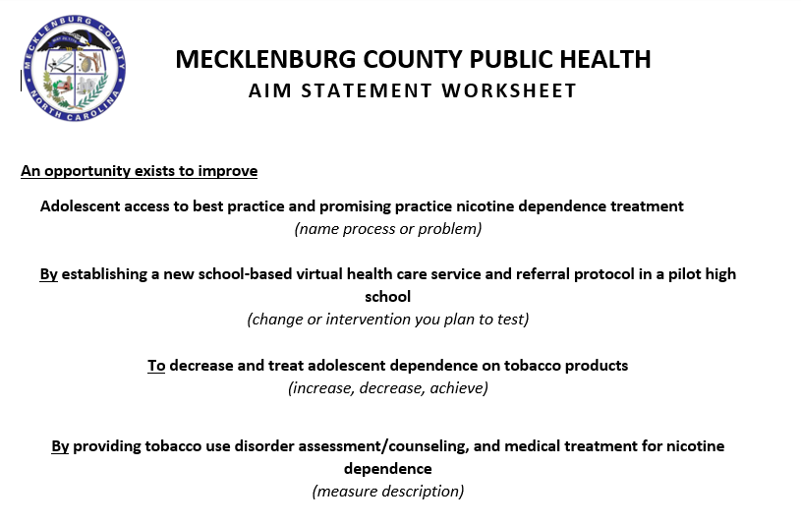
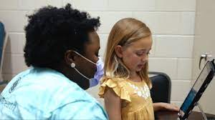
School Based Virtual Care (SBVC) Initiative
SBVC Partners:
MCPH
Atrium Health
Charlotte Mecklenburg Schools
Notes:
This effort should
reduce youth tobacco use rates, increase access to youth tobacco use treatment, and address stigma around treatment
(key characteristics of area the team is working on)
for high school youth using tobacco in the pilot high school, their families, and the staff at the school.
(customers, staff, or those affected by the process under improvement)
This process is important to work on now because
adolescent tobacco use and nicotine dependence are significant health concerns. Despite declines in cigarette use, youth still use tobacco products, including e-cigarettes, at high rates, negatively impacting physical and mental health, as well as social emotional learning and school absenteeism.

Slide 36
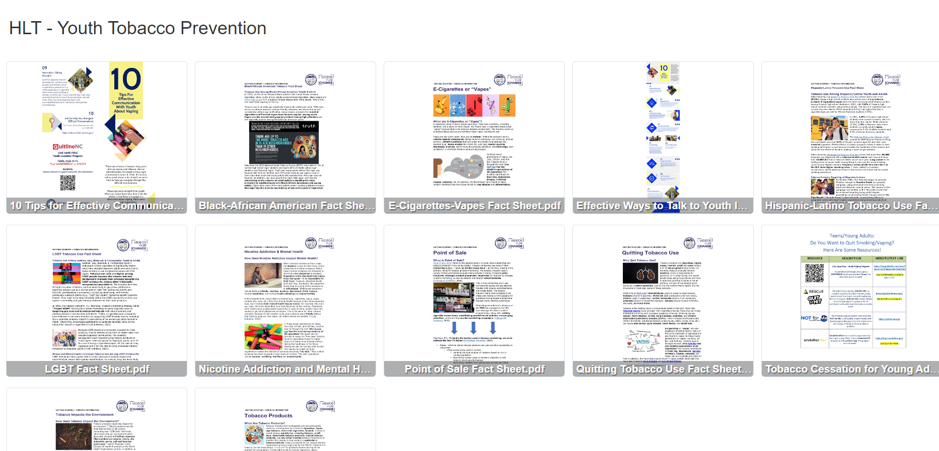
Visit
TobaccoFree.MeckNC.gov

Slide 37
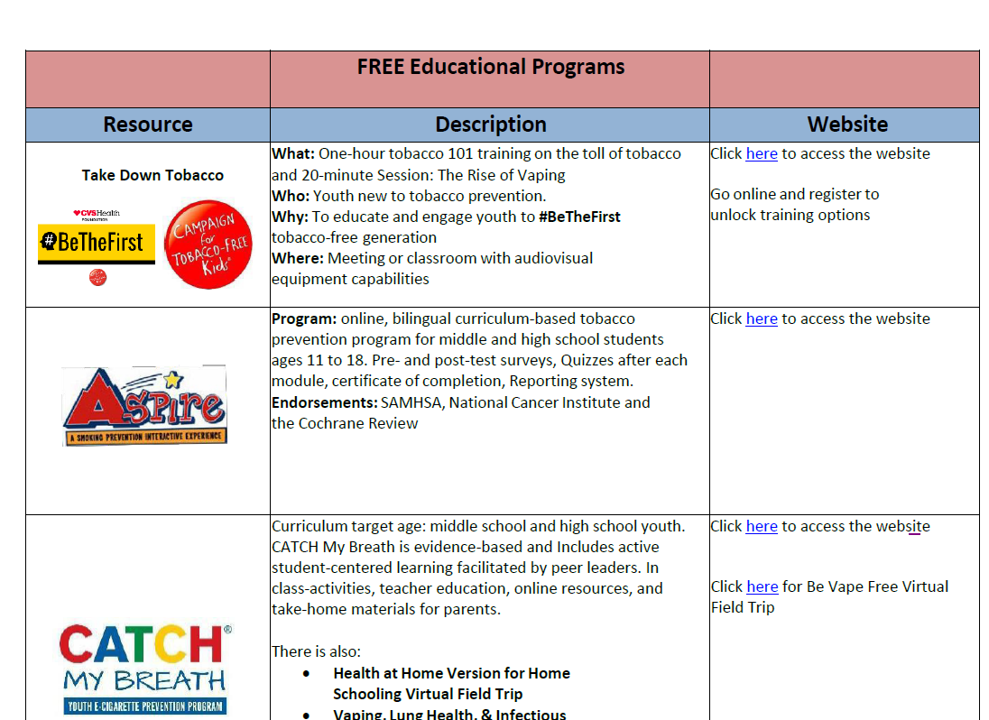

Slide 38
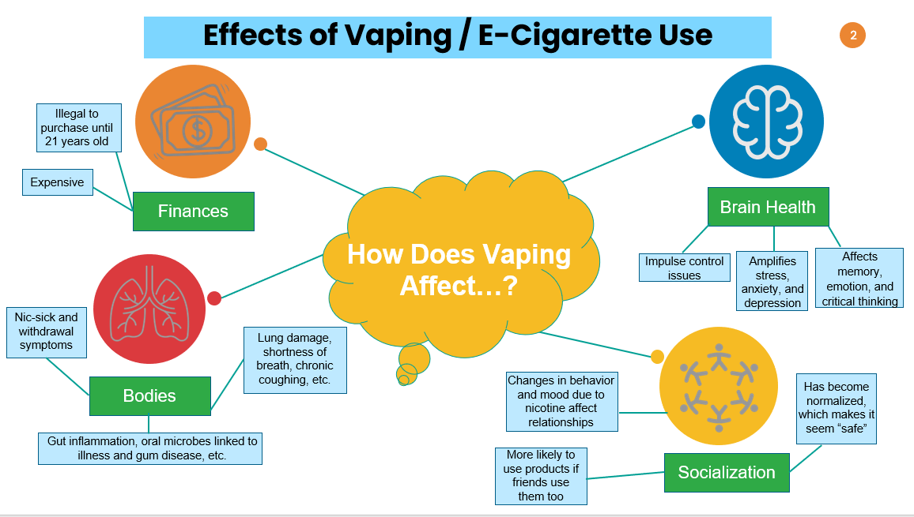

Slide 39
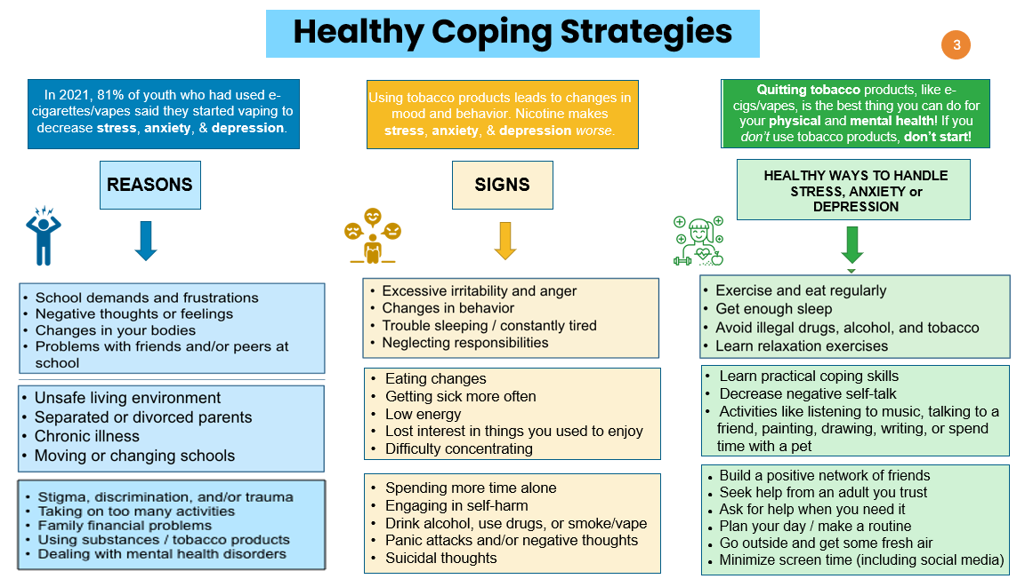

Slide 40



SUPPLEMENTAL TOOLS FOR TEACHERS TOOLKIT
VIDEOS
ACTIVITIES
RESOURCES

Slide 41
Advocacy

Slide 42

PROTECT OUR KIDS FROM VAPING AND NICOTINE ADDICTION
BY ESTABLISHING A RETAILER PERMITTING SYSTEM AND RAISING THE MINIMUM AGE TO PURCHASE TOBACCO FROM 18 TO 21
01

Slide 43



95% of all tobacco users start before the age of 21

Slide 44
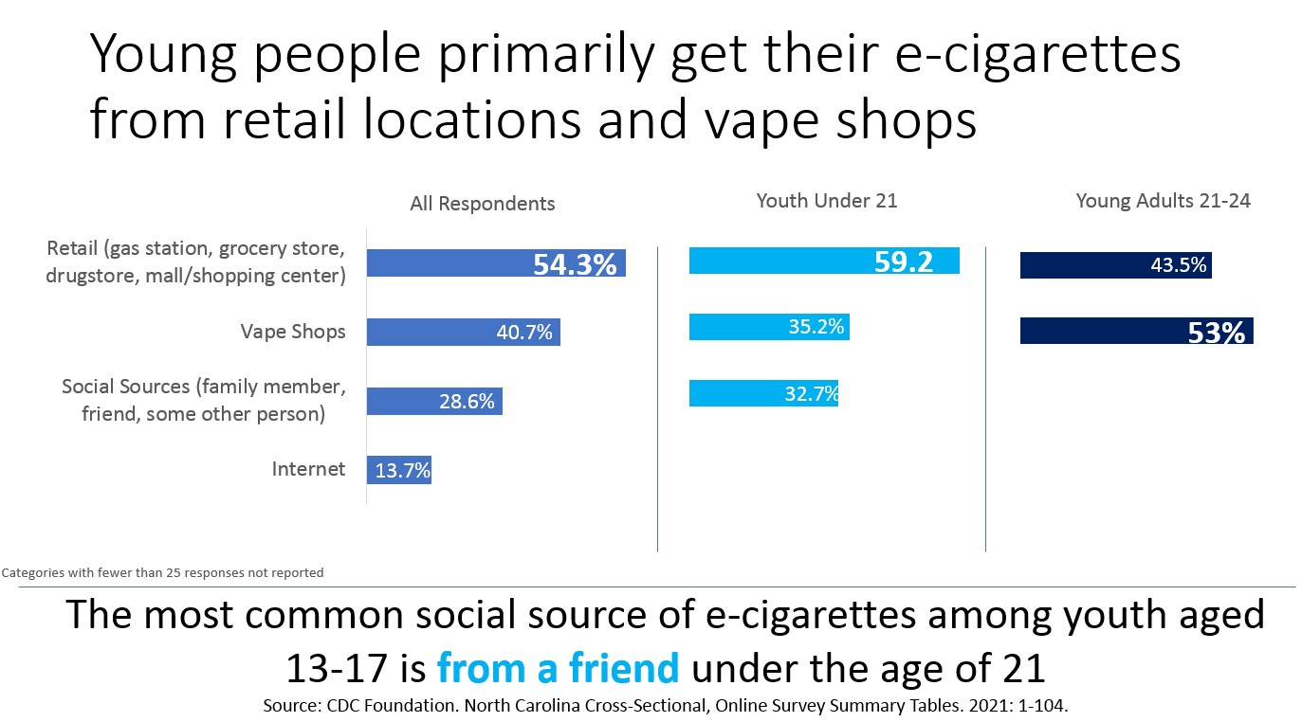

Slide 45
RAISE THE AGE TO 21 AND ESTABLISH TOBACCO RETAILER PERMITTING SYSTEM TO PROTECT NC YOUTH
NC needs to raise its minimum age to purchase tobacco products to 21 to match the new federal age requirement passed in 2019.
Many young people transition from experimental use to regular, daily use between the ages of 18 to 21.
It’s confusing to retailers and consumers to have separate ages for state and federal law.

Slide 46
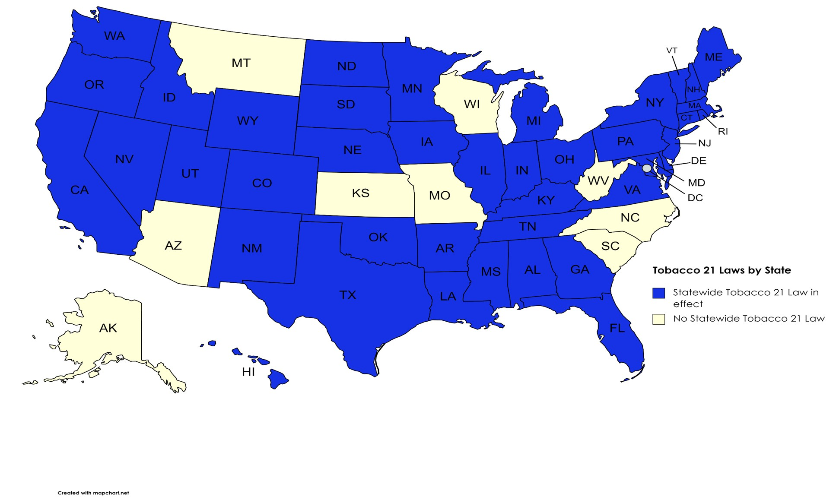


Slide 47
Current Law: NC General Statute 14-313
This is the criminal statute where all of North Carolina’s tobacco sales laws exist.
Maintains 18 as the minimum age for tobacco sales.
Tobacco products are defined as including vapor products and all products containing tobacco.
Criminally penalizes clerks for selling to underage persons and youth for buying tobacco products.
Preempts local governments from regulating the “sale, distribution, display, or promotion” of tobacco products.
Notes:
Currently our law is in the criminal code, but it really needs to be in the civil code. It’s penalizing the wrong people.

Slide 48
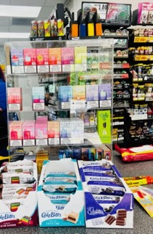
An Effective Law to
Raise Tobacco Sales Age to 21
Applies to all tobacco products
Requires retailer permit
Requires ID checks
Imposes minimal penalties for purchasers under 21
Holds retailers responsible for violations
Requires signage
Requires employee training
Prohibits internet sales to people under 21
Allows local government authority
Provides enough time for the state to implement and to educate retailers about the new law
Source:
https://www.cdc.gov/tobacco/stateandcommunity/tobacco_control_programs/surveillance_evaluation/tobacco-21-policy-evaluation/index.html
Notes:
Source: https://www.cdc.gov/tobacco/stateandcommunity/tobacco_control_programs/surveillance_evaluation/tobacco-21-policy-evaluation/index.html
Evidence shows this is

Slide 49
Federal Synar Amendment
Federal law, known as the Synar Amendment, now requires states to annually inspect a random sample of tobacco retailers to determine what percentage are selling to youth under age 21.
If the percentage of underage sales goes above 20%, the state may be forced to forfeit millions of federal Substance Abuse Prevention and Treatment block grant monies that fund prevention, treatment, and recovery initiatives
Recent high violation rates in North Carolina have sounded the alarm to focus on reducing sales to youth.

Slide 50
LICENSING OR PERMITTING OF TOBACCO PRODUCT RETAILERS IS AN EFFECTIVE MEANS TO REDUCE SALES TO YOUTH
Tobacco retailer permitting is beneficial because it:
Allows the state to know where tobacco products are being sold;
Allows the state to inspect for responsible retail practices;
Provides a more effective mechanism for enforcing the law when violations are detected; and
Provides a funding mechanism for inspections, retailer education and enforcement.

Slide 51
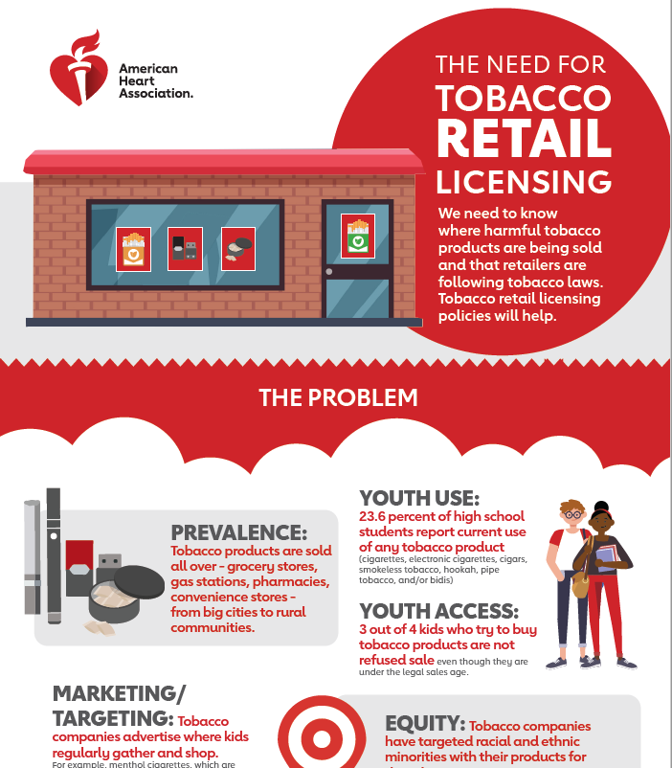
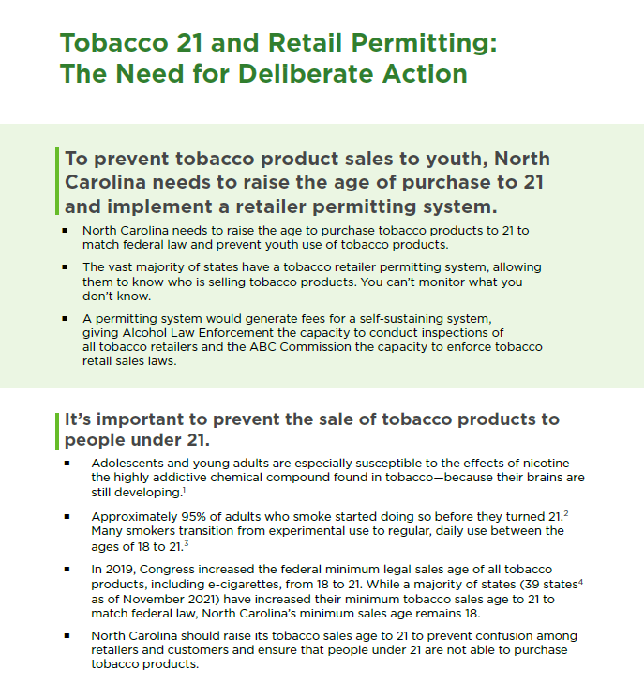
American Heart Association TRL Infographic
CINC T21 Fact Sheet

Slide 52
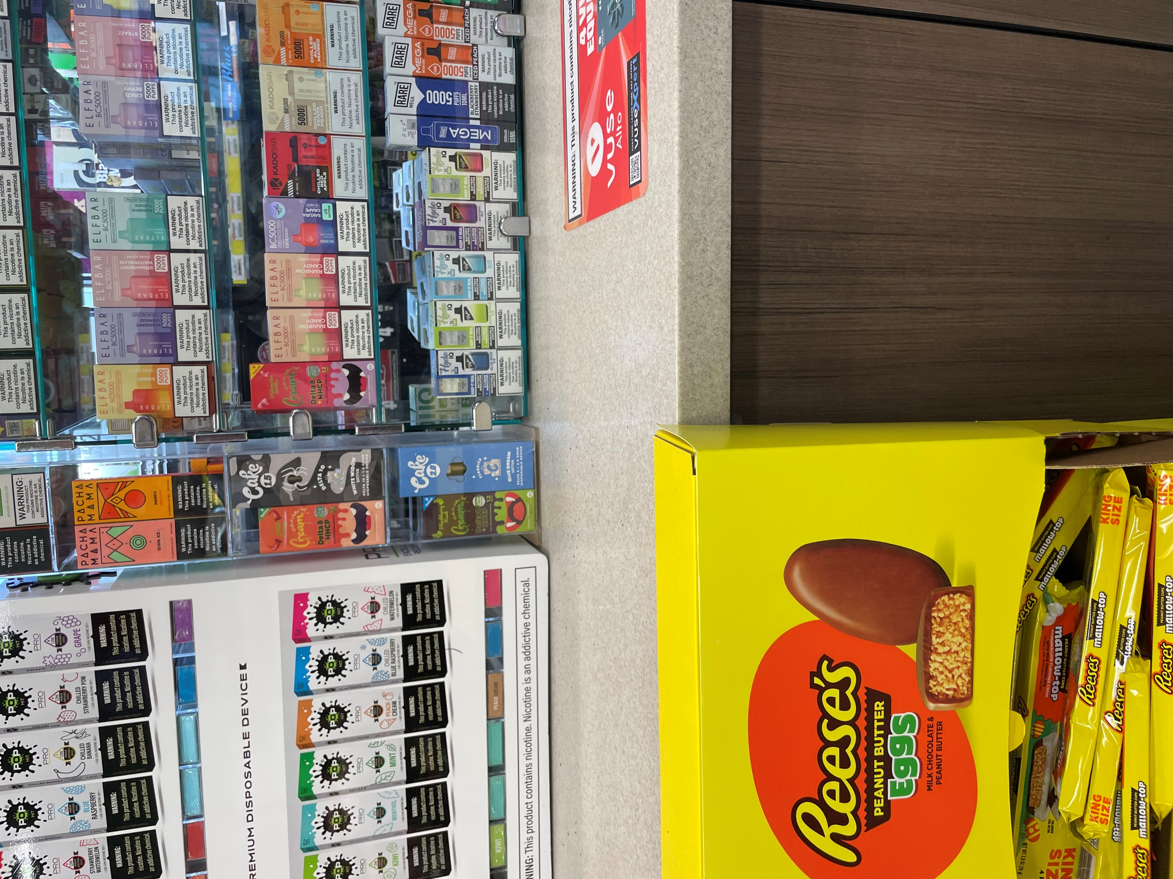
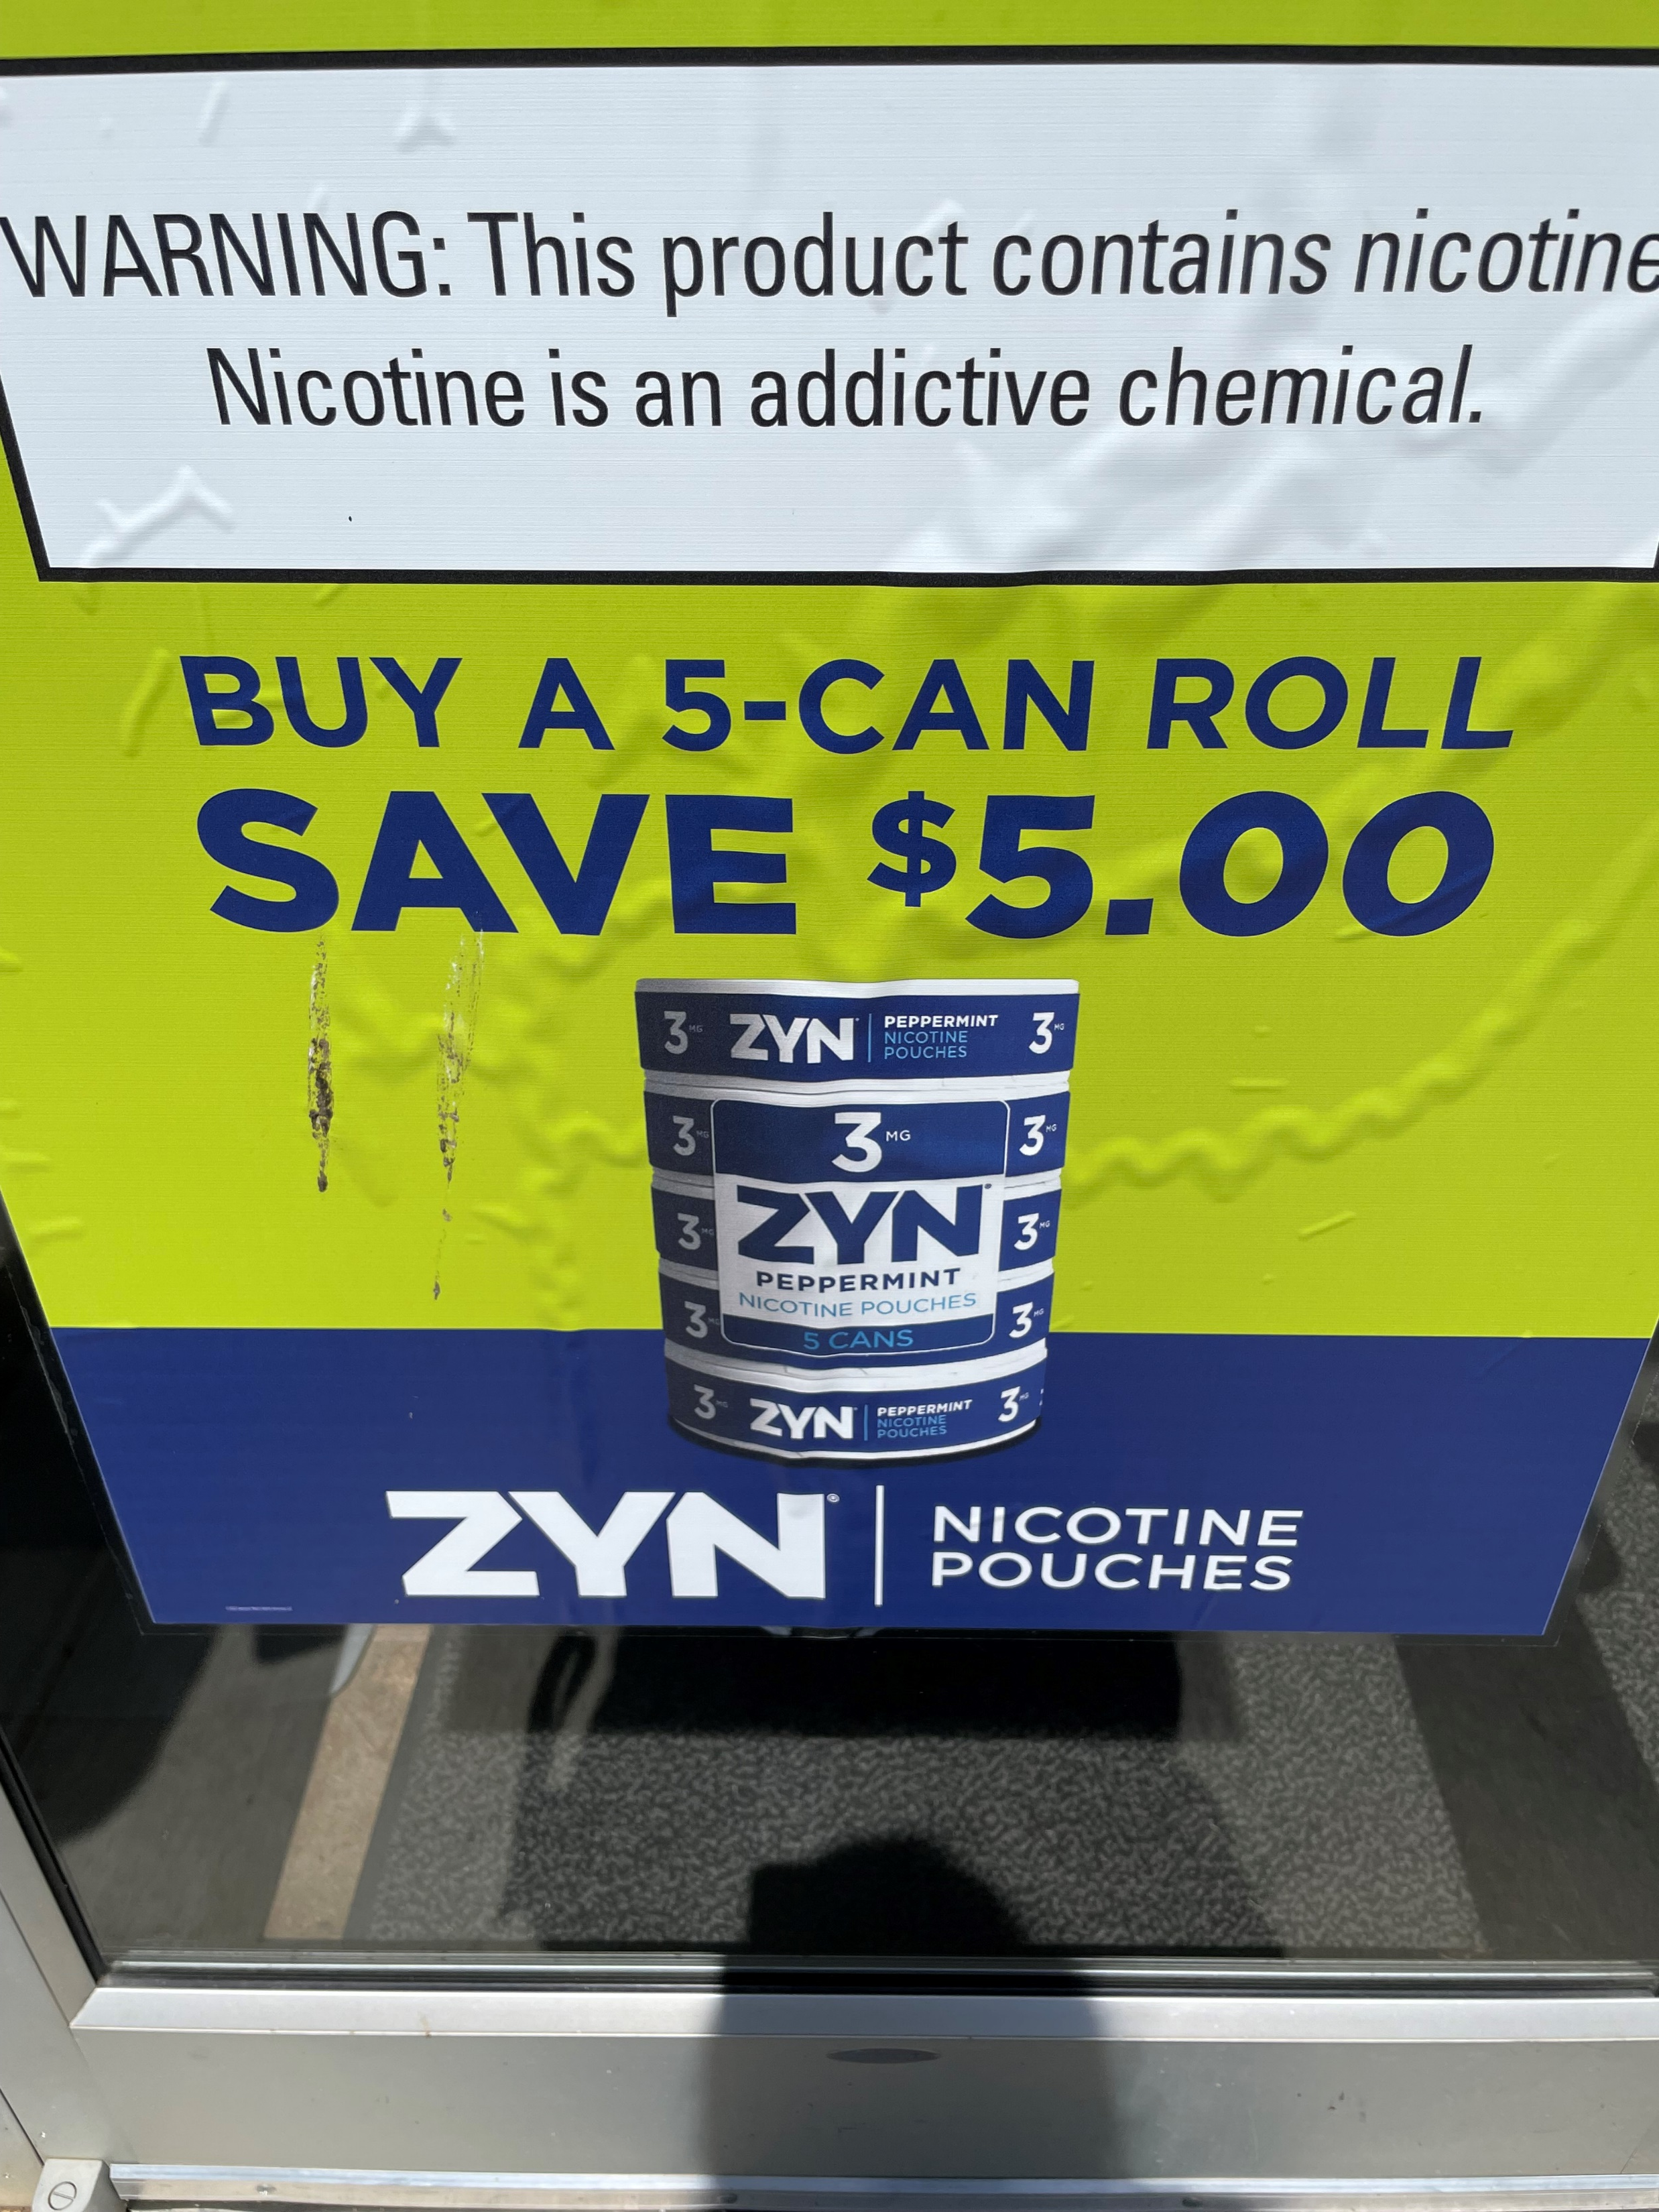
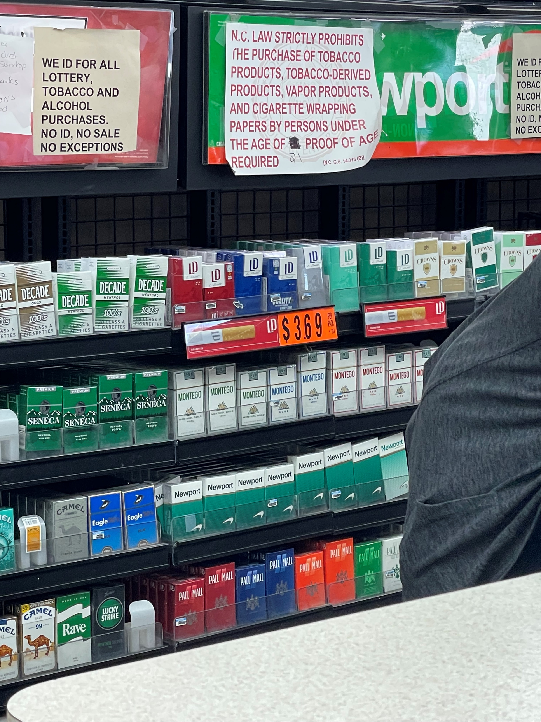
Partnering With Counter Tools
Storytelling
Communication Tools
Data Dashboard
Advocacy for T21 and TRL
Applied Practice Experience Internship (Wingate Student)

Slide 53
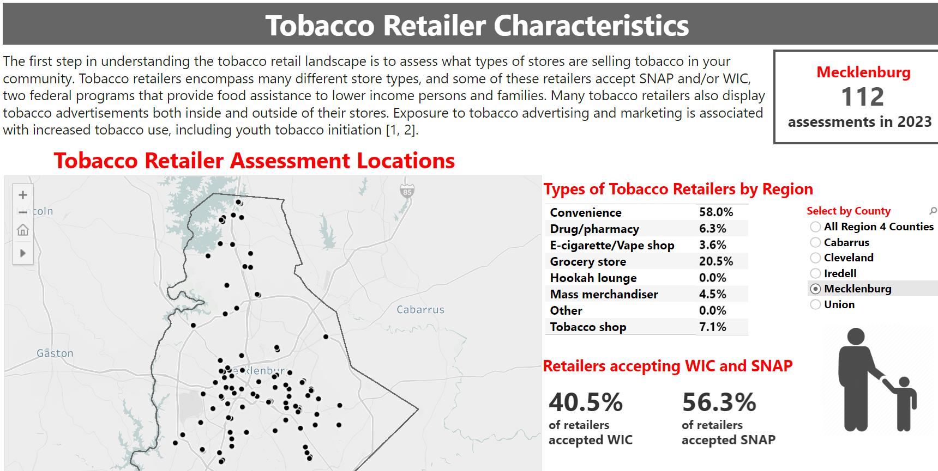
Counter Tools Data Dashboard

Slide 54

questions

Slide 55
Thank You!
Contact Information
Kim Bayha, CTTS
Tobacco Prevention & Control Supervisor
Office of Policy & Prevention | Mecklenburg County Public Health
(C) 704.614.7805
Kimberly.Bayha@MeckNC.gov
Irini McCarthy
Tobacco Prevention Coordinator
Office of Policy & Prevention | Mecklenburg County Public Health
(C) 980-406-0629
Irini.McCarthy@MeckNC.gov

