Slide 1

Tobacco Prevention Resources
Hellen Dekle, Med
Secondhand Smoke and Vaping Aerosol Protection Manager
Injury, Tobacco, & Substance Use Prevention Section
Tobacco Prevention & Control Unit
S.C. Department of Public Health

Slide 2
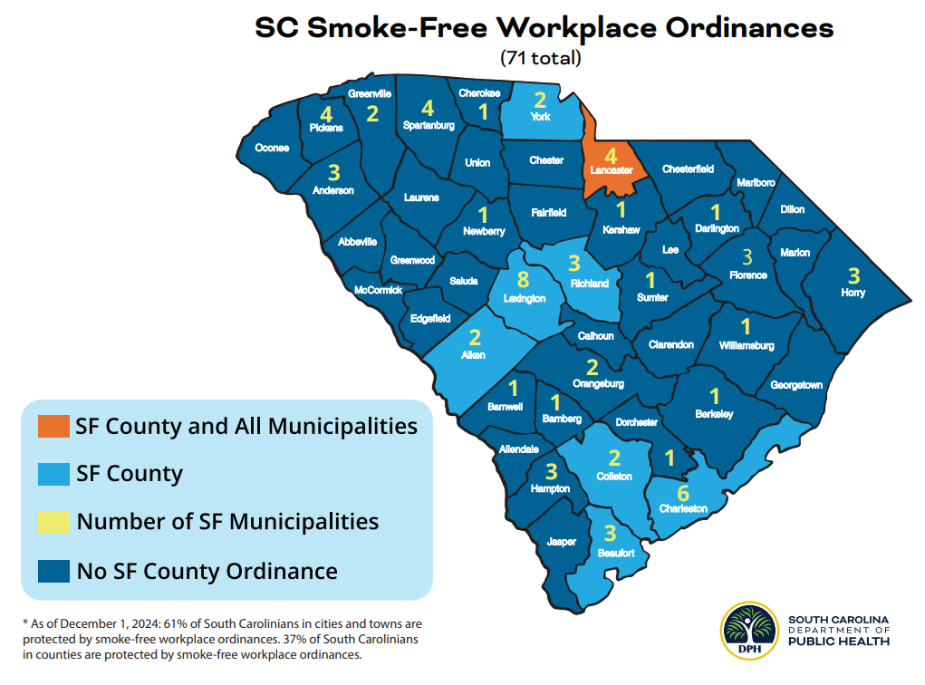
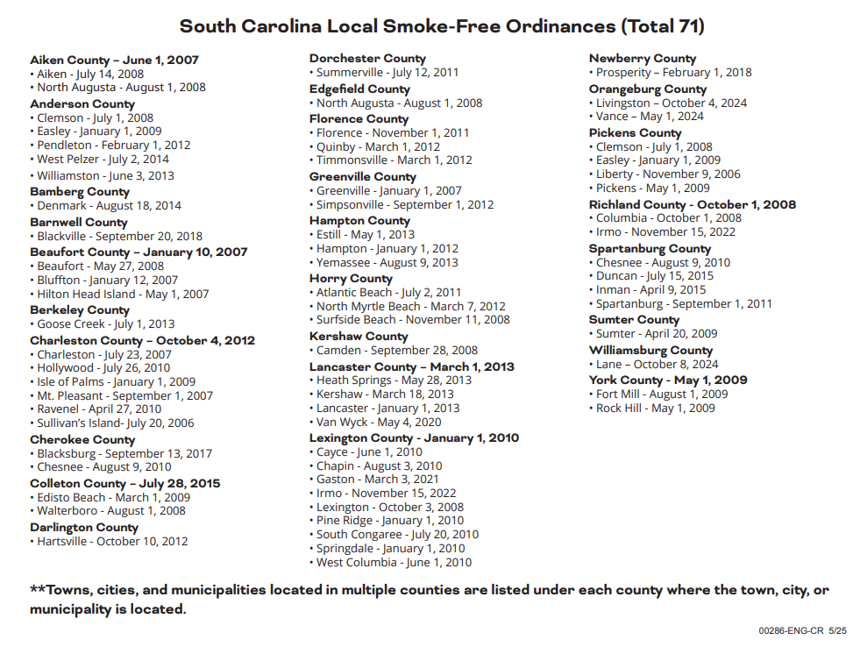

Slide 3
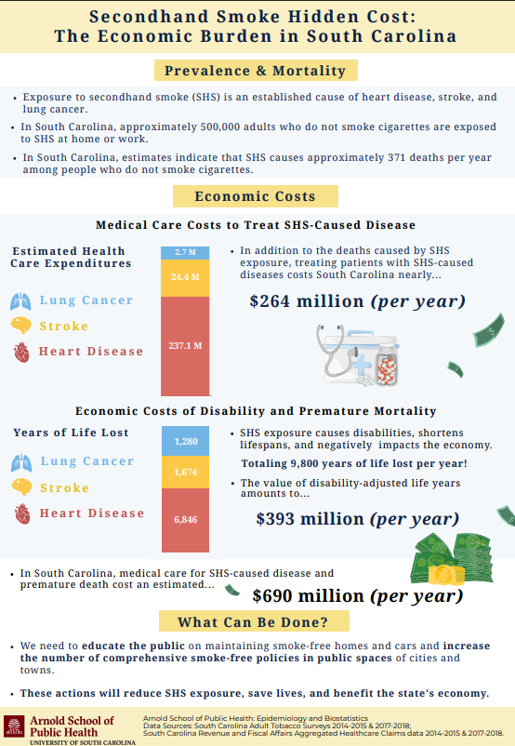

Slide 4
