Slide 1
Community-Based Tobacco Disparities (CBTD) Program
Presented by: ReAuta Scott, CBTD Coordinator
Division of Tobacco Prevention and Control
February 24, 2023

Slide 2
Presentation Overview
Program Requirements
Activities Year 1 and 2

Slide 3
Program Requirements
CDC Requirement
Local efforts to address tobacco-related disparities
Selection of the community

Slide 4
Program Requirements
Fund a Local Lead Agency (LLA)
Develop or recruit a local coalition
Develop a local workplan
Support from Tobacco Division

Slide 5
Program Requirements: Community is Key

Slide 6
Activities —Year 1 (May 12, 2021 – May 11, 2022)
Selection of Community

Slide 7
Selection of Community: Dillon County
Dillon County -- Pee Dee Region
Population – 28,087¹
Adult smoking rate 26.2%; SC adult rate 18%²
No local county ordinance

Slide 8
Selection of Community : Allendale County
Allendale County -- Low Country Region
Population – 7,858¹
Adult smoking rate 27.7%; SC adult rate 18%²
No local county ordinance

Slide 9
Activities —Year 1 (May 12, 2021 – May 11, 2022)
Selection of community
Partner with Local Lead Agency

Slide 10
Local Lead Agency
Hold Out the Lifeline: A Mission To Families (HOTL)
Statewide presence
Long history of working with communities on chronic diseases and risk factors

Slide 11
Activities —Year 1 (May 12, 2021 – May 11, 2022)
Selection of Community
Partner with Local Lead Agency
Community Engagement and Coalition Development

Slide 12
Community Engagement and Coalition Development
Community-based participatory process
Coalitions developed for Allendale and Dillon Counties
Workplan developed to address tobacco at local level
Local event participation
Tobacco prevention training
Quitline Promotion

Slide 13
Partners– Dillon Co.
Order of the Eastern Stars—SC Jurisdiction
Woman’s Baptist E&M Convention of SC
Midlands Baptist Association
Care South – Dillon
Dillon County Council
Dillon County Chamber of Commerce
Alpha Kappa Alpha Sorority INC—Dillon
SC DHEC Pee Dee Region
Boys & Girls Club—Dillon
Access to Health - McLeod Health
Dillon County Coordinating Council
Northeastern Rural Health Network
Pee Dee Healthy Start
Community Members— adult and youth

Slide 14
Partners – Allendale Co.
Woman’s Baptist Education and Missionary Convention of SC
Order of the Eastern Stars
Empowerment Center
SC DHEC Low Country Region
Allendale County Alive
Smart Box
Fairfax City Council
Allendale County Hospital
Community Members—Neighborhoods and youth
Allendale County Council
New Life Drug & Alcohol - Allendale

Slide 15
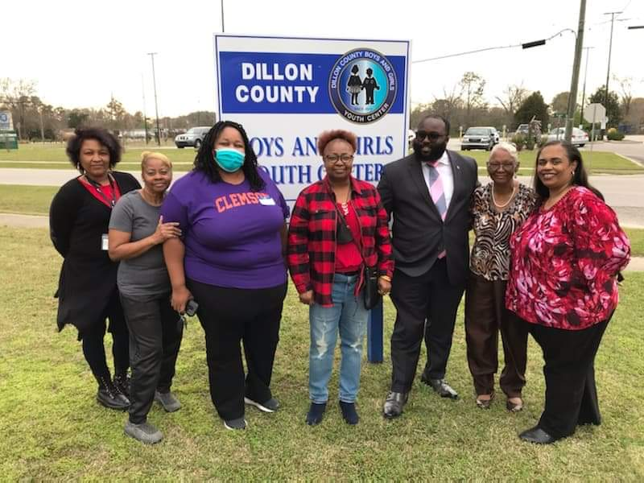
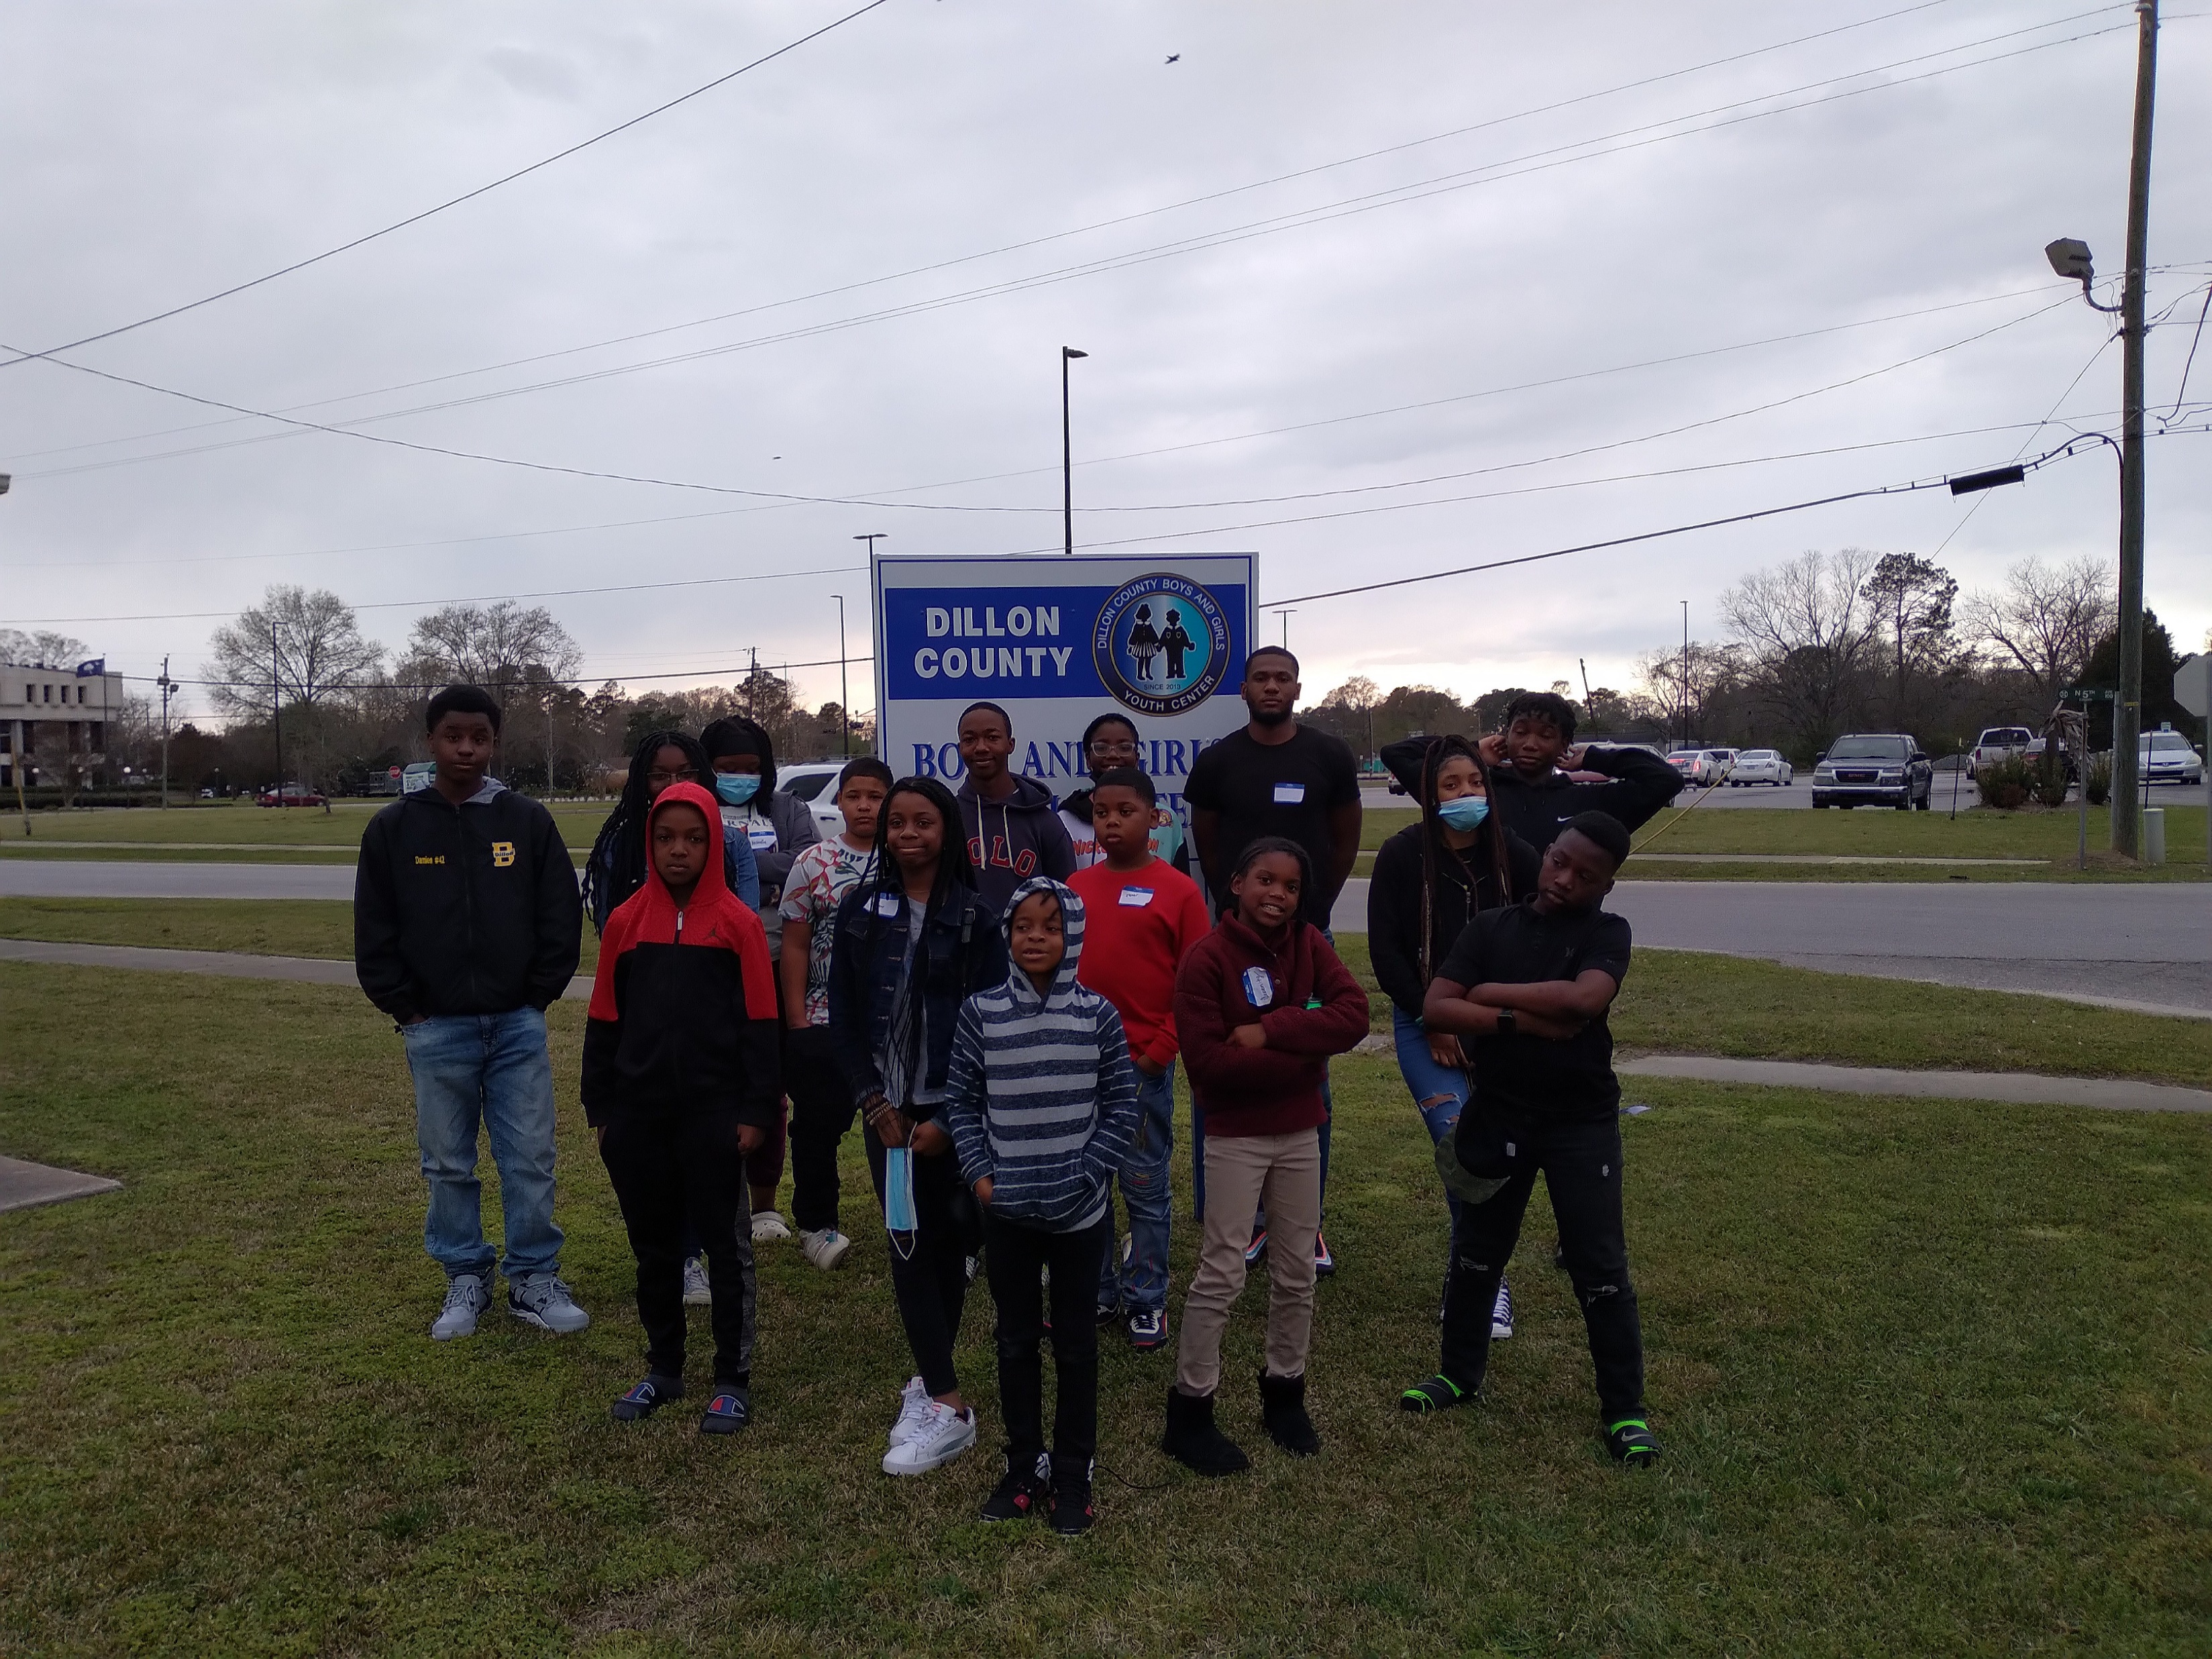
Dillon County Youth Event

Slide 17
Activities —Year 2 (May 12, 2022 – May 11, 2023)
Annual Workplan:
Coalition Maintenance
Voluntary Smoke-Free Policy Promotion
Quitline Promotion
CLEAN AIR IS FAIR Communications
Personal Cessation and Secondhand Smoke Stories

Slide 18
Local Cessation Story

Slide 19
CBTD Initiative Key Takeaways: “The Kitchen Sink”
Smoke-free/Tobacco-free Policy
Communications
Cessation
Youth Prevention

Slide 20
Questions

Slide 21
ReAuta Scott, MPH
CBTD Coordinator
SC DHEC
803-898-5026
scottrz@dhec.sc.gov
Hellen Dekle, MEd
SHS & VA Protection Coordinator
CBTD Team Lead
SC DHEC
803-898-2284
deklehe@dhec.sc.gov
Dolores Scott, MEd
Executive Director
Hold Out the Lifeline: A Mission to Families
803-401-5307
scottdb@hotlife.org
Website: www.holdoutthelifeline.org

