Slide 1
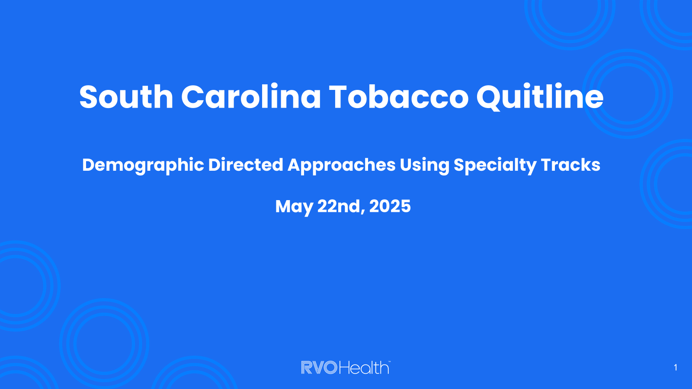

Slide 2





What is the Quitline?
Integrated telephone, text, chat and web-based services to support participants who are wanting to quit commercial nicotine and tobacco use.
Engagement with local, regional, state and national meetings, trainings and outreach efforts.
Committed to helping all participants quit commercial nicotine/tobacco use through evidence-based treatment including coaching, web support and free NRT.

Slide 3

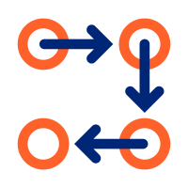





Member Journey
Enrollment
Program Stratification
Intake Data Collection
Phone
Web
Text (text2Start) – text READY to 34191 or LISTO to 34191
Referral
Youth
Pregnancy
Behavioral Health
American Indian
Standard
NAQC MDS questions are recommended
Data collected is reported out to state
Quit
Ongoing Milestones
Coach Session
Relapse prevention tools
Ongoing access to dashboard
Reenrollment and reengagement campaigns
Additional sessions with coaches
Ongoing milestones and action steps
Central dashboard with clear program details
Coaches focus on active listening, empathy, and evidence-based treatment information
Phone, chat, text, or group video

Slide 4

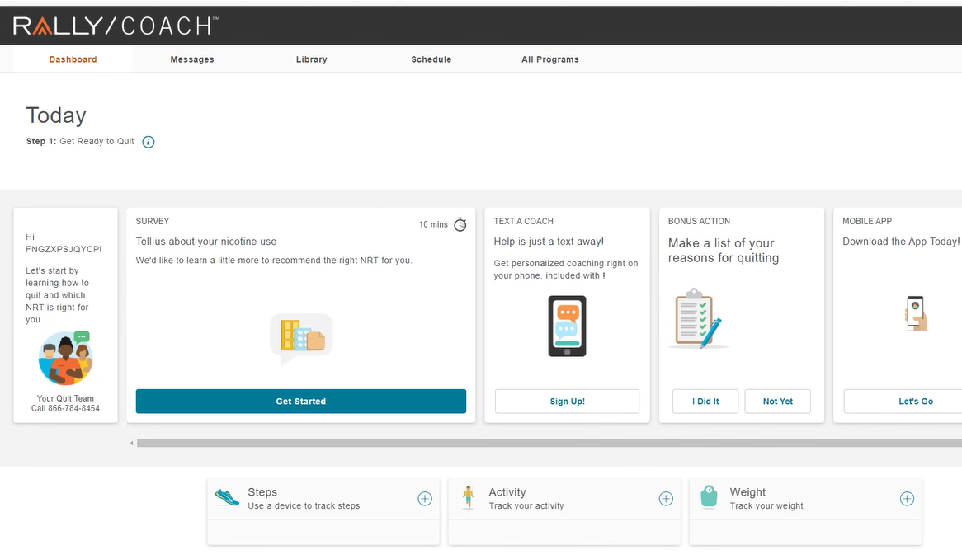
Platform Dashboard
The dashboard provides quick access to State Quit Services resources and tools:
Profile and settings
Text a Coach
Managing NRT
Nudges and reminders to connect
Messages
Library
Managing schedule
Multi-media content cards
Clear calls to action
Notes:
This slide shows you the members’ view of their online dashboard.
They can access their profile and settings
Profile and settings
Enroll in Text a Coach
Initiate coach chat
Managing NRT
Nudges and reminders to connect
Messages
Library
Managing schedule
Multi-media content cards
Clear calls to action

Slide 5
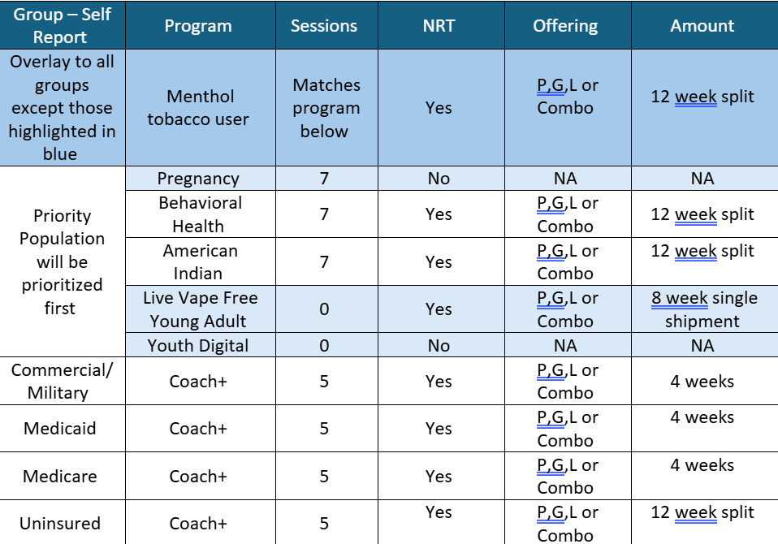

Slide 6
Specialty Tracks

Slide 7
Youth Digital Track
Our youth digital program is specifically designed to support youth aged 13-17 in quitting tobacco and/or vaping products. The program is structured around six online courses that take about 6-8 weeks to complete
Youth participants do not have scheduled coaching calls, but they can call or chat with a coach online if they have specific questions around the program or quitting process.
Upon completion of the sixth course the Youth’s Letter of Completion will be available on the dashboard to download or email to themselves. They can then share this letter with parents, guardians, judges, court employees, etc.
Not eligible for NRT

Slide 8
Pregnancy and Postpartum Track
NRT decision support: this includes addressing any concerns with NRT use, how to navigate choices involving NRT offerings, and how to seek physician review, as needed.
Extra coaching support: participants in this program receive two additional sessions with a coach team who understands sensitivities and the complex needs that may arise, along with the 5 base program calls.
Specialized coaching: participants receive personalized coaching from highly skilled, experienced experts who tailor their sessions to support those in this program. Sessions can be catered towards motivation to quit, pre-quit challenges, effects of smoking on pregnancy, benefits of quitting, urge management, or relapse prevention post-partum.
Not eligible for NRT

Slide 9
American Indian Track
Supporting Native American/American Indian commercial tobacco users, the Quitline offers the intensive American Indian Commercial Tobacco Cessation (AICTC) program to meet the needs of this population. The program design includes higher intensity behavioral and pharmacological support
Participants in this track receive two additional sessions to support their quit, along with the 5 base program calls.
A team of American Indian Quit Coaches and Non-American Indian Quit Coaches who will be trained in providing culturally tailored and specific interventions. Having a deep understanding of the uniqueness and social context of the issues facing this population is essential when it comes to commercial tobacco cessation.
Eligible for 12 weeks of NRT in 4x4x4 shipments

Slide 10
Behavioral Health Track
Of commercial tobacco users who call Quit Services, nearly 45% have at least one behavioral health condition – such as depression, anxiety, or PTSD – which can impact their ability to quit successfully.
Extra coaching support: participants with a behavioral health condition receive two additional sessions to support their quit, along with the 5 base program calls. .
Specialized coaching: participants receive personalized coaching from experienced experts who tailor their sessions to support those in this program.
Eligible for 12 weeks of NRT in 4x4x4 shipments

Slide 11

Thank You!
Lorenzo McCray Jr, BHS
Client Service Manager
State Quit Services
Lmccrayjr@rvohealth.com
M: 803-331-1793

