Slide 1
SC Tobacco Quitline
New Updates on Our Free Statewide
Tobacco Treatment Service
Smokefree SC Summit
May 16, 2023

Slide 2
Disclosure
Dr. Wynne has no disclosures, conflicts, or commercial interests related to this presentation.

Slide 3


Check out our Quitline website…
It’s Your Call to Quit
https://quitnowsc.org

Slide 4
Quitlines – National / S.C.
Quitlines provide free “quit services” to support quitting tobacco products, including vaping.
Services focus on behavioral counseling and FDA-approved medication support with a coaching team.
Every State, U.S. Territory, and Canadian Province has a Quitline.
S.C. Tobacco Quitline launched in Aug 2006.
All services are free – no insurance required.
Coaches are trained tobacco treatment specialists (TTS) – they connect with participants via phone, text, or online chat.
Barrier-free access – open 24/7 (except major holidays – open New Year’s Day).
Multiple language capacity – all diverse population groups served.

Slide 5


The Quitline in 2023
Digitally-expanded platform.
More individual preferences.
All tobacco/vaping products.
Health-focused, holistic approach.
Dashboard experience – access to articles, social media resources, apps, etc.
Group counseling/chat sessions offered.
Streamlined enrollment process with one person.

Slide 6
SC Tobacco Quitline
Improved Enrollment Options
CALL
1-800-QUIT-NOW
1-855-DÉJELO-YA
1-888-7AI-QUIT
1-877-777-6534 (TTY)
CLICK
http://www.quitnow.net/southcarolina
toggle to Spanish online
TEXT
READY to 34191
LISTO to 34191
VAPEFREE to 873373

Slide 7
SC Tobacco Quitline
Multiple Languages & Accessibility
Ages 13 and up.
Spanish speaking dedicated phone line: 1-855-DÉJELO-YA.
Native American Indian dedicated phone line: 1-888-AI7-QUIT.
Deaf/Hard of Hearing 1-877-777-6534/direct TTY machine.
Others are transferred automatically to someone who speaks their preferred language.
Multiple options to access a coach: phone, text, online, individual or group chat sessions.

Slide 8
New & Improved Quitline Services for SC
5 Session Program to All (Coach+)
  Traditional coaching via phone, inbound chat, text, and group video scheduling
  Unlimited inbound support via phone, text, and chat
  Online access to articles, courses, trackers, and more
  New digital dashboard experience all can access – digital services as an option
  Text message support program
Combo NRT products (patch + gum or patch + lozenge)
  12 weeks of combo therapy dosing for uninsured and Medicaid
  Quicker 3-day shipping of NRT products
7 Session Tailored Programs
  Pregnancy, Behavioral Health, American Indian, Live Vape Free, and Youth (Quit Tobacco, 13-17 – online experience with inbound chat/text with a Coach)

Slide 9
Carved Out Services
Behavioral Health Program (nicotine dependence focus)
  Co-Occurring Mental Health Conditions
  Co-Occurring Substance Use Disorders
Pregnant/Postpartum Program (relapse prevention focus)
  Pregnant women through postpartum phase to prevent relapse
American Indian Commercial Tobacco Cessation Program
  AICTC serves all original tribal native American groups across SC
  Culturally sensitive materials and coaching to honor sacred traditions
Live Vape Free™
  Vaping support tailored for both teens (13-17 yrs.) and their parents
Menthol & Smokeless Tobacco
  Customized coaching and resources to target menthol and smokeless use

Slide 10
Vaping Support
Live Vape Free™ for Teens
  GET STARTED: text VAPEFREE to 873373
  Access with a mobile phone
  Enroll and see what motivates you
  Interactive content
  1-on-1 support with a coach via their phone
Live Vape Free for Parents/Families
  EXPLORE MORE AT: rallyhealth.com/live-vape-free
  Helps you talk with your teen about vaping
  Self-paced online course
  1-on-1 support with a coach online
  Downloadable toolkit

Slide 11
Provider Services
Referral Program
  Fax referral (DHEC-1617 form) – fax to Optum and faxed outcomes returned to provider; Health Regions (DHEC-1042)
  Online Portal – another referral option for providers
  Electronic referral (via SC Tobacco eReferral Hub) – EHR SFTP referral >> eHub >> Optum and electronic outcomes returned to provider
  eHub vendor: TelASK, Inc.
Health/Other Systems Optimization (HOSO) Program
  Locally-based Outreach Specialists - free on-site and virtual training, TA, other support to S.C. providers from our TTS.
  HOSO goal: Optimize brief tobacco intervention (BTI) in standard clinical care across S.C. health systems and in other organizations.
  Free CME/CE provider training at http://helppatientsquitsc.org

Slide 12
Quitline - Numbers of Interest
Total South Carolinians served since start-up: 187,000+.
Total provider referrals since start-up: 52,018.
High Success: 42% Quit rate (individual services participants) and 40% Quit Rate (phone participants) – measured at 7 months after receiving services.
98% participant satisfaction with services.
ROI: $1.07 saved for every $1 spent (FY21/22 Quitline & tobacco cessation media)

Slide 13
SC Quitline Enrollment Data
Quitline Enrollment
  8,188 SC residents enrolled in the Quitline in 2022
    Averaging 682 a month!
Types of Tobacco Used
  Cigarette (7,451 participants)
  eCigarette (1,480 participants)
  Smokeless (177)
Provider Referrals
  6,035 Provider Referrals in 2022
Notes:
Steady Increase in QL enrollment from 2020 when the pandemic hit
We have also seen an unsurprising increase in the number of participants who report using eCigarettes. This number has more than doubled since 2020
Interestingly, the number of participants reporting using smokeless tobacco products has decreased each year since 2020
As Katy mentioned, there are a number of ways for providers to refer to the Quitline and we have providers all over the state who refer their patients or clients to the Quitline every month. This is another area of growth for SC, as we continue to see more and more provider referrals each year.

Slide 14
SC Quitline Demographics

Slide 15
SC Quitline Demographics
Notes:
In terms of race and ethnicity, the majority of participants were White or African American.

Slide 16
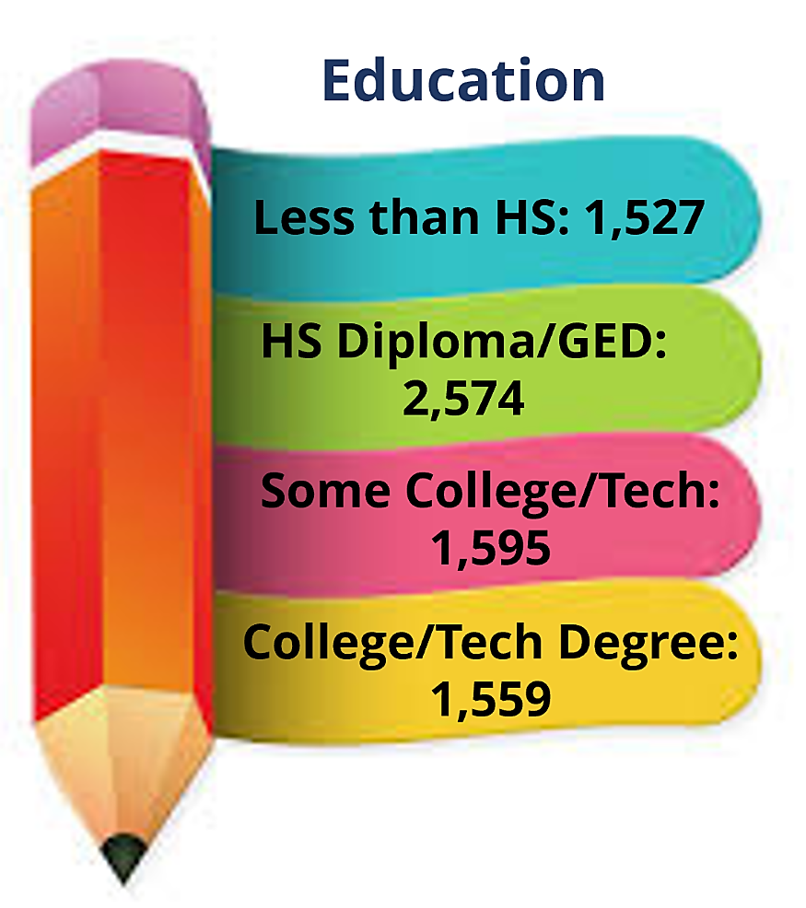

SC Quitline Demographics
Languages Spoken
English
Spanish
Korean
Notes:
The most commonly spoken language is English, but there were a few who spoke Spanish and did not access the dedicated Spanish speaking line – dejelo ya. And there was 1 participant who spoke Korean.

Slide 17
Chronic Disease
Asthma
Chronic Obstructive Pulmonary Disease (COPD)
CAD/CHF/HTN
Diabetes
Cancer
Notes:
Since we know that tobacco use contributes to and worsens chronic diseases, the Quitline also collects data on participants who report having one or more of these conditions.
Overall, 1,184 participants said they had COPD, 844 had diabetes, 705 had asthmas, 585 had Coronary artery disease/congestive heart failure or high blood pressure, and 393 stated they had cancer.

Slide 18
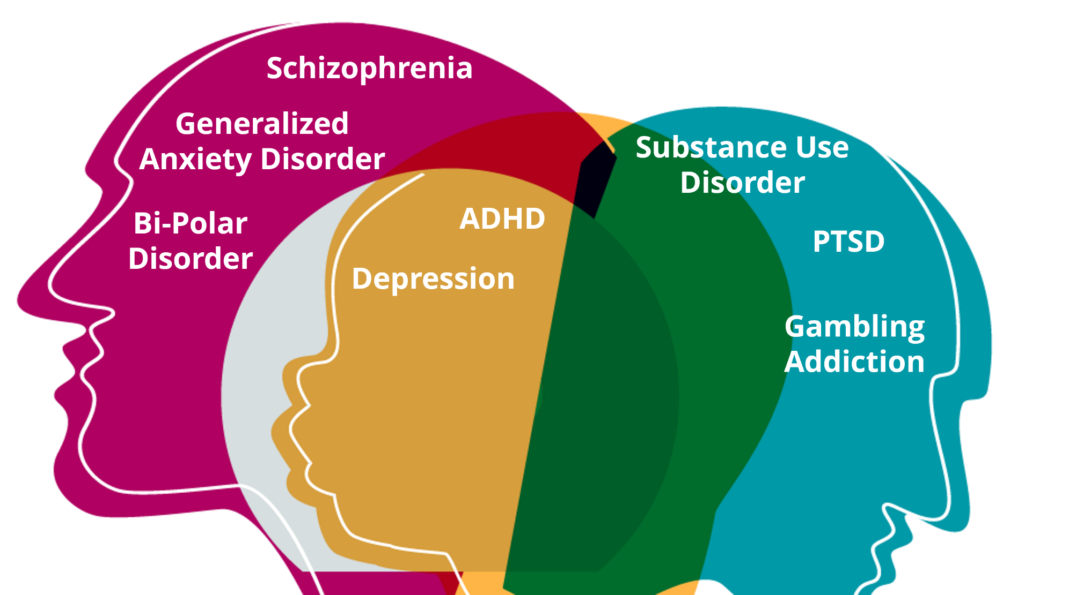
Behavioral Health
Notes:
Finally, since the Quitline has a carved out program for users with behavioral health conditions, we also have data for SC Quitline participants identifying with one or more of these conditions.
In 2022, the top three behavioral health conditions reported by participants were
Depression
Generalized anxiety disorder
And bi-polar disorder

Slide 19
Who to Contact
Dr. Katy L. Wynne, Ed.D., MSW
  Quitline Manager/Cessation Coordinator
  wynnekl@dhec.sc.gov
  803-898-2285
Catherine S. Sedergren, MSPH, CHES
  Quitline Assistant Manager
  sedergcs@dhec.sc.gov
  803-898-1876

Slide 20
SC Tobacco eReferral Hub
Update on Our eHub Program for SC Health Systems and Providers

