Slide 1
Lighting the Way Forward:
30 Years of Tobacco Control Progress in the U.S. and SC
Celebrating the Past and Forging the Future: Shaping SC's Next Chapter in Tobacco Prevention and Control
Sharon Biggers, MPH, CHES
Notes:
Good morning everyone, and thank you for the opportunity to be here. I’m very excited to be with you to celebrate our past and look forward to the future of tobacco prevention and control in South Carolina. My name is Sharon Biggers, and I have worked in tobacco control on the local, regional and state level for three decades, and now work at the national level across all state and territorial tobacco control programs to increase capacity and access to cessation. I’m pleased to be able to share some of our history with you.
Today I want us to spend a little time reflecting on where we’ve been as a tobacco control movement — nationally and here in South Carolina. Barbara asked that I cover 25, but since I’m been doing this for 30 years, I threw in the extra 5 years for fun😊
This field has evolved quite dramatically over this time period. What started largely as public education and awareness campaigns grew into one of the most successful public health movements recognized today.

Slide 2
Why This Story Matters
Tobacco use remains the leading preventable cause of death in the U.S.
The last 30 years transformed tobacco control from isolated efforts to systems-level public health action
South Carolina has played a unique role in tobacco prevention, cessation, and policy change
The next chapter will require new approaches for nicotine products, equity, and health systems integration
Notes:
When we talk about tobacco control history, we’re really talking about culture change. Over the last 30 years, smoking shifted from something deeply normalized in American life to something many young people today can barely imagine being allowed in hospitals, offices, or airplanes. But this story is bigger than changing social norms. Tobacco use remains the leading preventable cause of death in the United States, and the last three decades transformed tobacco control from scattered education efforts into coordinated public health action focused on policy, healthcare systems, prevention, cessation, and community partnerships.
South Carolina played an important role in that progress through smokefree policy efforts, coalition building, and growing healthcare engagement. And while we’ve made tremendous progress, the work is far from over. The next chapter will require new approaches to nicotine products, stronger healthcare integration, and continued adaptation to an evolving public health landscape. So today is not only about celebrating how far we’ve come, it’s also about helping shape South Carolina’s future in tobacco prevention and control.

Slide 3

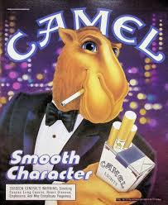
The Tobacco Landscape in the Early 1990s
Smoking was far more socially acceptable
Indoor smoking was common in workplaces, restaurants, and airplanes
Tobacco advertising was everywhere — sports, magazines, convenience stores
Public understanding of secondhand smoke was still emerging
Notes:
If you were around in the early 1990s, the tobacco environment looked completely different than it does today.
Smoking was everywhere. Restaurants had smoking sections. People smoked in offices. Airplanes still allowed smoking into the early 1990s. Cigarette vending machines were common.
Tobacco advertising was deeply embedded in American culture. Sports sponsorships. Magazine ads. Convenience stores. Billboards.
Youth smoking rates were also significantly higher. And while we understood smoking was harmful, the public conversation around secondhand smoke was still developing.
For younger audiences today, some of these images almost feel unreal.
That’s important because it reminds us just how much cultural change has occurred in one generation.

Slide 4
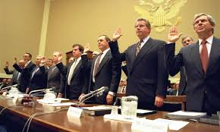
Major National Milestones: 1990s
1992: EPA identifies secondhand smoke as a carcinogen
1994: Tobacco executives testify before Congress
1996: FDA begins regulating youth access and marketing
1998: Master Settlement Agreement (MSA) reshapes tobacco control funding and accountability
CDC Best Practices for Comprehensive Tobacco Control Programs released (1999)
Notes:
The 1990s were a major turning point in tobacco control, when science, policy, and public awareness began aligning in powerful ways. In 1992, the EPA classified secondhand smoke as a known carcinogen, shifting the conversation from personal choice to public health protection. Then in 1994, tobacco executives testified before Congress that nicotine was not addictive — a moment that intensified public distrust of the tobacco industry.
In 1996, the FDA began asserting authority over tobacco products, particularly around youth access and marketing, signaling a growing push for regulation. Then came the 1998 Master Settlement Agreement, which restricted tobacco marketing and helped states build long-term tobacco control infrastructure. South Carolina began receiving and continues to receive millions of dollars annually through the settlement, though none of it is now dedicated specifically to tobacco control. Toward the end of the decade, CDC released its Best Practices framework, helping define what comprehensive tobacco control should look like — including coalitions, media campaigns, Quitlines, policy change, and surveillance. Together, these milestones laid the foundation for modern tobacco control: stronger science, stronger policy, and coordinated systems-level prevention and cessation efforts.

Slide 5
South Carolina in the 1990s
Emergence of statewide partnerships and coalitions through Project ASSIST
Early clean indoor air efforts
Increasing engagement from hospitals, voluntary agencies, and local advocates
Development of statewide prevention and cessation strategies
Notes:
What did things look like during that time frame in South Carolina? Efforts were very local coalition focused, with about 15 coalitions statewide. We were operating under what was then known as “Project ASSIST”, which was the precursor to CDC Office on Smoking and Health’s national tobacco control framework. Many of these partnership, including the work of the American Cancer Society and National Cancer Institute that funded ASSIST, laid the groundwork for advancing tobacco control in South Carolina.

Slide 6
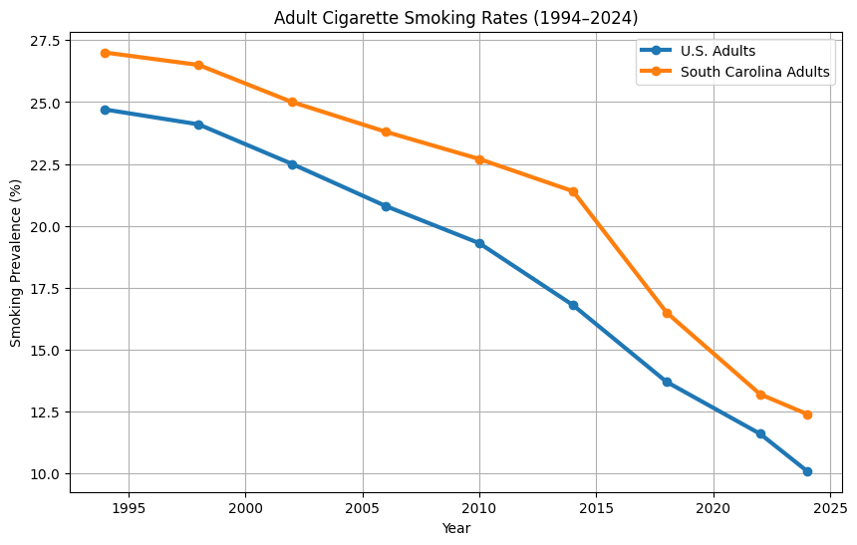
Adult Cigarette Smoking Trends
Source: BRFSS
Notes:
During this time, we had a major focus on cigarette smoking. Just to give you a snapshot of what smoking rates looked like at the time, adults were up close to 30%.

Slide 7
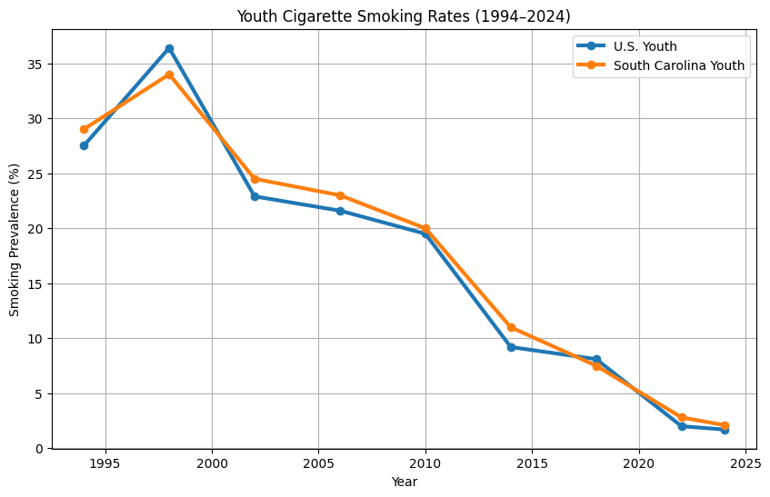
Youth Cigarette Smoking Trends
Source: YRBS
Notes:
And youth were as high as 33%.

Slide 8
The 2000s: Building Comprehensive Tobacco Control
Establishment of the SC Tobacco Collaborative, the original name of Smokefree SC
Expansion of state Quitlines
Evidence-based youth prevention campaigns
Growth of local smokefree ordinances
Healthcare systems increasingly engaged in cessation
National focus on disparities in tobacco use and access to care
Notes:
The 2000s marked a major shift in tobacco control — from individual education campaigns to broader systems-level approaches focused on prevention, cessation, healthcare integration, smoke-free air, and policy change.
In South Carolina, this era included the creation of the SC Tobacco Collaborative in 2001, the precursor to Smokefree SC, and the launch of the SC Tobacco Quitline in 2006. Around the same time, the national 1-800-QUIT-NOW portal expanded access to counseling, nicotine replacement therapy, and cessation support nationwide. Youth prevention efforts also became more targeted and evidence-based.
The Rage Against the Haze youth movement empowered hundreds of youth to become visible smokefree advocates in their schools and communities. Another major turning point came with the 2006 Surgeon General’s Report on Secondhand Smoke, which concluded there is no safe level of exposure. In South Carolina, later court decisions, including from the state Supreme Court, affirmed that local communities could enact their own smokefree ordinances, helping expand protections across the state. Healthcare systems also became increasingly engaged in tobacco treatment through screening, referrals, and cessation support integrated into routine care. Together, these efforts reflected the rise of comprehensive tobacco control strategies that combined policy, healthcare, prevention, media, and cessation services to create lasting population-level change.
It is really fun to encapsulate these accomplishments of this time so easily into one slide, but this represented incredible hard work, hard conversations, and wholesale changes in the way we operated to move tobacco control forward.

Slide 9
The Family Smoking Prevention and Tobacco Control Act (2009)
Gave FDA authority to regulate tobacco products
Restricted youth-focused marketing
Required stronger warning labels and product oversight
Marked a major shift toward federal regulatory action
Notes:
Moving to 2009, the Family Smoking Prevention and Tobacco Control Act marked one of the most significant tobacco control actions to date.
For the first time, the law gave the FDA authority to regulate the manufacturing, marketing, and distribution of tobacco products. That was a major turning point because tobacco products had previously operated with far less federal oversight than many other consumer products.
The Act also focused heavily on reducing youth exposure to tobacco marketing. It restricted youth-oriented advertising tactics, limited flavored cigarettes that appealed to younger audiences, and placed new rules on how tobacco products could be promoted.
Another important component was stronger health warnings and product oversight. The law required more visible and graphic warning labels and gave the FDA the ability to review ingredients, product claims, and new tobacco products entering the market. However, the graphic warning labels are still tied up in litigation, 17 years later.
Overall, this legislation represented a major shift from simply educating the public about the dangers of tobacco to actively regulating the tobacco industry at the federal level.

Slide 10
South Carolina’s Biggest Win-2010
•South Carolina had the lowest cigarette tax in the nation for many years
•Public health advocates and partners worked for nearly 10 years to increase the tax
•In 2010, the state passed a historic cigarette tax increase
•Tax increased from 7¢ to 57¢ per pack
Why It Mattered
✓ Higher tobacco prices help reduce smoking, especially among youth
✓ $5 million annually dedicated to the Department of Public Health
✓ Funding supports prevention, cessation, education, and essential public health programs
10 Years
of advocacy and legislative effort
Notes:
For many years, South Carolina had the lowest cigarette tax in the country, and raising it became one of the state’s longest-running tobacco control policy efforts. Public health advocates, healthcare organizations, and community partners spent nearly a decade educating policymakers and the public about the health and economic impact of tobacco use and the importance of increasing the cigarette tax as both a prevention and revenue strategy.
After 10 years of advocacy and legislative efforts, South Carolina successfully passed a cigarette tax increase in 2010. The tax increased from just 7 cents per pack to 57 cents per pack — a historic change for the state. This was significant not only because higher tobacco prices are proven to reduce smoking, especially among youth, but also because it represented a major shift in South Carolina’s approach to tobacco control policy.
Importantly, the legislation also dedicated a portion of the revenue — $5 million annually — to the South Carolina Department of Public Health to support essential tobacco prevention and cessation programs. Those funds helped strengthen statewide efforts in education, quit support, community programs, and broader public health initiatives aimed at reducing tobacco-related disease and death across South Carolina.

Slide 11
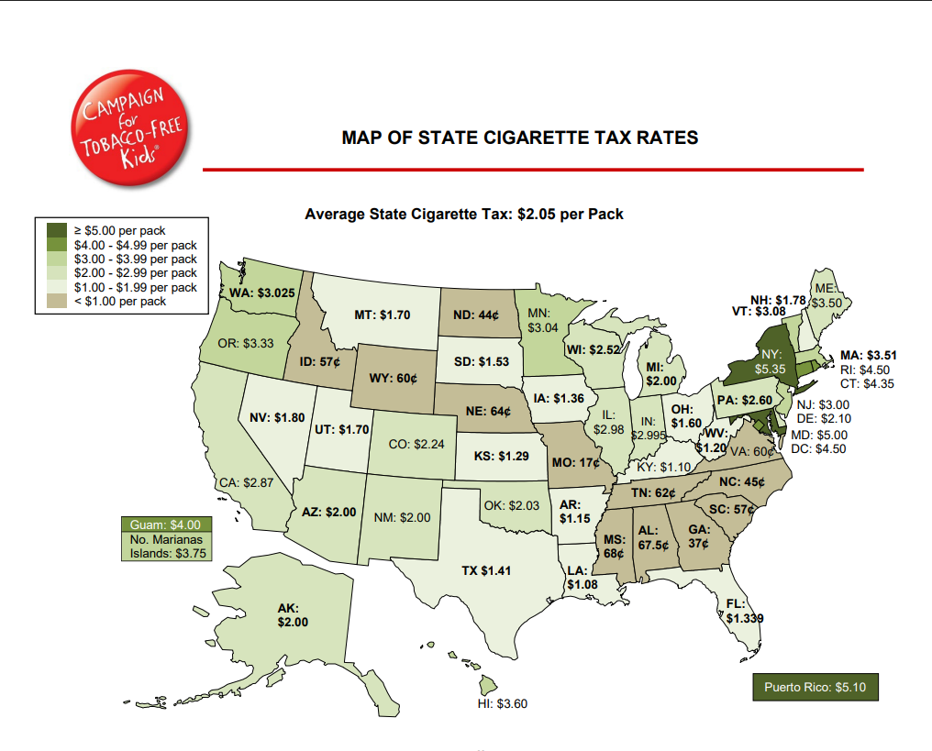
Notes:
At the time, we moved out of the #1 lowest tax in the country position, but as you can see, as time has passed, we’re back down in the lowest tax group along with our Southeastern neighbors.

Slide 12
The Rise of E-Cigarettes and New Nicotine Products
Rapid growth of vaping products in the 2010s
Sharp increases in youth nicotine use
Complex public health debates around harm reduction and cessation
New challenges in messaging, surveillance, and policy
Notes:
One of the most significant shifts in tobacco control over the last decade has been the rapid rise of electronic cigarettes and vaping products. What began as a relatively small market quickly became a major public health concern, particularly among youth. By the late 2010s, youth e-cigarette use had surged, driven by flavored products, social media marketing, and devices that were easy to conceal.
This created an entirely new landscape for public health. Unlike traditional combustible tobacco products, vaping introduced new questions about nicotine addiction, long-term health effects, youth appeal, product regulation, and cessation that we are still working to fully understand today.
In 2019, these concerns intensified with the EVALI outbreak — e-cigarette or vaping product use-associated lung injury — which hospitalized thousands of people nationwide and resulted in dozens of deaths. Investigations later identified Vitamin E acetate, an additive commonly found in some THC-containing vaping products, as a primary cause of the lung injuries. The outbreak highlighted how quickly new products and additives can emerge ahead of research, surveillance, and regulation, creating major challenges for public health response and consumer safety.
At the same time, vaping sparked ongoing and often complex discussions around harm reduction. Many public health and clinical experts view e-cigarettes as potentially less harmful than combustible cigarettes and as a possible pathway for adult smokers to transition away from smoking. Others have raised concerns about youth initiation, long-term nicotine addiction, dual use, and the potential to undermine decades of progress in tobacco prevention. These conversations continue today and reflect the complexity of balancing prevention, cessation, and risk reduction in a rapidly evolving environment.
The rapid evolution of vaping products has also created challenges for surveillance, education, cessation approaches, and policy development. New devices, disposable products, synthetic nicotine products, and changing marketing strategies often emerge faster than research and regulation can keep pace. Overall, the rise of vaping products marked a new and far more complex era in tobacco control.

Slide 13
Campaigns That Changed the Conversation
CDC’s Tips From Former Smokers campaign
The Real Cost® youth prevention campaign
Expansion of media countermarketing
Use of social media and digital outreach
Notes:
Media campaigns have become one of the most influential tools in tobacco control, helping shift public perception, reduce tobacco initiation, and increase quit attempts.
A major milestone was the CDC’s Tips From Former Smokers campaign, launched in 2012. By sharing real stories of people living with smoking-related disease, the campaign used powerful, emotional storytelling to encourage quitting and increase awareness of tobacco’s health impacts.
The Family Smoking Prevention and Tobacco Control Act also helped pave the way for national youth prevention efforts like the FDA’s The Real Cost campaign, launched in 2014. The campaign focused on preventing youth tobacco use through hard-hitting messaging about addiction, loss of control, and other immediate consequences of nicotine use.
In South Carolina, youth prevention and cessation messaging has expanded through statewide media partnerships and targeted campaigns such as Down and Dirty, Behind the Haze, and Quit the Hit. These efforts have used modern, digital-first strategies to increase awareness of vaping risks, strengthen prevention messaging, and support cessation among youth and young adults.
Together, these campaigns reflect the evolution of tobacco control messaging—from broad awareness campaigns to emotionally compelling and highly targeted communication strategies designed for today’s rapidly changing nicotine landscape.

Slide 14
Healthcare Systems Change and Tobacco Cessation
Integration of tobacco treatment into clinical workflows
Electronic health record prompts and referrals
Insurance coverage for cessation treatment
Behavioral health integration
Focus on systems-level sustainability
Notes:
Over the past 30 years, tobacco cessation has shifted from individual counseling approaches to health systems change and population health strategies that embed treatment into routine care.
A major evolution has been the integration of tobacco treatment into clinical workflows and electronic health records, including automated prompts and “opt-out” referral systems that connect patients directly to cessation services like Quitlines or embedded programs. This helps make tobacco treatment a standard part of care rather than an optional step.
There has also been significant progress in insurance coverage for cessation counseling and medications, reducing financial barriers and improving access across populations.
In addition, tobacco treatment is increasingly integrated into behavioral health and chronic disease care, recognizing tobacco use as a key factor in conditions like cardiovascular disease, COPD, and mental health treatment.
Taken together, these shifts reflect a move toward systems-level sustainability, where cessation support is built into how care is delivered and funded, not dependent on individual providers alone.
I also work at the national level in this space, supporting efforts to strengthen these systems and expand access to evidence-based tobacco treatment across all states and territorial tobacco control programs. So I am continuing to see this evolve and grow across the country.

Slide 15
South Carolina’s Public Health and Healthcare Partnerships
Collaboration across public health, hospitals, health systems, and nonprofits
Role of statewide organizations and coalitions
Expansion of the state’s Medicaid Cessation Benefits
Expansion of cessation referrals and provider engagement
  SC CAN Quit
  Tobacco-Free Recovery
Cross-sector approaches to chronic disease prevention
Notes:
In South Carolina, tobacco control progress has increasingly been driven by cross-sector collaboration across public health, hospitals, health systems, and nonprofit partners, creating a more coordinated approach to prevention and cessation.
A major milestone in this arena was the expansion of South Carolina’s Medicaid cessation benefits in 2018, which has helped improve access to counseling and FDA-approved medications for individuals who rely on public coverage. This policy shift has been critical in reducing financial barriers to quitting and increasing access to services.
At the clinical level, there has also been growth in cessation referrals and provider engagement, with more health systems integrating tobacco use screening and referral processes into routine care workflows. This includes stronger use of electronic referral pathways that connect patients directly to quit services. I’m sure Katy will cover this during her presentation, it is a huge win for SC.
Community and statewide initiatives like SC CAN Quit and Tobacco-Free Recovery further strengthen this ecosystem by supporting quitting in both clinical and community-based settings, including for populations with behavioral health needs and substance use recovery. Early successes in smoke-free policy adoption in these settings has helped bolster this initiative.
Together, these efforts reflect a broader cross-sector approach to chronic disease prevention, where tobacco use is addressed alongside other key risk factors through coordinated systems rather than isolated programs.

Slide 16
Tobacco Industry Evolution
Shift from traditional cigarettes to alternative nicotine products
Targeted marketing strategies
Industry adaptation to regulation
Continued focus on youth and vulnerable populations
Notes:
Over the past 30 years, the tobacco industry has continually adapted its products and marketing strategies in response to policy, public awareness, and changing consumer behavior. As cigarette use declined, the industry shifted toward new products, new messaging, and new audiences.
We’ve seen the rise of products like flavored cigars, hookah, e-cigarettes and vape devices, nicotine pouches like ZYN, heated tobacco products like IQOS, and disposable flavored and smart vapes that are heavily marketed through social media and digital platforms.
Marketing has also evolved—from traditional advertising to influencer culture, lifestyle branding, and products designed to appeal to youth and young adults through flavors, sleek technology, and perceptions of reduced harm.
This constant evolution is why tobacco control must continue evolving as well. Public health efforts must remain flexible and responsive through updated policy, surveillance, prevention messaging, cessation support, and health systems approaches that can keep pace with a rapidly changing nicotine landscape.

Slide 17
What Worked Over the Last 30 Years
Comprehensive tobacco control programs
Policy and environmental change
Media campaigns
Price increases and taxation
Quitline access and treatment coverage
Community partnerships
Notes:
Over the past 30 years, progress in tobacco control has come from comprehensive, coordinated strategies working together across public health, healthcare, policy, and communities.
Comprehensive tobacco control programs created the foundation for prevention and cessation efforts nationwide. Policy and environmental changes—like smoke-free laws and tobacco regulations—helped shift social norms and reduce exposure to tobacco use.
Media campaigns such as Tips From Former Smokers and The Real Cost increased awareness, prevented youth initiation, and encouraged quit attempts, while price increases and tobacco taxes proved highly effective in reducing use, especially among youth.
At the same time, expanded quitline access, insurance coverage, and evidence-based treatment made quitting more accessible, and strong community partnerships helped sustain these efforts at the local level.
Together, these strategies created lasting culture change and significantly reduced tobacco use across the country.

Slide 18
Persistent Challenges
Rural access barriers
Youth nicotine addiction
Behavioral health and tobacco use
Funding instability
Misinformation and evolving products
Uneven policy adoption
Notes:
As we look ahead, the next chapter of tobacco control will require adaptable, collaborative leadership that can respond to a rapidly changing landscape.
Today’s challenges also create opportunities for innovation. Rural access barriers highlight the need for stronger telehealth and community-based cessation support, while rising youth nicotine use calls for prevention strategies that can keep pace with social media and emerging products. There is also growing recognition of the connection between tobacco use, behavioral health, and chronic disease, creating opportunities to better integrate cessation into mental health, substance use, cancer, cardiovascular, and diabetes programs.
At the same time, the tobacco industry continues to evolve through aggressive lobbying, new product strategies, and efforts to weaken public health protections. The recent elimination of the CDC Office on Smoking and Health and ongoing policy challenges across states underscore the need for continued vigilance and strong public health leadership.
Funding instability, misinformation, evolving nicotine products, and uneven policy adoption remind us that tobacco control cannot remain static. The past 30 years have shown what is possible — and the next generation now has the opportunity to build stronger, more sustainable approaches to prevention and control.

Slide 19
South Carolina’s Next Chapter
Strengthening prevention among youth and young adults
Expanding healthcare system integration
Leveraging data and evaluation
Supporting local communities
Building the next generation of tobacco control leaders
Notes:
As we think about South Carolina’s next chapter in tobacco control, the opportunity ahead is not just to sustain progress—but to reimagine how we protect the next generation.
That means strengthening prevention efforts among youth and young adults, expanding healthcare system integration so cessation becomes a standard part of care, and leveraging data and evaluation to guide smarter, more responsive strategies.
It also means continuing to support local communities, particularly rural communities, because lasting change happens when statewide efforts are paired with local leadership and trusted partnerships.
Most importantly, the future of tobacco control depends on building and empowering the next generation of leaders who can navigate emerging products, changing policy environments, and new public health challenges.
This conference theme reminds us that tobacco control is not just about reflecting on the past 30 years—it’s about preparing for the next 30 and ensuring the field continues evolving to meet the moment.

Slide 20
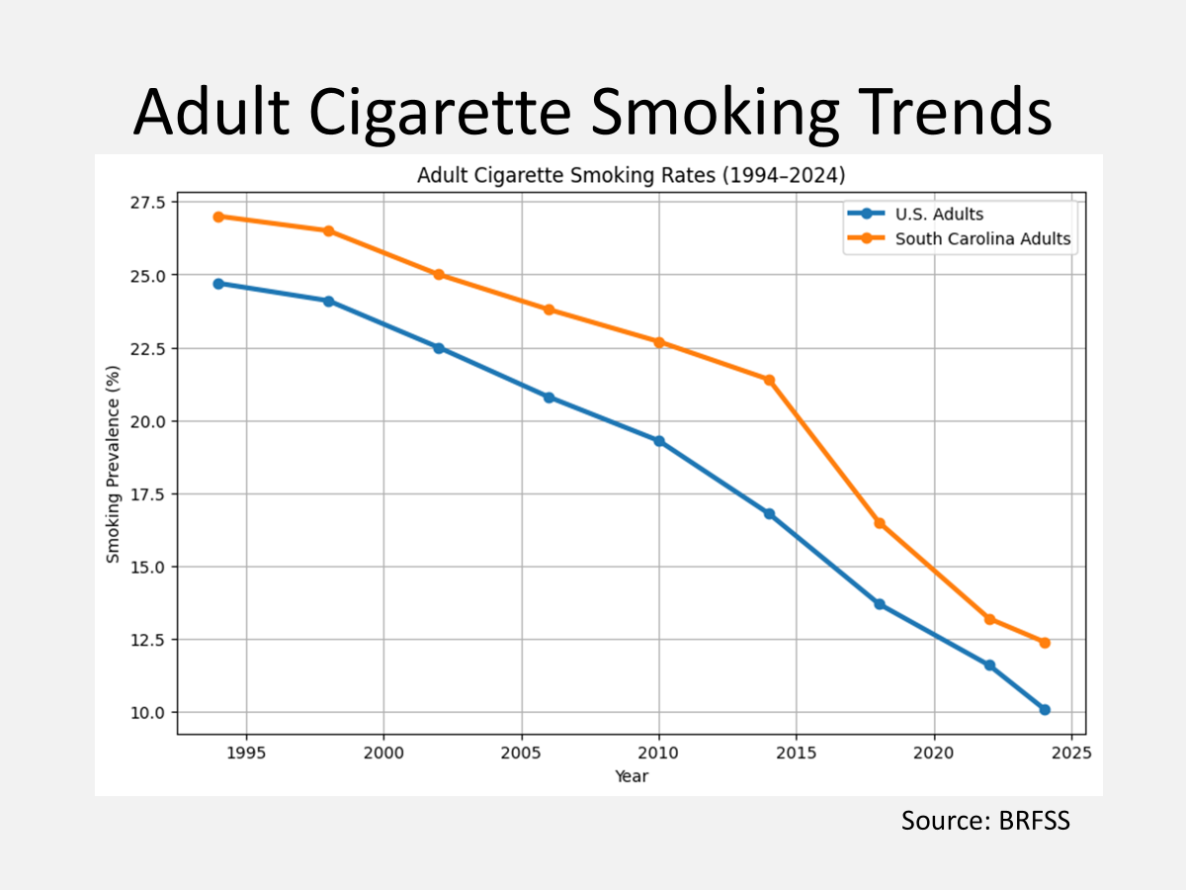
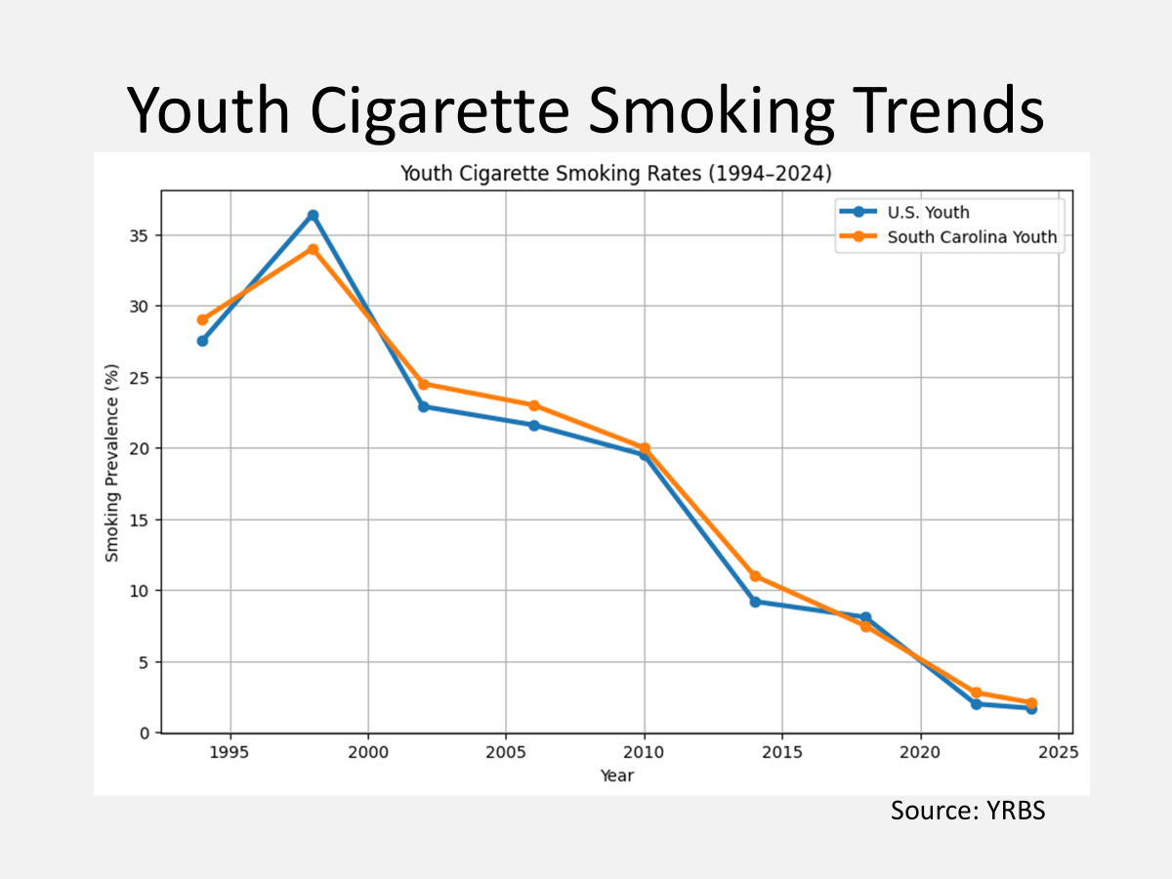
Honoring the Past. Leading the Future.
Notes:
The progress we’ve seen over the past 30 years was not accidental. It was built through persistence, strong partnerships, evidence-based policy, scientific leadership, and the dedication of communities, advocates, healthcare providers, educators, and public health professionals across South Carolina and the nation.
Every smoke-free policy, every quit attempt supported, every young person who never started, and every system changed reflects decades of collective effort and commitment.
And while we’ve made tremendous progress, the next chapter of tobacco control in South Carolina is still being written. The challenges are evolving—but so are the opportunities, the partnerships, and the next generation of leaders ready to continue this work.
Thank you to the longtime warriors and champions who have dedicated their blood, sweat, and tears to bring us to where we are today in moving this field forward—and to the next generation of leaders who will carry this work into the future.

