Slide 1
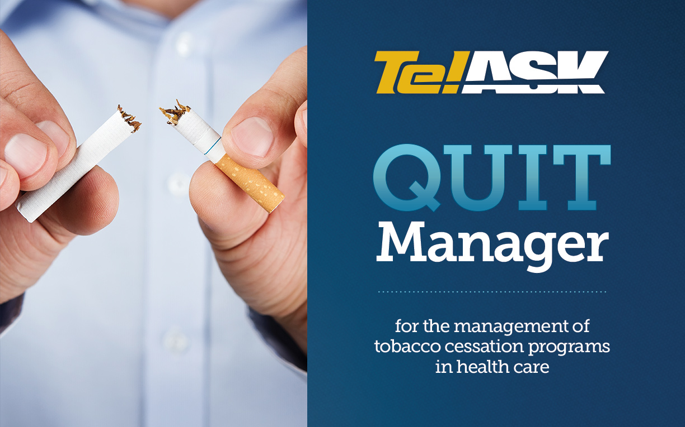

Slide 2




Peter Fallis
Erin Greenwell
Vincent Talbot

Slide 3



TelASK Quit Manager
Cloud-based Software as a Service (SaaS) designed to help optimize tobacco treatment programs in hospitals and clinics.

Slide 4
TelASK Quit Manager
Provides helpful tools and feedback for Tobacco Treatment Specialists
Automates follow-up of tobacco users
Triages them to the SC Tobacco Quitline
Generates reports for management

Slide 5



TelASK Quit Manager
            Quit Manager is HIPAA Compliant
            Hosted on the Microsoft Azure Platform
            TelASK signs a Business Associate Agreement

Slide 6



TelASK Quit Manager
Organizations live with the eReferral Hub

Slide 7


TelASK Quit Manager
Organizations in progress with the eReferral Hub

Slide 8


TelASK Quit Manager
Organizations in discussions with the eReferral Hub

Slide 9
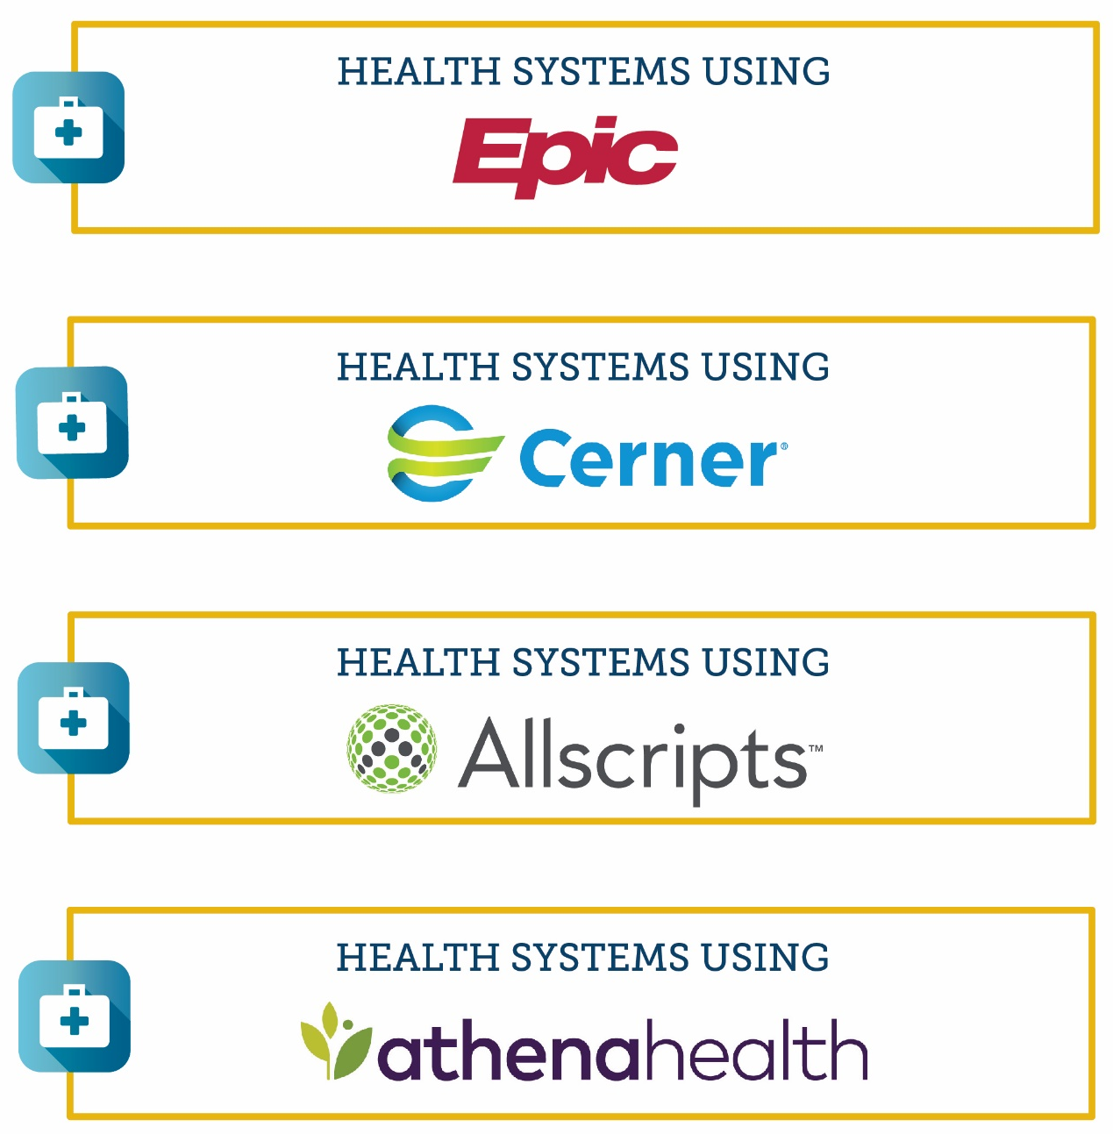
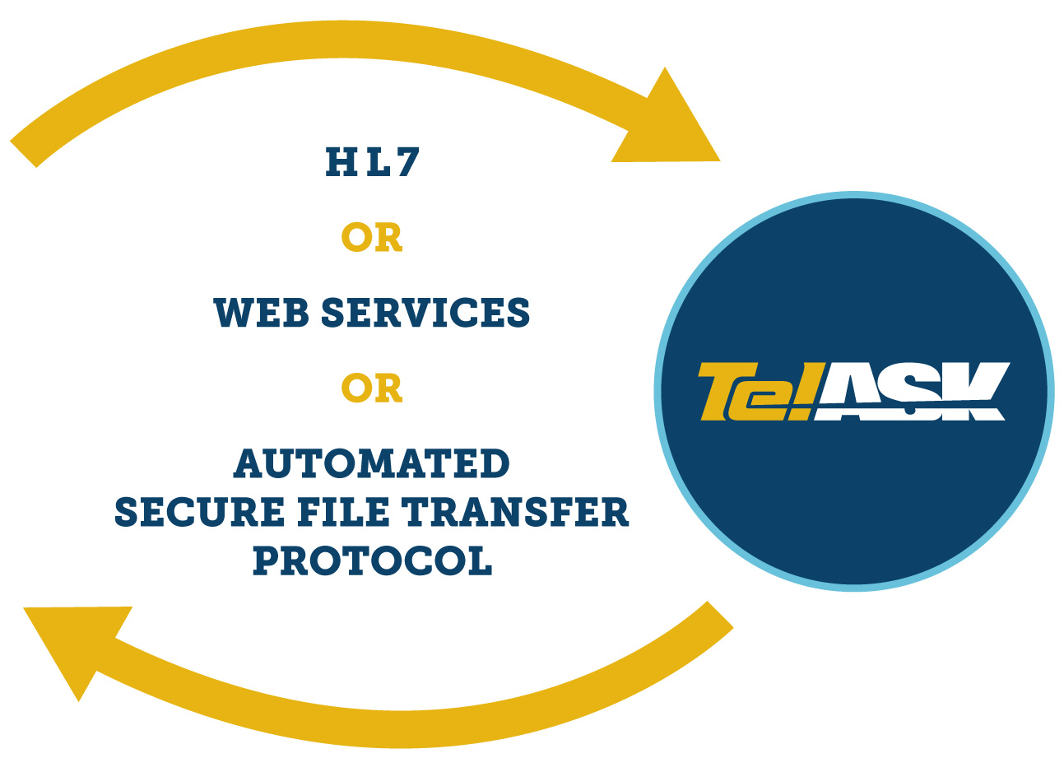
Interfaces with EMRs
Quit Manager is available in the Epic Connection Hub.

Slide 10
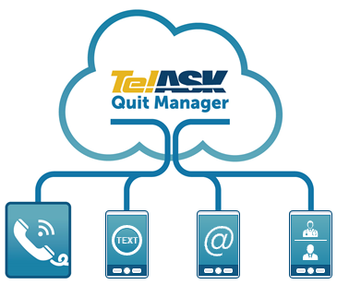
Automated Follow-ups
Follow-ups are generated utilizing these modalities:
  Automated Voice
  Calls (IVR)
  E-mails
  Text messages (SMS)

Slide 11
Interactive Voice Response
Call display shows preferred local number and customized message - ‘HELP 2 QUIT’
Tobacco users are addressed by name
Call flows can be customized
Include motivational messages and offer to connect the tobacco users to help

Slide 12
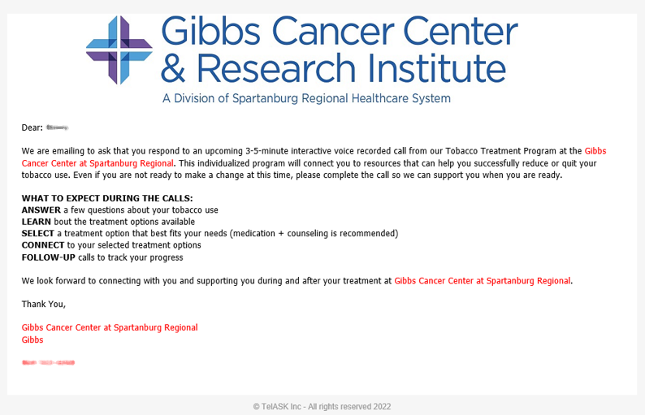
E-mail

Slide 13
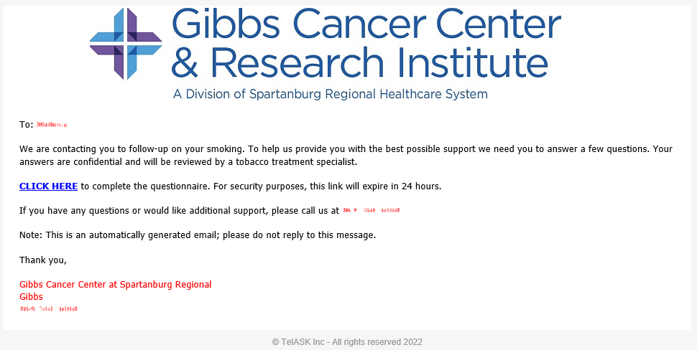
E-mail

Slide 14


Text Messages (SMS)
Gibbs Tobacco: We are following up with you on your smoking. Please complete this tobacco survey: <CLICK HERE> 800-784-8669

Slide 15
eHub Quit Manager Outcomes
Gibbs Cancer Center
(January 1, 2022 – March 31, 2023)
eHub Enrollments: 2,623
Quitline Referrals: 752 (28.7%)
Gibbs LDCT
(October 1, 2022 – March 31, 2023)
eHub Enrollments: 966
Quitline Referrals: 258 (26.7%)
Gibbs total eHub Enrollments: 3,589
Gibbs total Quitline Referrals: 1010 (28.1%)

Slide 16
eHub Quit Manager Outcomes
South Carolina Oncology Associates (SCOA)
(June 1, 2022 – March 31, 2023)
eHub Enrollments: 1,874
Quitline Referrals: 573
(30.6%)

Slide 17
eHub Quit Manager Outcomes
HopeHealth
(December 1, 2022 – March 31, 2023)
eHub Enrollments: 108
Quitline Referrals: 9
(8.3%)
*HopeHealth is piloting with five providers.

Slide 18
eHub Quit Manager Outcomes
Statewide eHub
(January 1, 2022 – March 31, 2023)
eHub Enrollments: 5,574
Quitline Referrals: 1,592
(28.6%)

Slide 19
eHub Quit Manager Outcomes
(Reporting and Demographics)
Gibbs Cancer Center
(January 1, 2022 – March 31, 2023)
Gender:
Male: 959 (36.3%)
Female: 1685 (63.7%)
Race:
African American/Black: 610 (23.1%)
Caucasian/White: 1988 (75.2%)
Age:
18-44: 389 (14.7%)
>45: 2255 (85.3%)
Gibbs LDCT
(October 1, 2022 – March 31, 2023)
Gender:
Male: 500 (51.8%)
Female: 466 (48.2%)
Race:
African American/Black: 153 (15.8%)
Caucasian/White: 795 (82.3%)
Age:
18-44: 0
>45: 966 (100.0%)

Slide 20
Questions

Slide 21
Contact Information:
Erin.Greenwell@telask.com

