Slide 1

SC Tobacco Quitline:
Past, Present, & Future
Smokefree SC Summit
May 20, 2026

Slide 2
Presenter
Katy L. Wynne, Ed.D., MSW
Quitline/Cessation Manager
SC Department of Public Health
Tobacco Prevention and Control Unit
Disclosure:
Dr. Wynne has no disclosures, conflicts, or commercial interests related to this presentation.

Slide 3
Objectives
Present a brief history of the South Carolina Tobacco Quitline.
Highlight the Quitline’s services and successes over the past 20 years.
Forecast what the future holds for the Quitline and nicotine cessation across South Carolina.
Note: References to “tobacco” and “smoking” describe the use of commercially sold combustible and chewed tobacco products and not the cultural and ceremonial use of tobacco among Native American tribal groups.

Slide 4

If we forget our past,
we cannot fully appreciate our present
or successfully forge our future.

Slide 5
Do You Remember?
1977 – SC cigarette tax increased from $.06 to $.07 per pack. Same year, national adult smoking rate = 36%. (Today’s cigarette smoking rate = 9.9%.)
1990 – American Stop Smoking Intervention Study (ASSIST) under NCI and ACS launched in SC and 16 other states to implement comprehensive tobacco control, focusing on policy, media, and community programs.
1990 – SC Clean Indoor Air Act passes, with loopholes that remain today.
1997 – Alliance for a Smoke-Free South Carolina published Saving Lives Through Public Policy: An Environmental Approach to Tobacco Prevention and Control, which included a focus on national and state policy issues to address tobacco use and Model Tobacco Use Policies for Schools, Worksites, and Healthcare Facilities in SC.
1998 – Tobacco Master Settlement Agreement brought $2.3 billion over 25 years into SC; but the state ended up accepting ~$900 million in a lump sum that is still earning interest today – none of which is dedicated for tobacco prevention and cessation.
1999 – National funding for state tobacco prevention and control programs switched from NCI to the CDC, which funded state level cooperative agreements across the nation and U.S. territories.

Slide 6
Do You Remember?
2000 – SC Tobacco Prevention and Control program established at SC DHEC (now SC DPH) under first CDC Cooperative Agreement and new staff were hired.
2001 – South Carolina Tobacco Collaborative is formed, which became today’s Smokefree SC. (Both are successors of the Alliance for a Smoke-Free SC.)
2004 – Statewide South Carolina Tobacco Policy Forum held March 22-25 at Hickory Knob State Park designed to forge consensus and conceptual clarity on key issues related to policy approaches for tobacco control, resulting in a second Saving Lives Through Public Policy: A Resource/Action guide of Tobacco Policy Change in SC.
2006 – South Carolina Tobacco Quitline is launched with 1-800-QUIT-NOW. Same year, Town of Sullivan’s Island enacts state’s first comprehensive smoke-free indoor workplace law.
2010 – State excise tax on cigarettes increased $.50 – from the lowest in the nation at $.07 to $.57 per pack. Adult smoking rate in SC was 21%-22%, slightly higher than the national rate of 19.3%.
2012 – SC General Assembly earmarked $5 million annually from the 2010 $.50 tax increase to DHEC for tobacco prevention and cessation programs starting in FY2012.

Slide 7
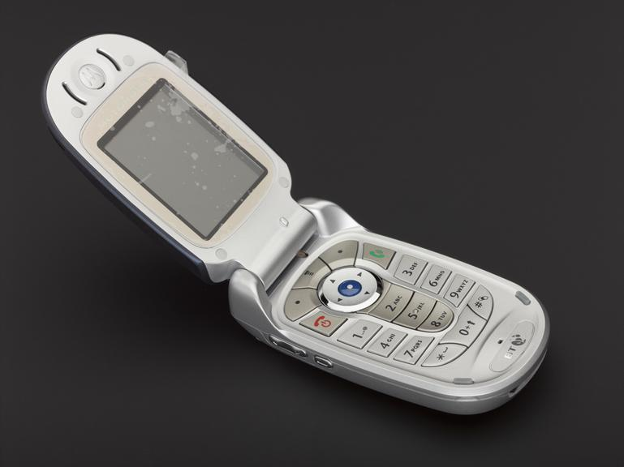
OUR PAST
Think flip phones and
a BlackBerry

Slide 8

Happy Birthday!
August 18, 2026

Slide 9
Brief History
2002-2003 – I attended 2 significant meetings that jump-started our quest for a Quitline in SC.
  Arizona gathering: met Linda Bailey (NAQC founder and former CEO), learned about Quitlines for the first time, and SC was one of the original states that helped launch the North American Quitline Consortium (NAQC).
  CDC/NCI meeting: learned about the newly proposed 1-800-QUIT-NOW toll free line to be offered nationwide.

Slide 10
Brief History
2004-2005 – took advantage of NCI’s toll-free line as a temporary Quitline substitute.
  1-877-44U-QUIT: adopted this number for the SC Tobacco Quitline – still in operation today as the National Cancer Institute’s smoking quitline.
  American Legacy Foundation: received seed funding from ALF to operate a skeleton version of our Quitline and support implementing 1-877-44U-QUIT.

Slide 11
Brief History
2006-current – launched our official statewide SC Tobacco Quitline with federal funding support.
  1-800-QUIT-NOW: adopted the new national toll-free portal as South Carolina’s official Quitline phone number. Branded all of our materials with 1-800-QUIT-NOW.
  CDC Supplemental Funding: secured our first state level procurement for a new Quitline with CDC funding of $250,000.
  State Tobacco Prevention and Cessation Trust Fund: funding for the Quitline greatly expanded with the funds earmarked to DHEC from the FY2012 cigarette tax increase.

Slide 12
Behind the Scenes 1
What most people don’t know about the Quitline:
Our budget has ranged from a low of $250,000 to a high of $35 million.
Today, with a slightly scaled back budget, we continue to have one of the nation’s most successful Quitlines thanks to continued state funding under the Tobacco Prevention and Cessation Trust fund.
And this is all without the historic Tobacco Settlement Funding.
If our Quitline was federally funded, we would have had to shut it down last April. So, we have immense gratitude for our wonderful statewide non-profit advocates that worked so hard to secure state funding from the cig tax increase.

Slide 13
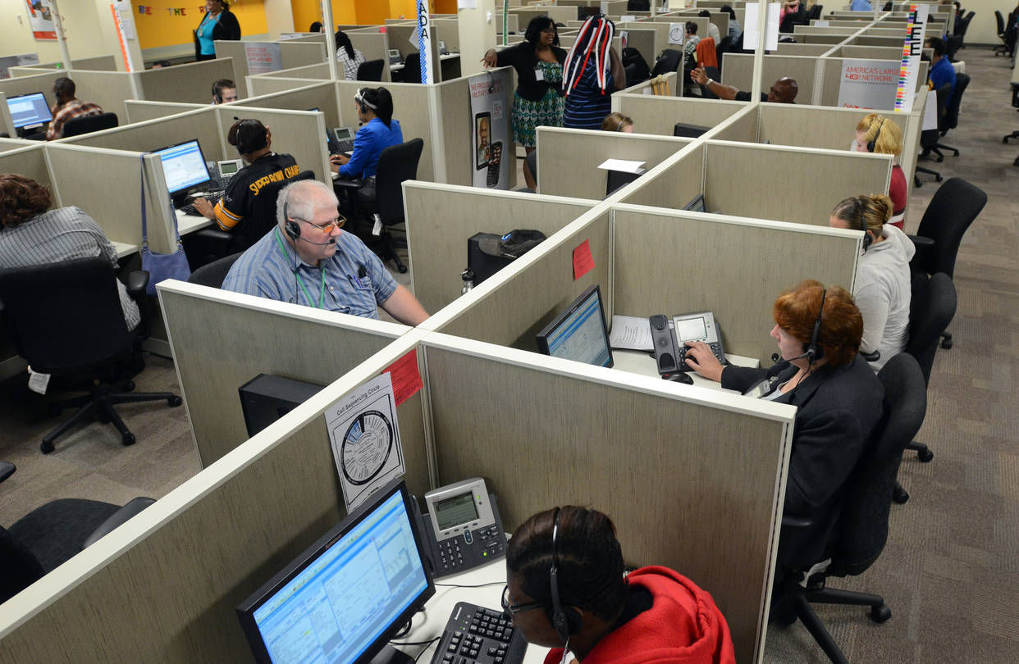

Behind the Scenes 2
What most people don’t know about the Quitline:
Operational changes: (from a large call center located in downtown Seattle with live coaches working with participants from their counseling offices to a 100% remote staff using a virtual platform with 24/7 access to live coaches and connections via online/digital and mobile devices).
Started out with live call sessions offered between 8:00am and 8:00pm; then advanced to available support 24 hours a day, 7 days a week. Closed on major holidays, but open on New Year’s day to serve those making a resolution to quit.

Slide 14




Behind the Scenes 3
What most people don’t know about the Quitline:
Business portfolio: (mergers and acquisitions over the years) – began in 2006 with Free & Clear; named changed in May 2011 to Alere Wellbeing, but ownership remained the same.
Alere Health (parent company of Alere Wellbeing) was acquired in 2015 by Optum, Inc., a subsidiary company of United Healthcare.
In 2022, Optum created a “joint venture” business relationship with Red Ventures (Fort Mill, SC-multi-billion-dollar privately held company that owns a number of health brands), which became RVO Health, our current Quitline vendor.

Slide 15

OUR PRESENT
Phone call coaching enhanced by digital/online support

Slide 16
Foundational Facts
All tobacco products – not just cigarettes – inflict devastating health, economic, and social costs.
People smoke for many reasons – peer influence, pleasurable taste, stress relief, addiction.
Quitting is hard due to nicotine’s strong effect on the brain and behavioral dependency.
Repeated clinical intervention is many times needed to help a smoker master quitting.

Slide 17
Sobering Facts
More adults are quitting tobacco, but more are also dying from long-term use. In the United States alone, smoking causes over 1,300 daily deaths.
The costs are high. Cigarette smoking costs over $600 billion each year from direct medical care and causes more than 480,000 deaths annually in the United States (including deaths from secondhand smoke exposure).
Smoking and smokeless tobacco damage nearly every organ in the body, leading to cancer, heart disease, stroke, COPD, diabetes, and more.
Cigarette smoking causes premature death – with a life expectancy for smokers estimated at least 10 years shorter than for nonsmokers.
People with less than a high school diploma, those with low incomes, and those who experience mental illness are among the groups statistically more likely to smoke.

Slide 18
Encouraging Facts
Deaths due to smoking are preventable.
Approximately 70% of current smokers report wanting to quit, while over 50% have tried to quit in the past year.
It is never too late to quit. No matter the age, quitting is still going to benefit a smoker’s health. Our oldest Quitline participant was 100 years of age.
We have the tools and resources to help people quit. Decades of science support behavioral counseling and medication as the gold standard for tobacco cessation.
Along with medical providers, public and behavioral health providers can play a major role in successful smoking cessation when effective intervention is built into routine interactions with patients and clients.
We know what works. Let’s use it to improve the health and well-being of all South Carolinians.

Slide 19
This is Our Quitline
August 2026 will mark the 20th Anniversary of the SC Tobacco Quitline.
Over 250,000 South Carolinians have been served since the beginning.
Over 100 unique healthcare systems and practices routinely refer their patients to the Quitline – ranging from a few per month to triple-digit referrals from large hospitals and health systems.
The Quitline specializes in providing free counseling, coaching, and quit medications to South Carolinians who have no health insurance or maybe have coverage but fewer cessation benefits in their health plan.
The Quitline also partners with SC Health and Human Services Healthy Connections to provide counseling and quit support to their Medicaid members.
Multiple services are offered that are personalized and customized for special populations who are pregnant, under age 18, experience one or more behavioral health conditions, have one or more chronic health conditions, or are Native American Indian. Quit materials are available for other high-risk groups.

Slide 20
This is Our Quitline
Anyone can access the Quitline 24 hours a day, seven days a week, except for major holidays.
Quitline coaches are trained Tobacco Treatment Specialists, and the free medications offered are the over-the-counter nicotine replacement therapies that are FDA approved for smoking cessation – nicotine patch, gum, lozenge or a combination of these.
Enrolling in the Quitline is as close as a call or click away: 1-800-QUIT-NOW by phone; http://quitnow.net/southcarolina online; or texting “READY” to 34191.
Services and enrollment options are available in English and Spanish, but there are coaches available for participants who speak other languages.

Slide 21
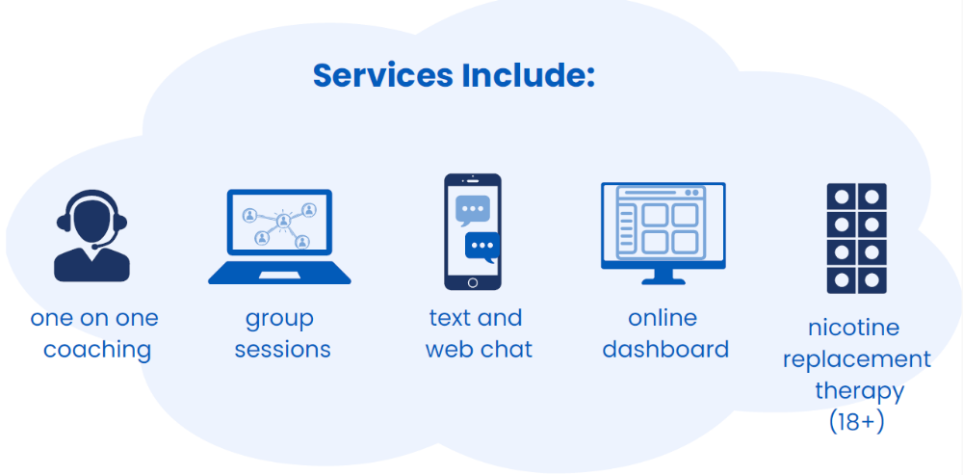
Services Include

Slide 22
Participant Profiles
76% - Enroll by Phone
80% - Ready to Quit
87% - Accept NRT
75% - Tobacco Only / 10.6% - Tobacco + eCigs / 11% - eCigs Only
57% - Standard Care / 38% - Behavioral Health / 2.6% - Pregnant/PP
30% - Hear About Quitline from a Health Professional
32.5% - Medicare / 20.5% - Medicaid / 22% - Uninsured / 21% - Private
74.4% - Age 45 or older
68.2% - White or Caucasian / 27.4% - Black or African American
58.3% - High School Degree or Less (GED, no HS degree)
59% - Chronic Health Condition ( COPD, Diabetes, Asthma, Cancer)
58.5% - Behavioral Health Condition (Mental Health, Illicit Drugs, Alcohol)

Slide 23
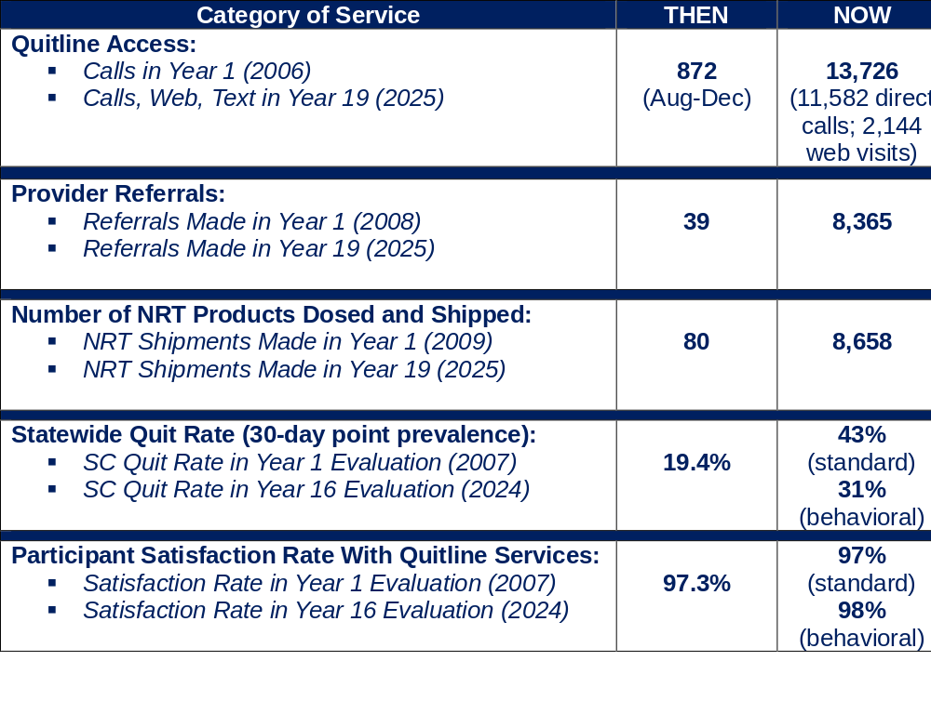
Snapshot Successes

Slide 24
Interesting to Note
NAQC’s benchmark for state Quitline Quit Rates is 30%. SC’s quit rates have remained at a consistent high of 40-43% over the past five years.
SC even does quite well with a Quit Rate of 37.7% for ENDS users.
Until we offered support for electronic referrals in 2020 with our Tobacco eReferral Hub, fax referring was all we could offer providers. As of March 2026, referrals from providers are: 38% fax – 60.5% EHR – and 1.5% online. We are slowly succeeding at converting from fax to eReferring to the Quitline.
While the push is on to covert more services to a digital platform, our Jan-Mar 2026 data show that out of 6,596 participant interactions with the Quitline – 53.5% utilized digital tools and 84.4% interacted live with a coach. Trend data over the past year has shown that between 85%-90% of our participants still prefer to speak with a live coach and phoning the Quitline is still the preferred method.

Slide 25

OUR FUTURE
Mobile apps with A.I. support – maybe even tele-counseling one day

Slide 26
On the Horizon
2026 and beyond – If we can harness the good of Artificial Intelligence and securely protect ourselves from the bad, then we will see more of an A.I. presence to help enhance quit services across our state.
Shift in Products – Users of oral nicotine pouches (ZYN, Velo, On!) and other ever-emerging nicotine products will be better served along with combustible tobacco and vape users.
HOPE – A.I. “agents” added to help give more adaptive support and quick answers with tons of guardrails put in place. This interactive text messaging service will help free up live coaches so they can concentrate on delivering direct counseling support. Currently in the development pipeline.

Slide 27
On the Horizon
Quit for Life app – Geared for users who prefer services on their smart phones or watches. Already approved and in production line for release in the fall. Can download on Apple, Google, Samsung, and Android devices.
Live Vape Free™ – Currently offer LVF-Youth (ages 13-17) and LVF-Young Adults (ages 18-26). More background quality improvements are being considered to enhance the platform experience for these younger participants.
Omniboarding – Again, background upgrades are being considered to improve enrollment “flow” in how we process intake and registration; and to get more participants on board with evaluation follow-up.

Slide 28
On the Horizon
Pregnancy & Postpartum incentives – Picking up where our Baby and Me Tobacco Free program left off when we lost that program due to funding losses.
  Plan to offer voucher incentives through our Quitline vendor to participants who are pregnant or have recently delivered a baby.
  Diapers and baby wipes for a year post-delivery.
  Must stay engaged with their coach to receive incentives.
  Not yet figured out how to validate their tobacco-free status – but working on it.

Slide 29

Wish List…
TeleQuitSupport – Offering a counseling platform that mirrors telehealth appointments where eligible providers can deliver real-time and live counseling quit support to patients and participants backed up by the Quitline’s free tools and NRT. Potential is real for licensed medical and behavioral health providers to bill and reimburse for these telehealth services.

Slide 30
Wish List…
Medication Expansion – Continuing to offer free NRT patch, gum, and lozenge, but expanding our Quitline “formulary” to dose for varenicline and (hopefully, when FDA-approved) cytisinicline – with doctor’s authorized Rx.
Cytisinicline is an investigational plant-based alkaloid designed to treat nicotine dependence by acting as a partial agonist that attaches to the brain's nicotinic receptors. It helps individuals quit smoking and vaping by reducing nicotine cravings, withdrawal symptoms, and the rewarding effects of nicotine. Works like varenicline, but studies have validated it as more successful with fewer side effects.

Slide 31

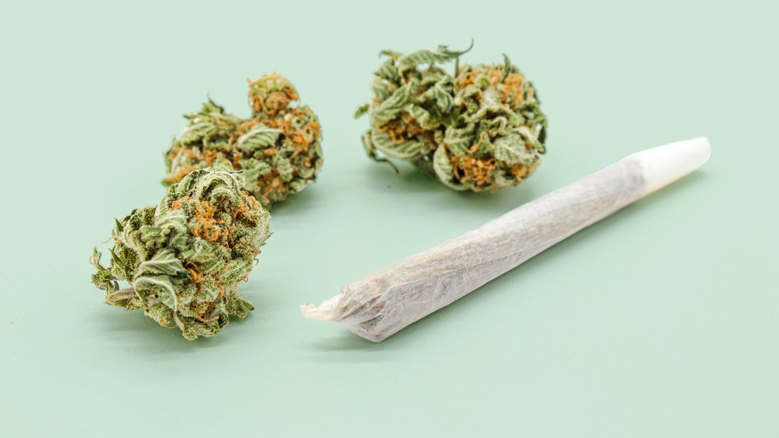
Wish List…
Cannabis Users – Hopefully, we will reach the time when we can offer services and promote the Quitline to marijuana users.
Same issues – different addictive drug. Because this problem is only going to grow stronger and get more out of hand from both policy and health perspectives, much like vaping has done.

Slide 32
Wish List Disclaimer
The previous three slides are Katy’s “wish list” and are not necessarily in our vendor’s or anyone’s pipeline.
Just forecasting three unique features that, if added to our Quitline’s services, could be game-changers for how well we succeed in nicotine cessation across our state.

Slide 33
Getting in Touch
Katy L. Wynne, Ed.D., MSW
SC DPH – Tobacco Program
wynnekl@dph.sc.gov
803-898-2285
LEARN MORE ABOUT OUR QUITLINE:
https://www.quitnowsc.org/

Slide 34
References
VanFrank B, Malarcher A, Cornelius ME, Schecter A, Jamal A, Tynan M. Adult Smoking Cessation — United States, 2022. MMWR Morb Mortal Wkly Rep 2024;73:633–641. DOI: http://dx.doi.org/10.15585/mmwr.mm7329a1
US Department of Health and Human Services. Smoking cessation: a report of the Surgeon General. Rockville, MD: US Department of Health and Human Services; 2020. https://www.hhs.gov/sites/default/files/2020-cessation-sgr-full-report.pdf
U.S. Department of Health and Human Services. The Health Consequences of Smoking—50 Years of Progress. A Report of the Surgeon General. Atlanta: U.S. Department of Health and Human Services, Centers for Disease Control and Prevention, National Center for Chronic Disease Prevention and Health Promotion, Office on Smoking and Health, 2014.
Centers for Disease Control and Prevention. QuickStats: Number of Deaths from 10 Leading Causes—National Vital Statistics System, United States, 2010. Morbidity and Mortality Weekly Report 2013: 62(08);155.
SC Department of Public Health. Tobacco Quitline Monthly Reports: State Dashboards, State Referrals, State Telecom, State Quitline Services, unpublished.

Slide 35

Thank you!
ANY
QUESTIONS?

