Slide 1


BUILDING A TOBACCO-FREE FUTURE:
INNOVATION, PARTNERSHIPS, & PREVENTION IN YORK COUNTY

Slide 2


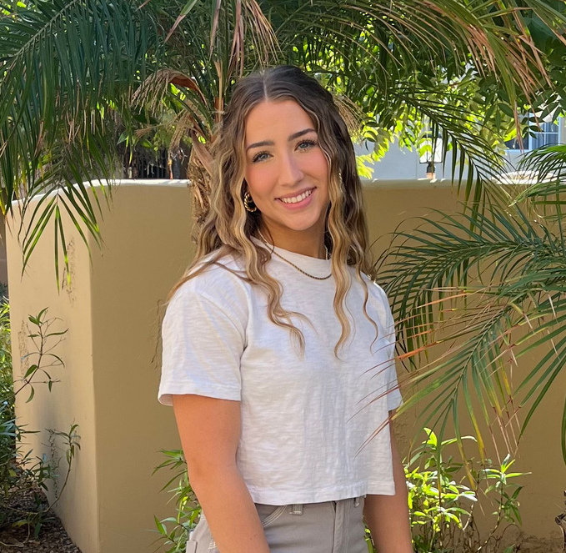

WHO WE ARE
DR. DAVID KEELY
JASMINE WILLIAMS
ABIGAIL TRULY
Alexandria Newberry, LMSW
TFYCC Chair
Marketing Manager
Marketing & Outreach Intern
Community Education Specialist and Impact Analyst

Slide 3
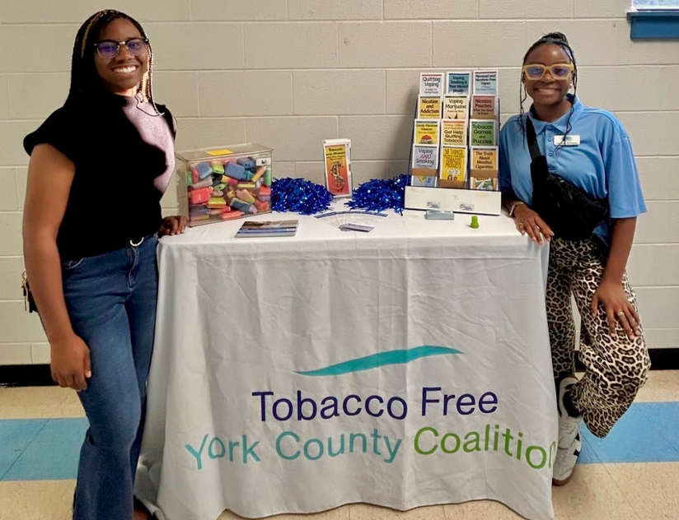
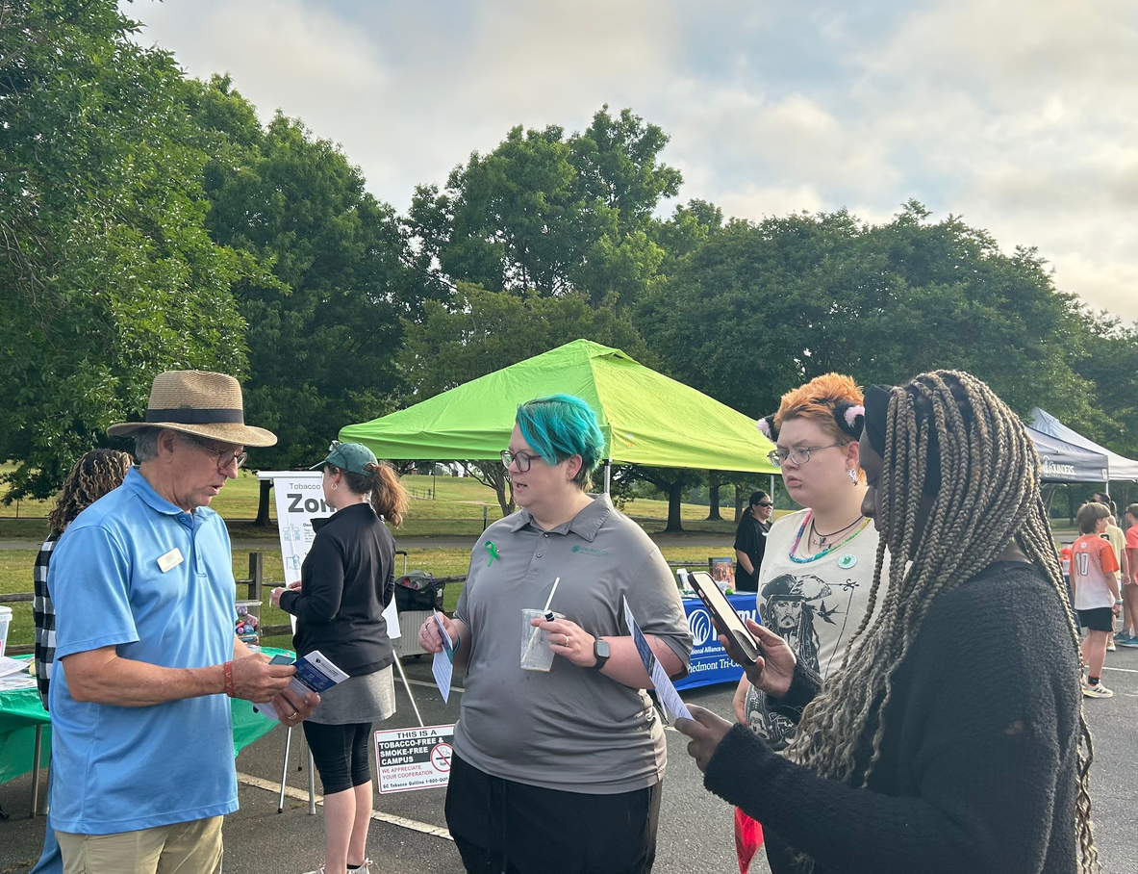

WHAT WE DO
The Tobacco Free York County Coalition, or TFYCC, is very active pushing back against commercial tobacco product marketing (including vapes and nicotine pouches) that is clearly targeting youth and young adults (under age 26 years old). TFYCC also helps promote the free South Carolina Tobacco Quitline resources for ages 13 years old and up, both via telephone and text message formats, at all of its community education events and online.
ADVOCATE
PROMOTE
EDUCATE
AID LOCAL BUSINESSES, ELECTED OFFICIALS, SCHOOLS, AND COMMUNITY LEADERS IN THE DEVELOPMENT OF TOBACCO-FREE POLICIES
PROMPROMOTE TOBACCO, FREE EVENTS AND ENVIRONMENTS THROUGHOUT THE COUNTY BY UTILIZING MEDIA TO ADVANCE TTOBACCO, FREE INITIATIVES
PROVIDE TOBACCO-RELATED EDUCATIONAL OPPORTUNITIES TO THE COMMUNITY THROUGH DIGITAL EFFORTS, AS WELL AS COMMUNITY INVOLVEMENT

Slide 4

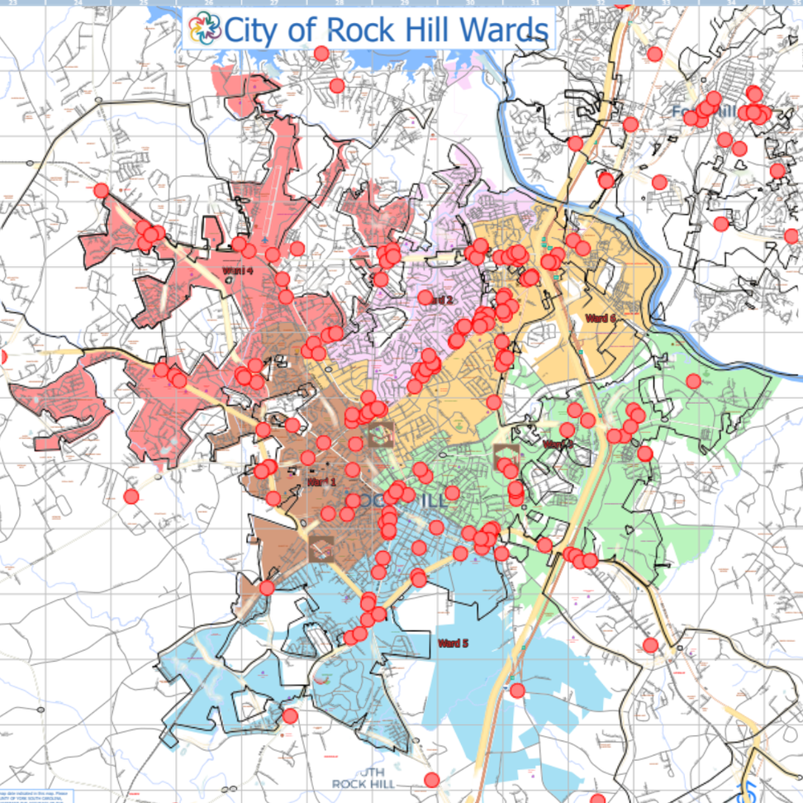
POLICY & ZONING ORDINANCE WORK
ADVOCATE
WHY
By strengthening and enforcing zoning laws that restrict where tobacco and vape retailers can operate, communities can take a proactive step toward overall health and tobacco-free living.
HOW
A series of meetings with locally elected officials.
WHAT WE ADVOCATE FOR IN ZONING ORDINANCES
  Buffer zones around schools and parks: Prohibit new tobacco and vape shops within a certain distance of schools, playgrounds, or youth centers.
  Caps on the number of tobacco retailers: Limit how many tobacco-selling businesses can operate within a given area.
  Restrictions on signage and advertising: This would limit how and where tobacco products can be marketed, especially near youth-dense locations.
.

Slide 5
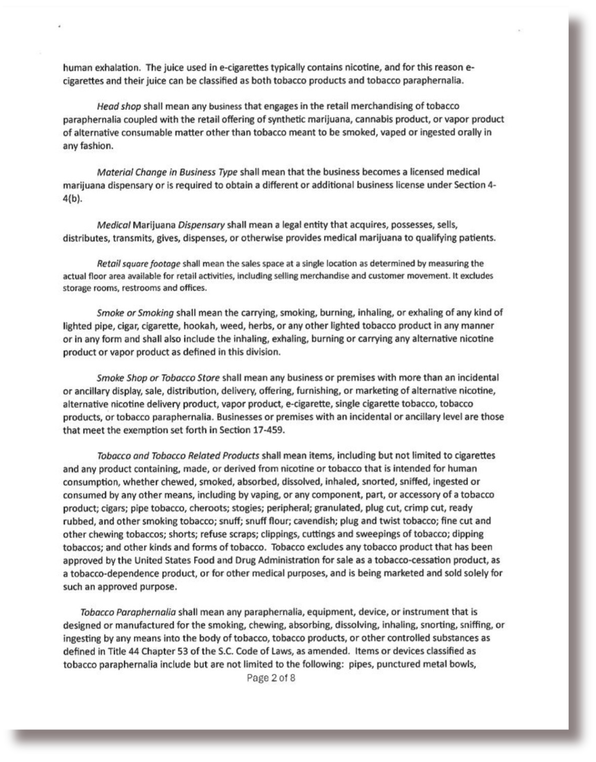
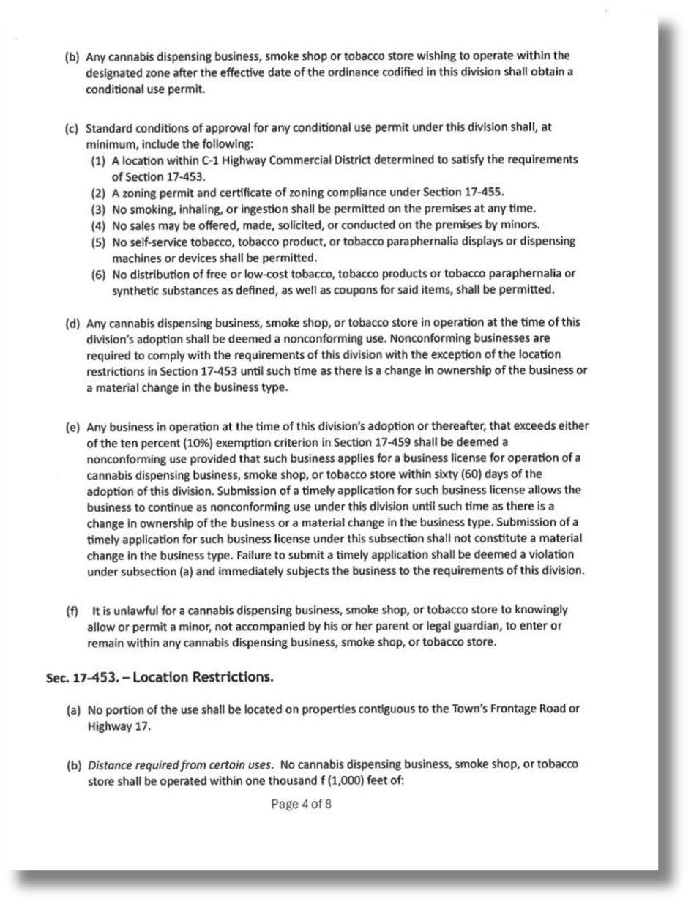

Slide 6
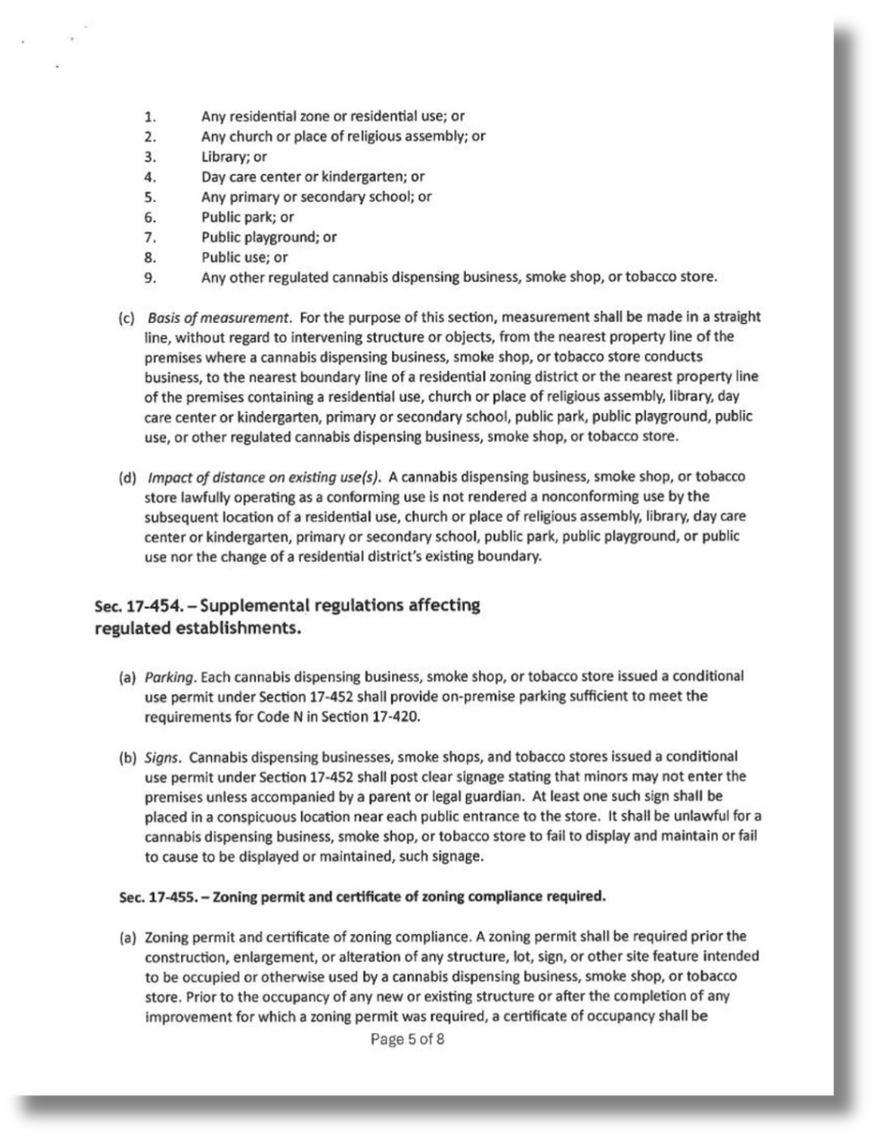
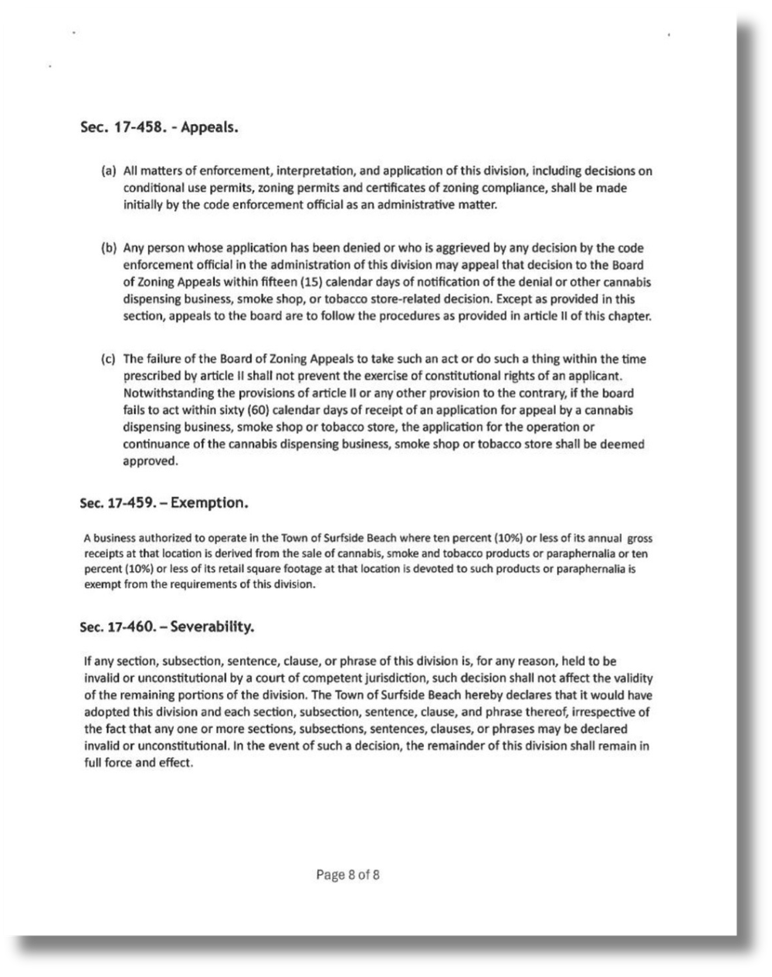

Slide 7

BUILDING COMMUNITY BUY-IN THROUGH MEDIA CAMPAIGNS
PROMOTE

Slide 8
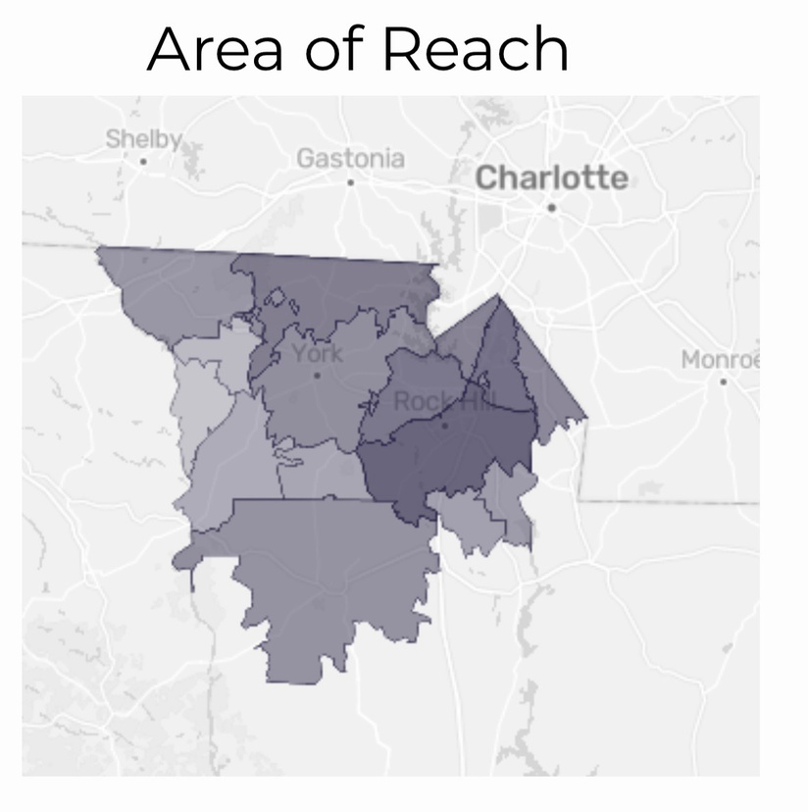

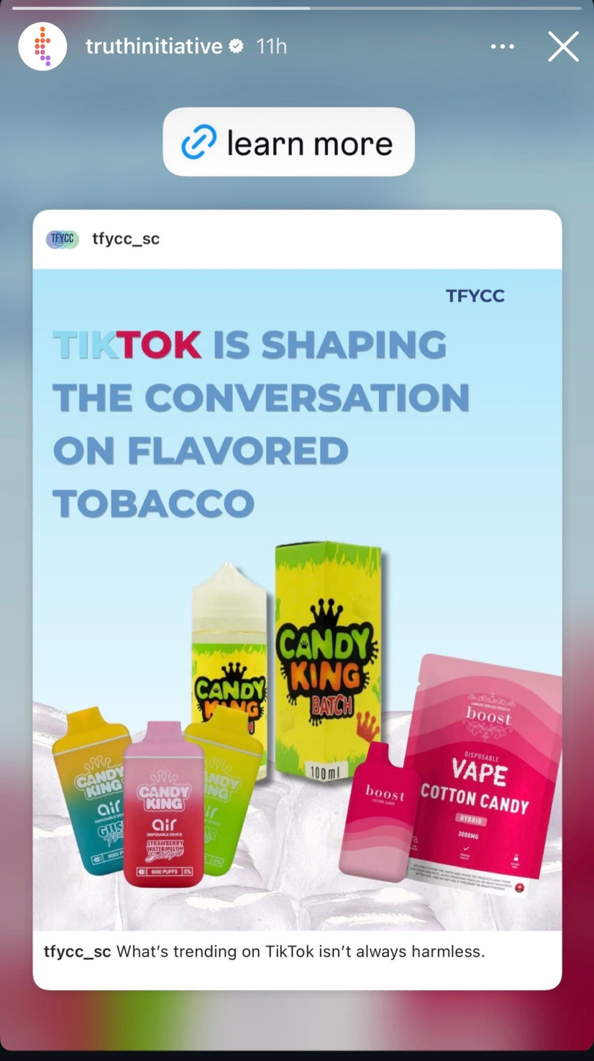

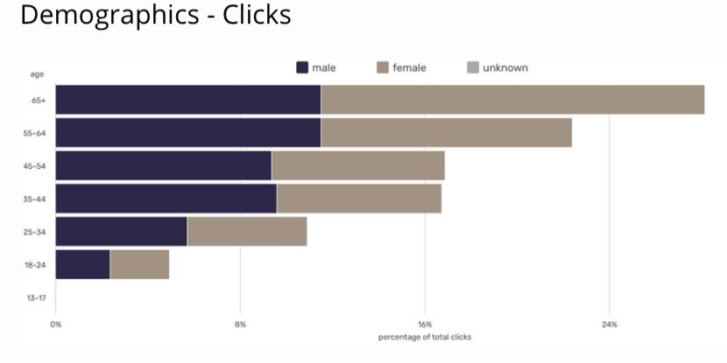
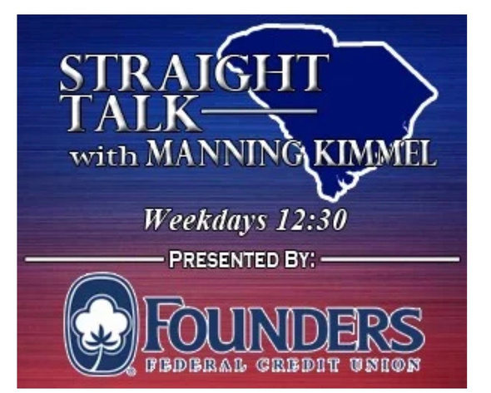
PROMOTE

Slide 9
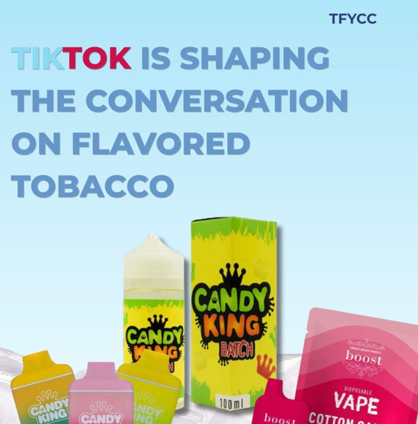
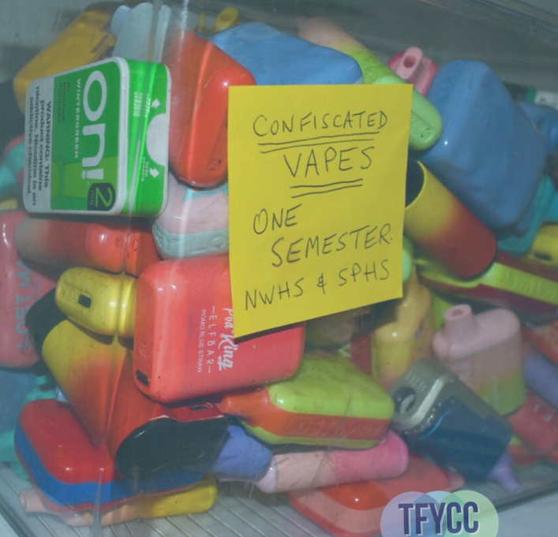
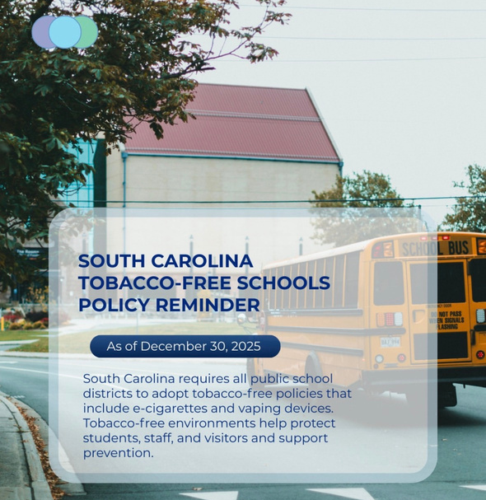
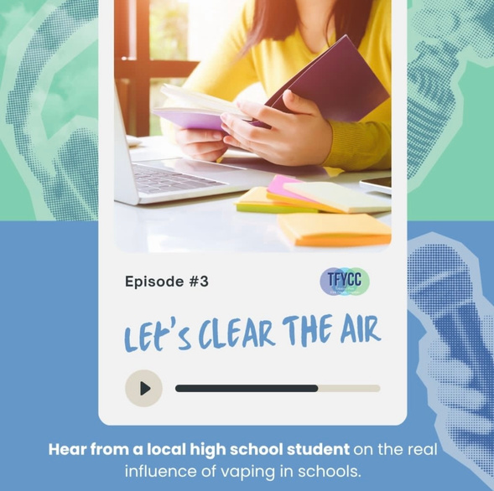
TRENDS & SOCIAL MEDIA
PROMOTE
  Over 70% of middle and high school students report seeing tobacco ads online
  Youth exposed to social media vape marketing are 3x more likely to try vaping
  Visual/social appeal lowers risk perception and normalizes use
  Youth-oriented design: bright colors, pop culture references, meme content
  Influencer marketing via “vape ambassadors” on Instagram, YouTube, and TikTok
WHAT WE SHARE
  Policy Updates
  Events/posts from other agencies
  Local Outreach efforts
  Trends/Things to look out for
  Blog/ Podcast updates

Slide 10
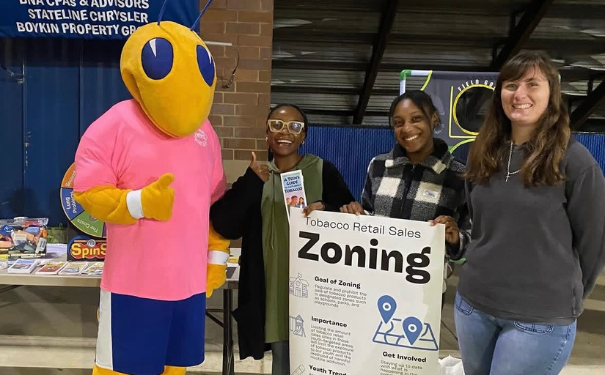
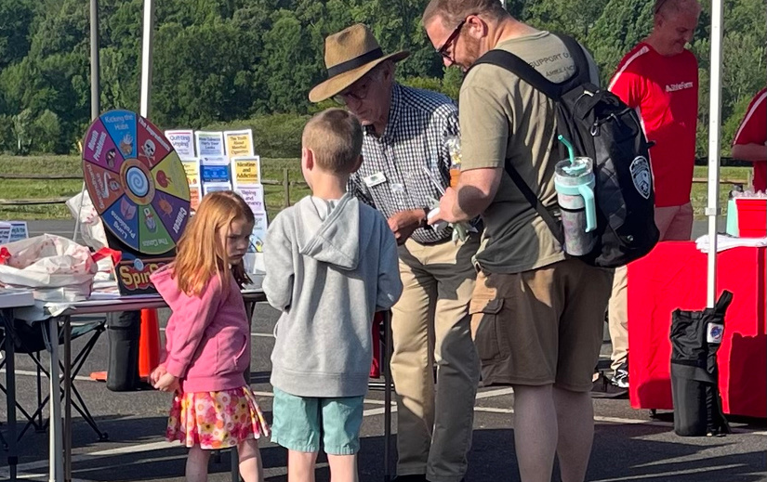
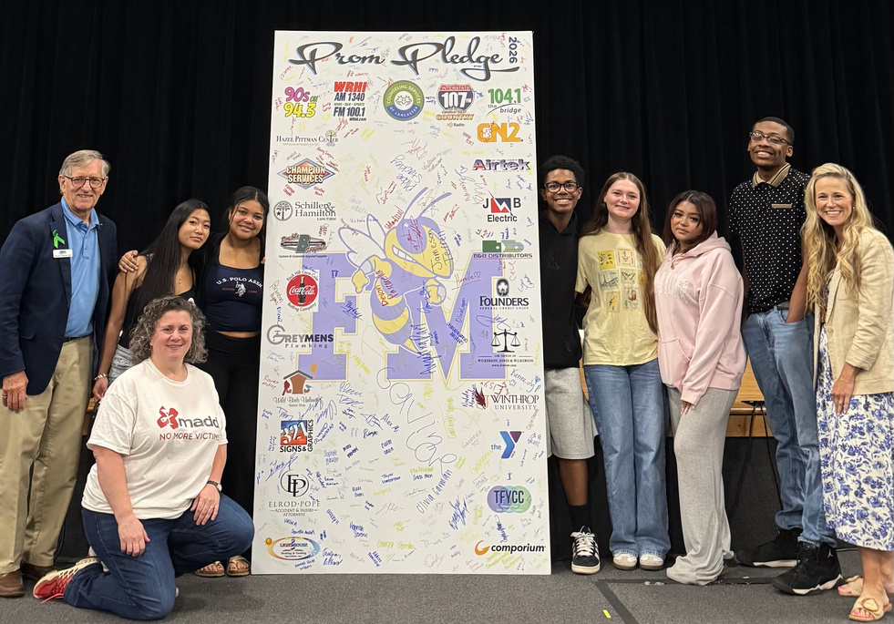
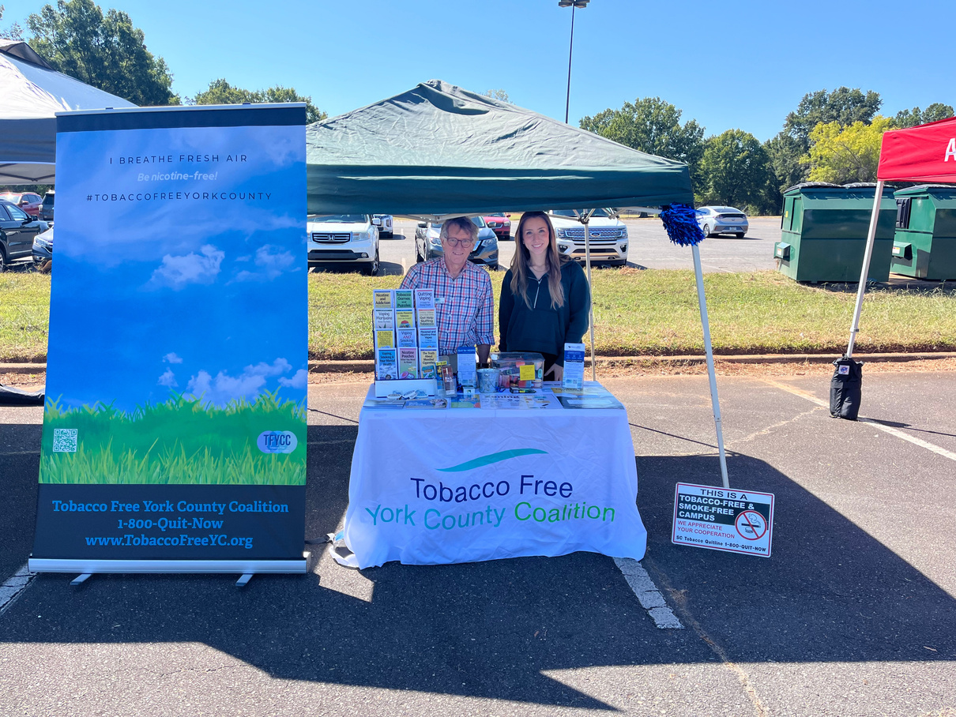





COMMUNITY PARTNERS
EDUCATE
  All YOUth On Board: youth-led coalition within York County
    Northwestern High School
    Rock Hill High School
    Clover High School
    Fort Mill High School
    Nation Ford High School
    South Pointe High School
    York High School
    Castle Heights Middle School
    Saluda Trail Middle School
    Sullivan Middle School
    Dutchman Creek Middle School
    Rawlinson Road Middle School
    Oakridge Middle School
    Clover Middle School
    York Intermediate
    York Middle School
    Gold Hill Middle School
    Banks Trail Middle School
    Springfield Middle School
    Pleasant Knoll Middle School
    Walnut Grove Middle School
  Keystone
  Catwaba Area Coalition for the Homeless
  York County First Steps
  NAMI
  YMCA
  Straight Talk w/ Manning Kimmel

Slide 11
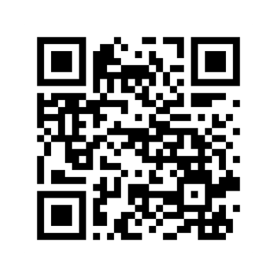
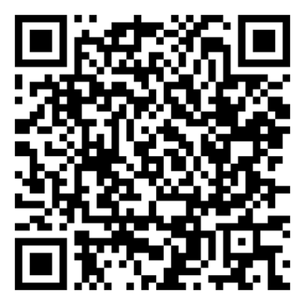
STAY IN TOUCH!
Website,
Blogs, and Podcast!
Socials
https://www.tobaccofreeyc.org
TobaccoFreeYC@comporium.net

