Slide 1

Down, But Not Out:
Staying Resilient In Times of Uncertainty
Meg Riordan, MPH / Vice President, US Research, Campaign for Tobacco-Free Kids

Slide 3

Our Journey
Where We’ve Been
Where We Are
Where We’re Going

Slide 4

Where We Are
Tobacco Use Rates

Slide 5
National Adult Smoking Trends
1965-2024
Source: National Health Interview Survey

Slide 6

Disparities in Adult Tobacco Use
2024
Low
Medicaid
Source: 2024 National Health Interview Survey; severe depression data from 2022.

Slide 7
Adult Tobacco Product Use
South Carolina, 2024
Source: 2024 Behavioral Risk Factor Surveillance System

Slide 8
High School Tobacco Product Use
United States, 2011-2025
7.1%
E-Cigarette
1.8%
2.3%
Nicotine Pouches
1.8%
Cigarette
1.2%
Cigar
10%
1.8%
Smokeless
1.2%
5%
Hookah
0.8%
2011
0.6%
Heated Tobacco

Slide 9
Tobacco Product Use Among Young Adults
Recent Trends
U.S. Adults Aged 18-24 Years
U.S. Adults Aged 18-29 Years
1.8%
1.2%
1.8%
0.8%
0.6%
Source: National Health Interview Survey
Source: International Tobacco Control Youth Tobacco and Vaping Survey

Slide 10
High School Tobacco Product Use
South Carolina, 2015-2024
*
**
Source: South Carolina Youth Tobacco Survey
*Smokeless tobacco products include chewing tobacco, snuff, and dip; **Cigars includes little cigars and cigarillos

Slide 11
Where We Are
Product Landscape

Slide 12
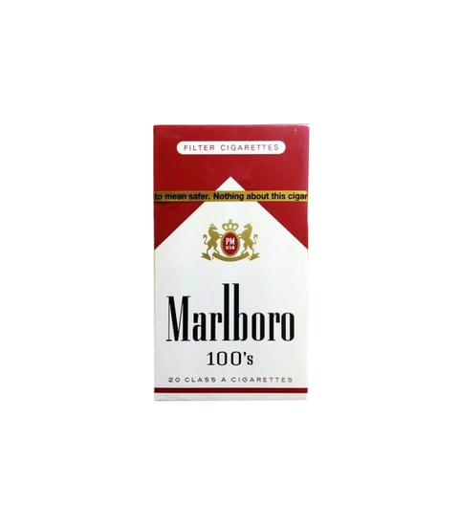
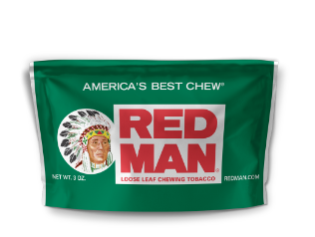
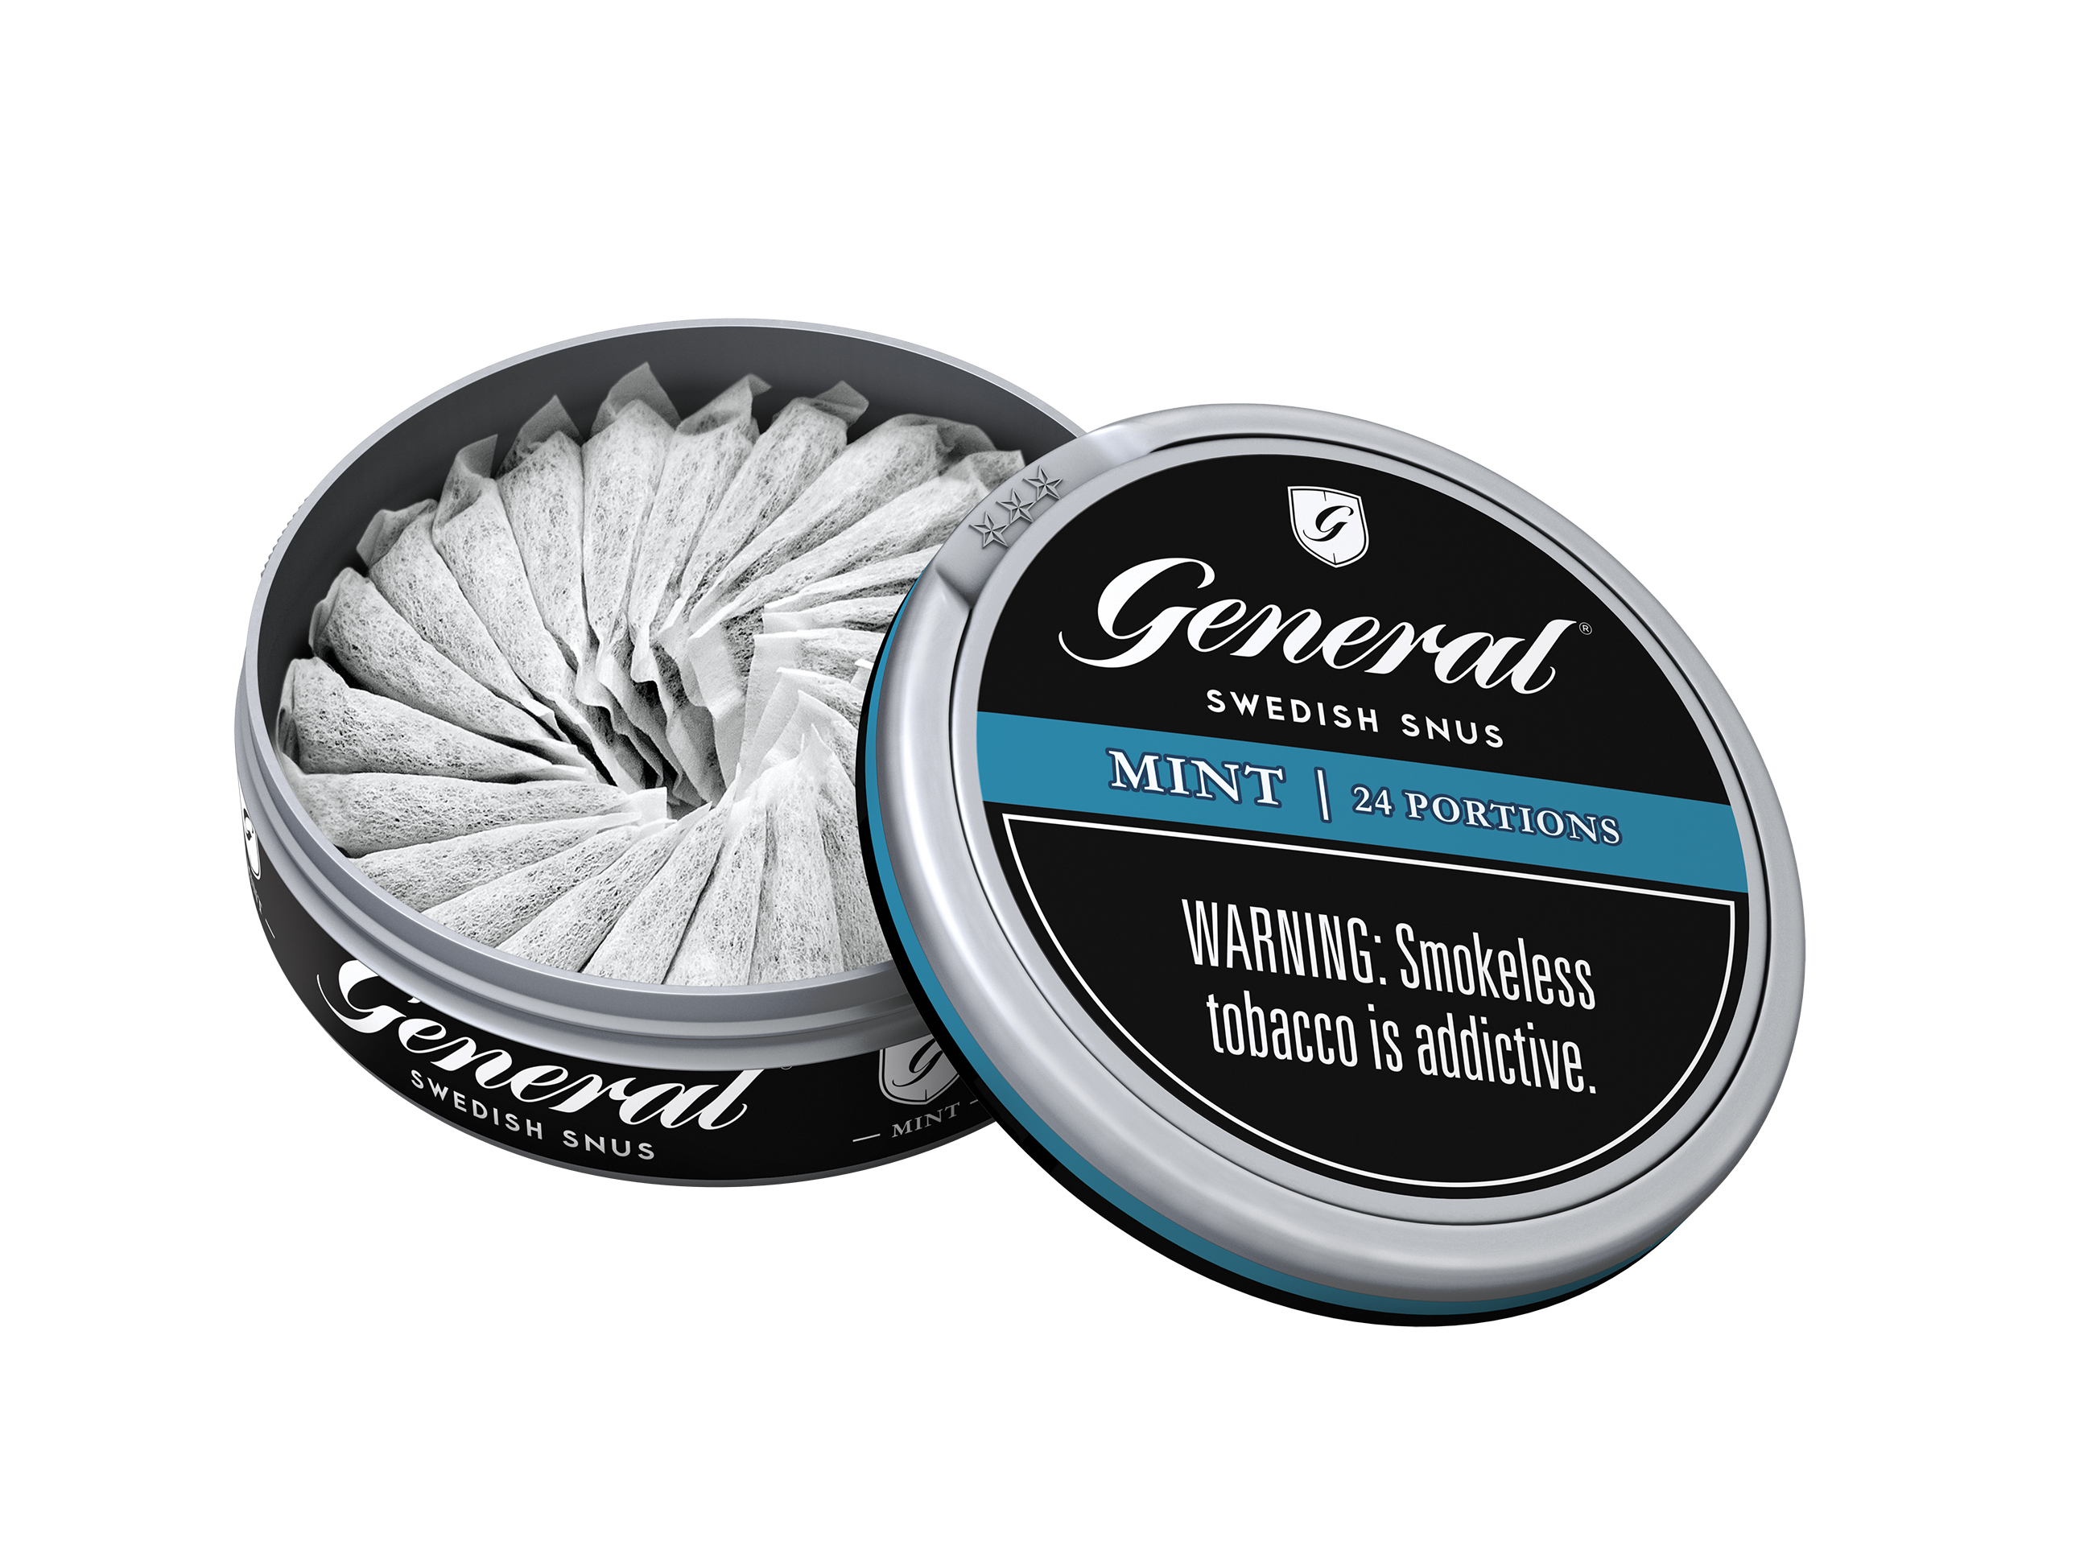
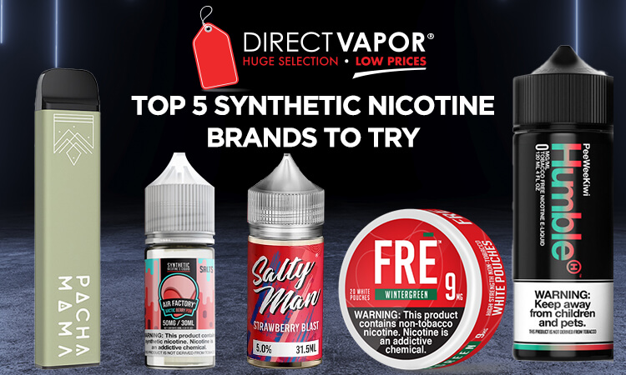
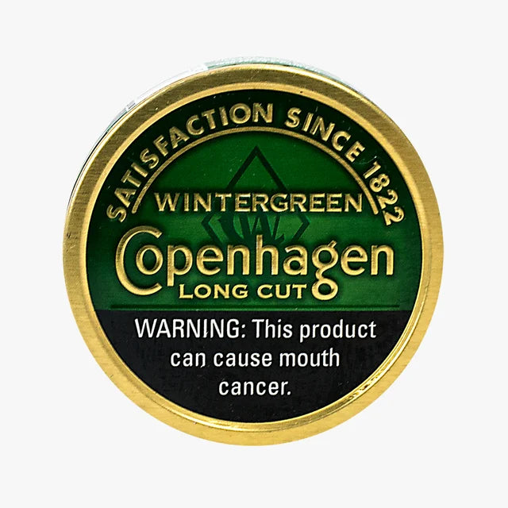
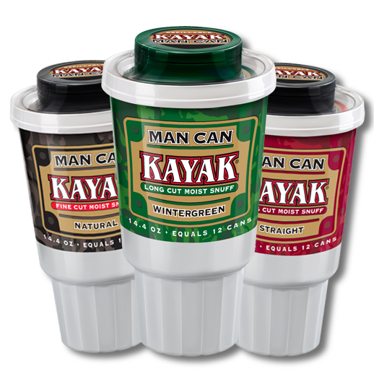
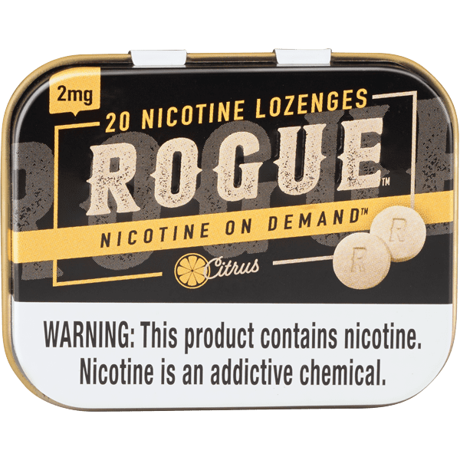
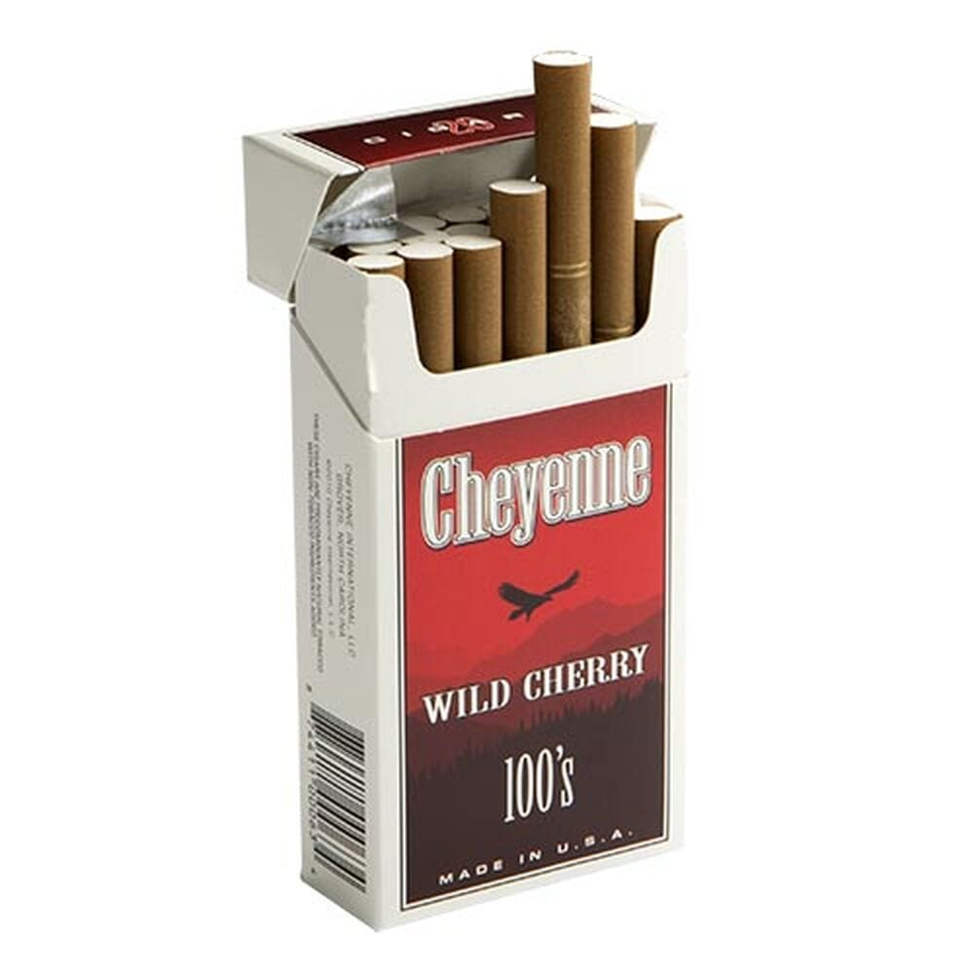
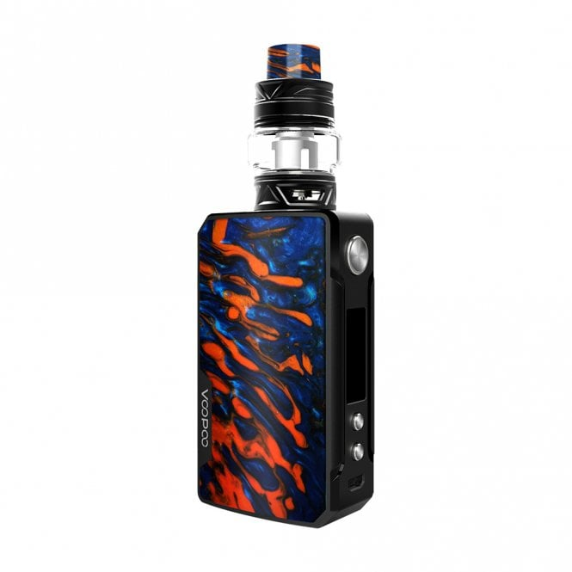
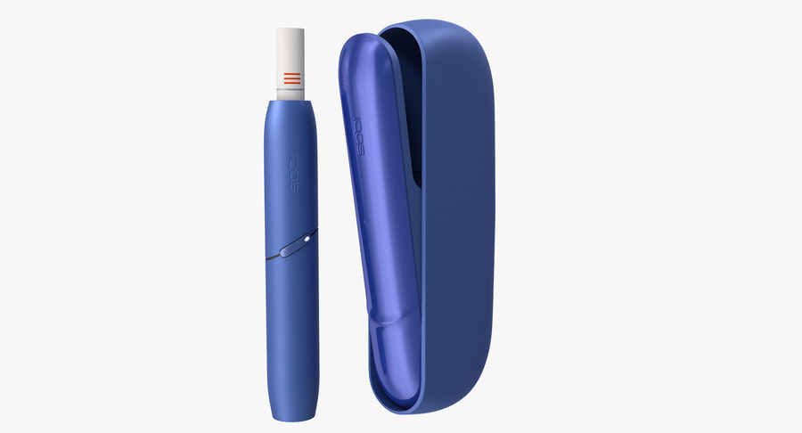
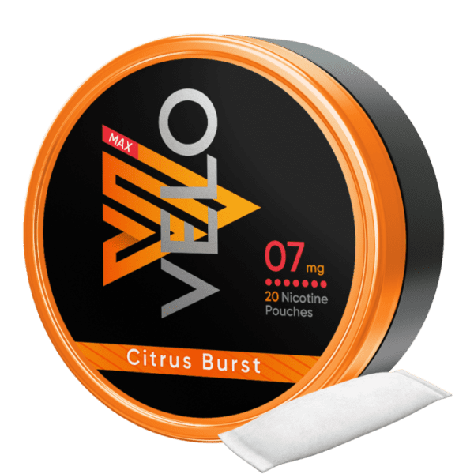
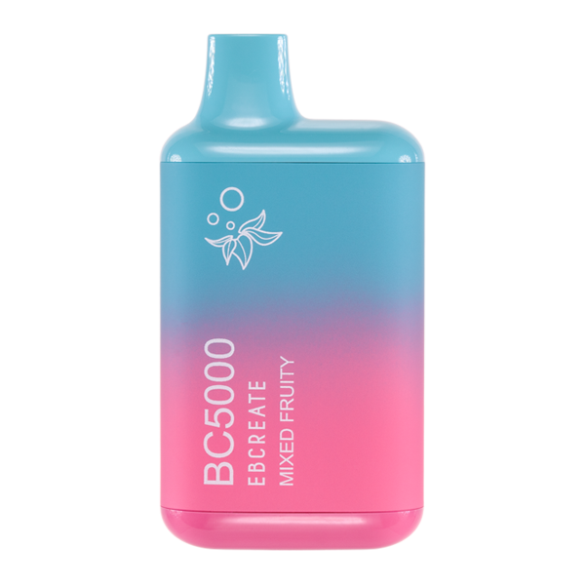
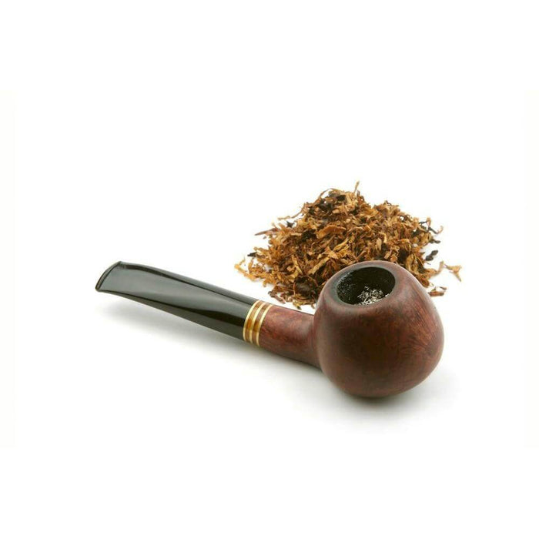
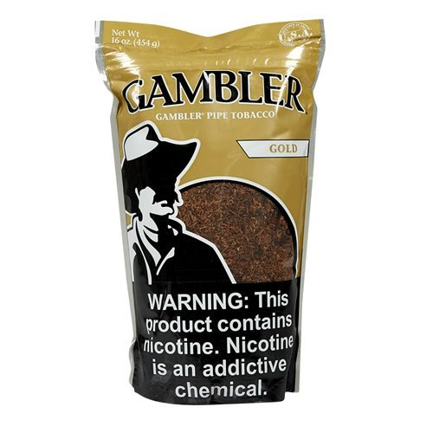
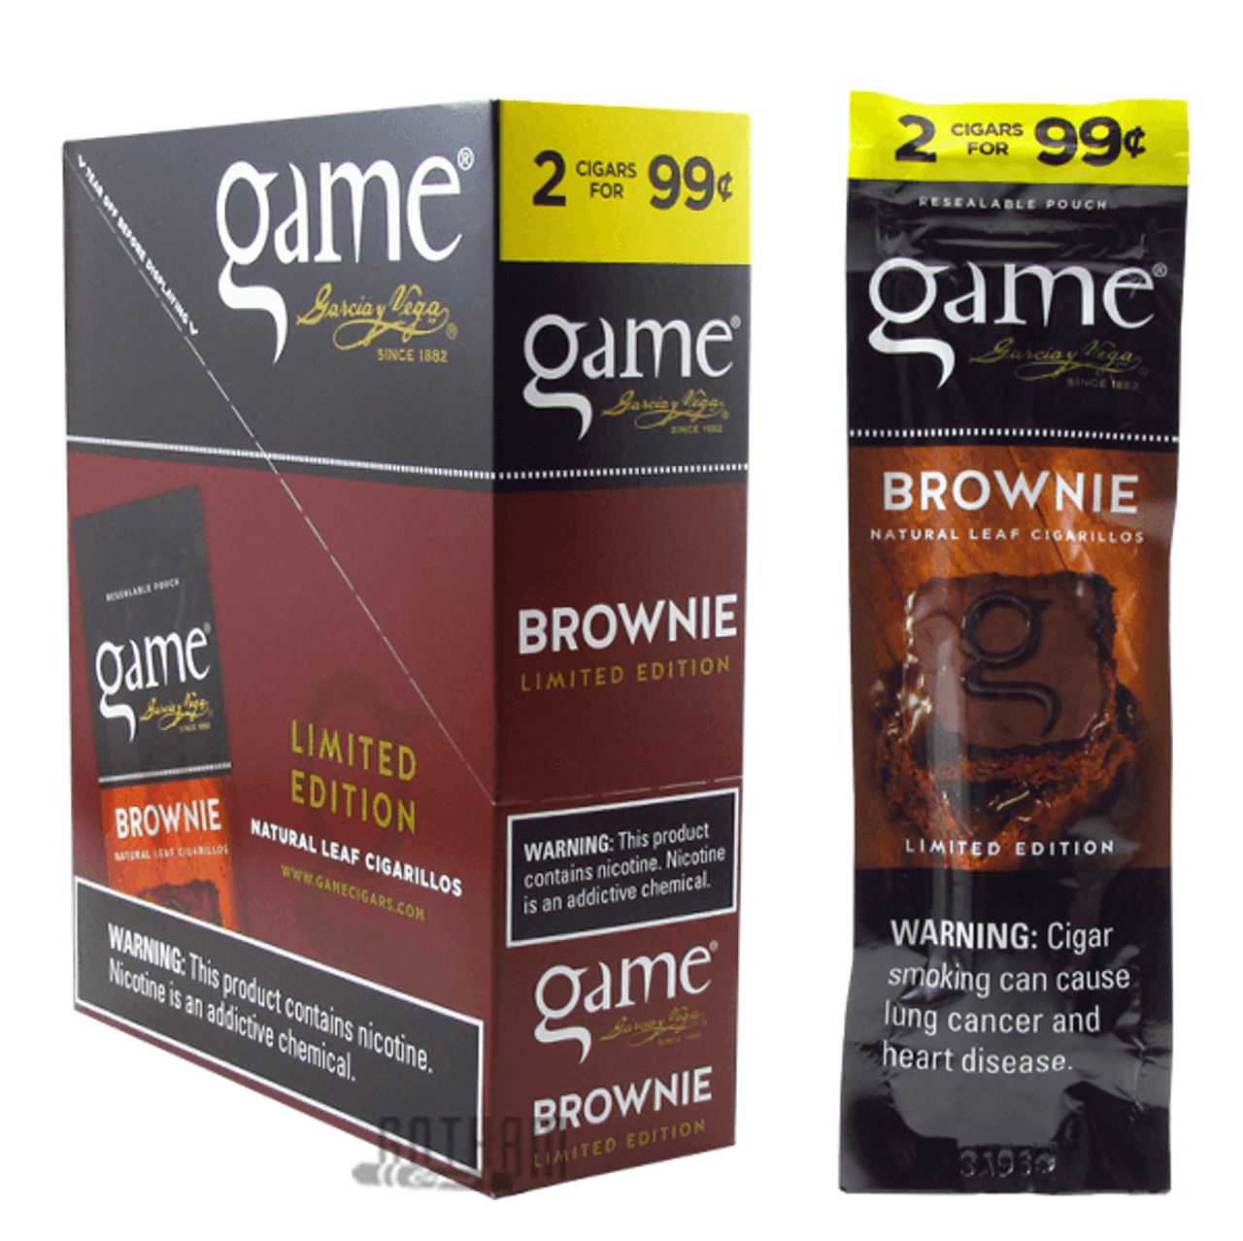
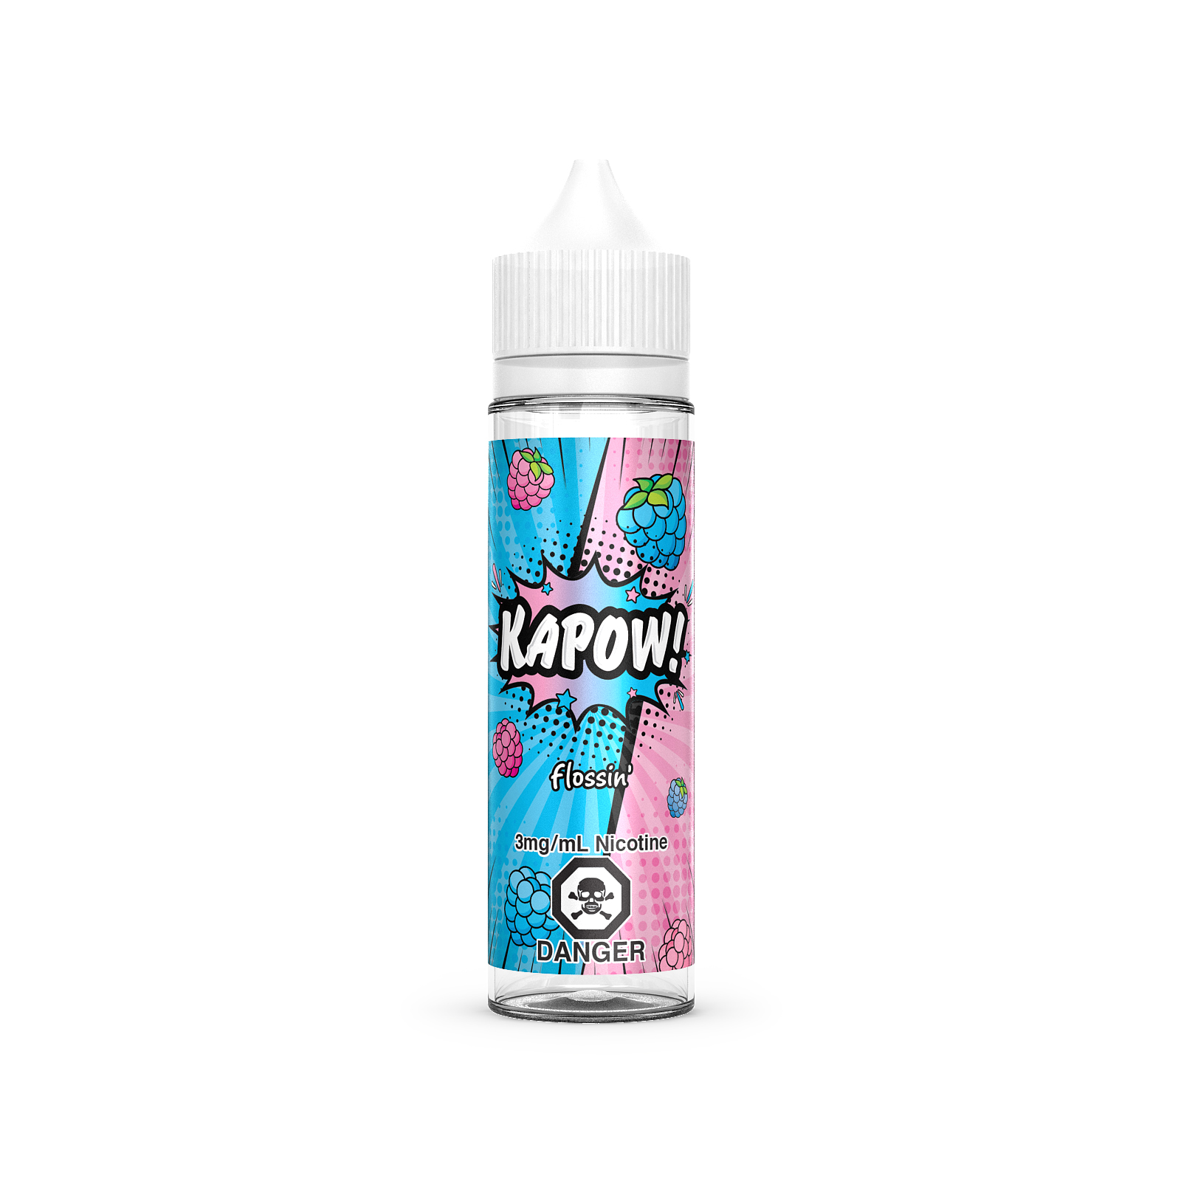
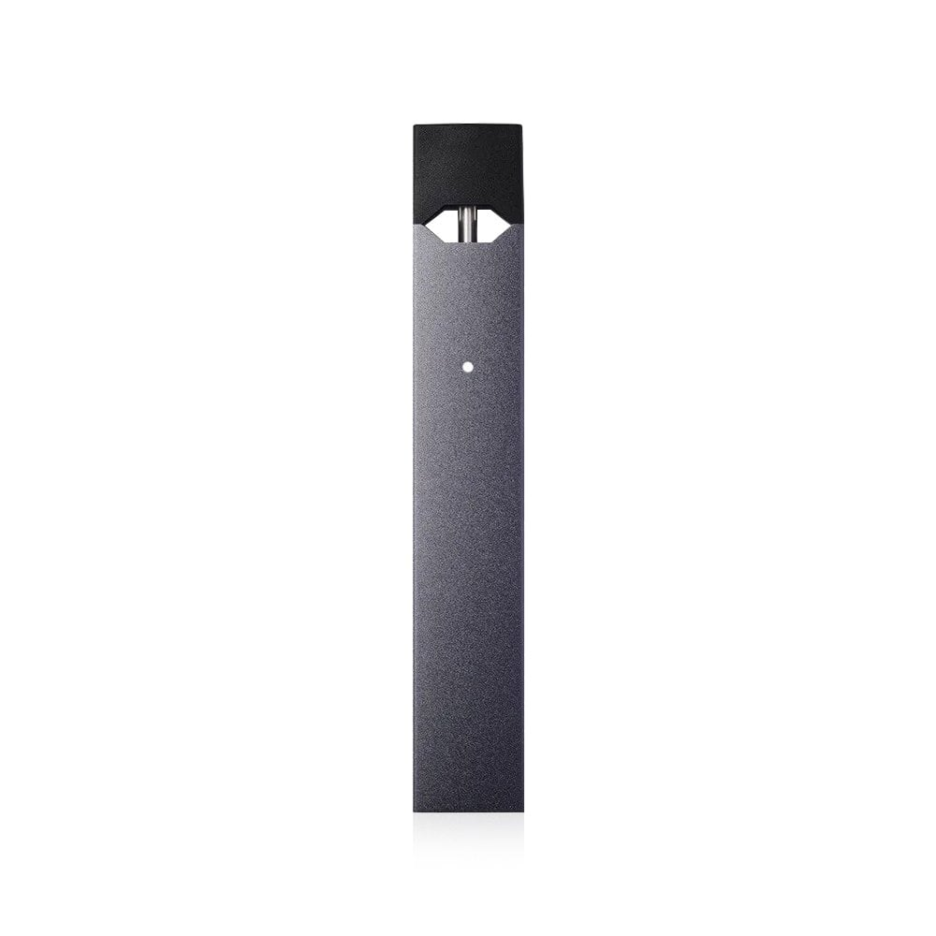
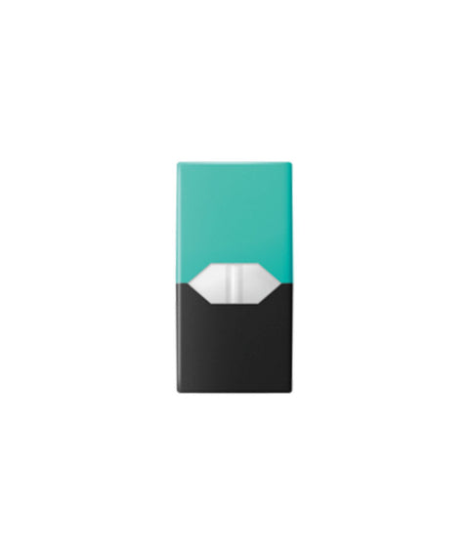
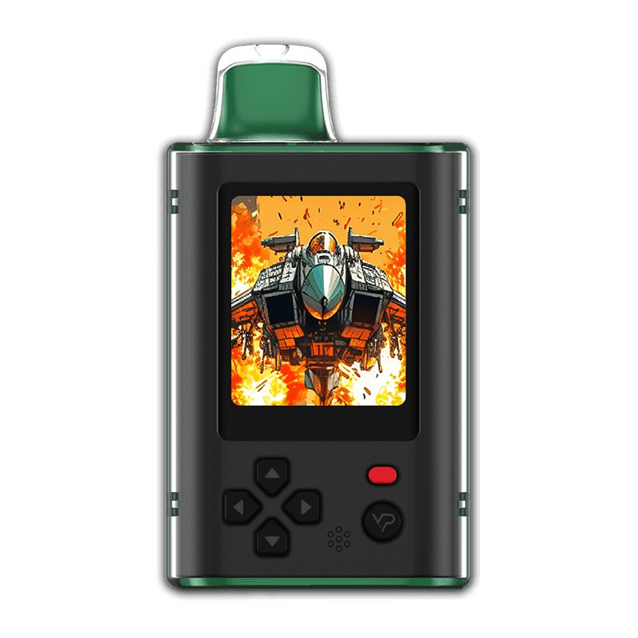
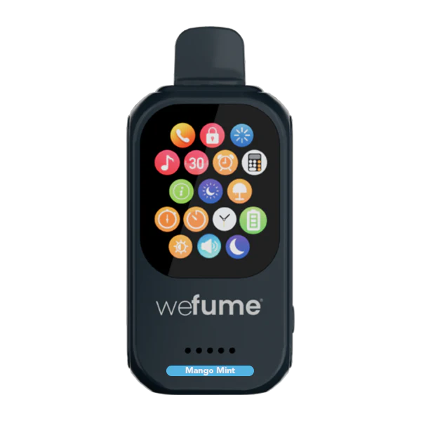
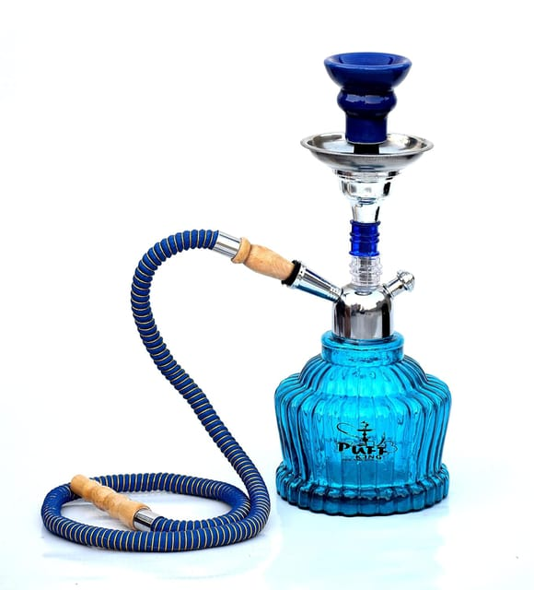
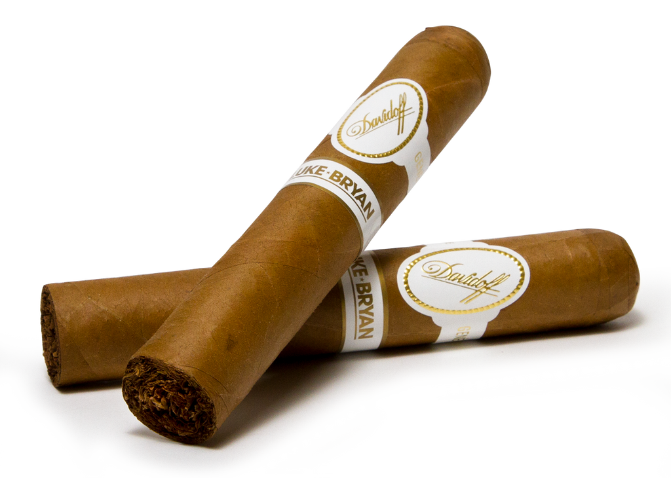
The Tobacco Landscape Has Expanded

Slide 13

The Rise of Nicotine Pouches

Slide 14
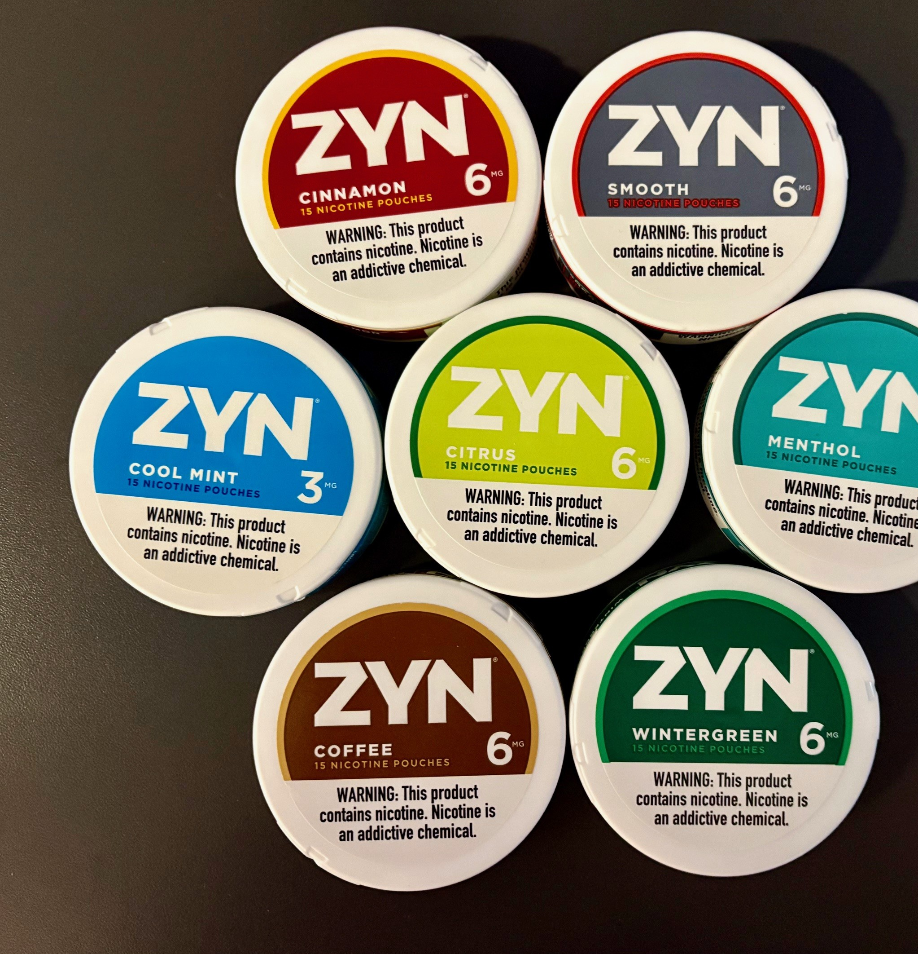
Concerns About Impact on Young People
Nicotine pouches are flavored and easy to conceal – two features that drove youth e-cigarette use to epidemic levels.
Can deliver similar levels of nicotine as cigarettes and smokeless tobacco
92% of HS pouch users use flavored versions
76% HS users use Zyn
The last thing we need is for another highly appealing and addictive tobacco product to be widely available and promoted to young people.

Slide 15
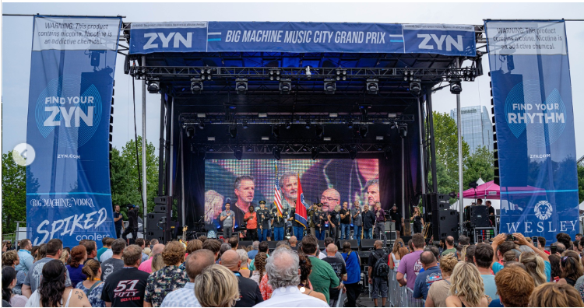
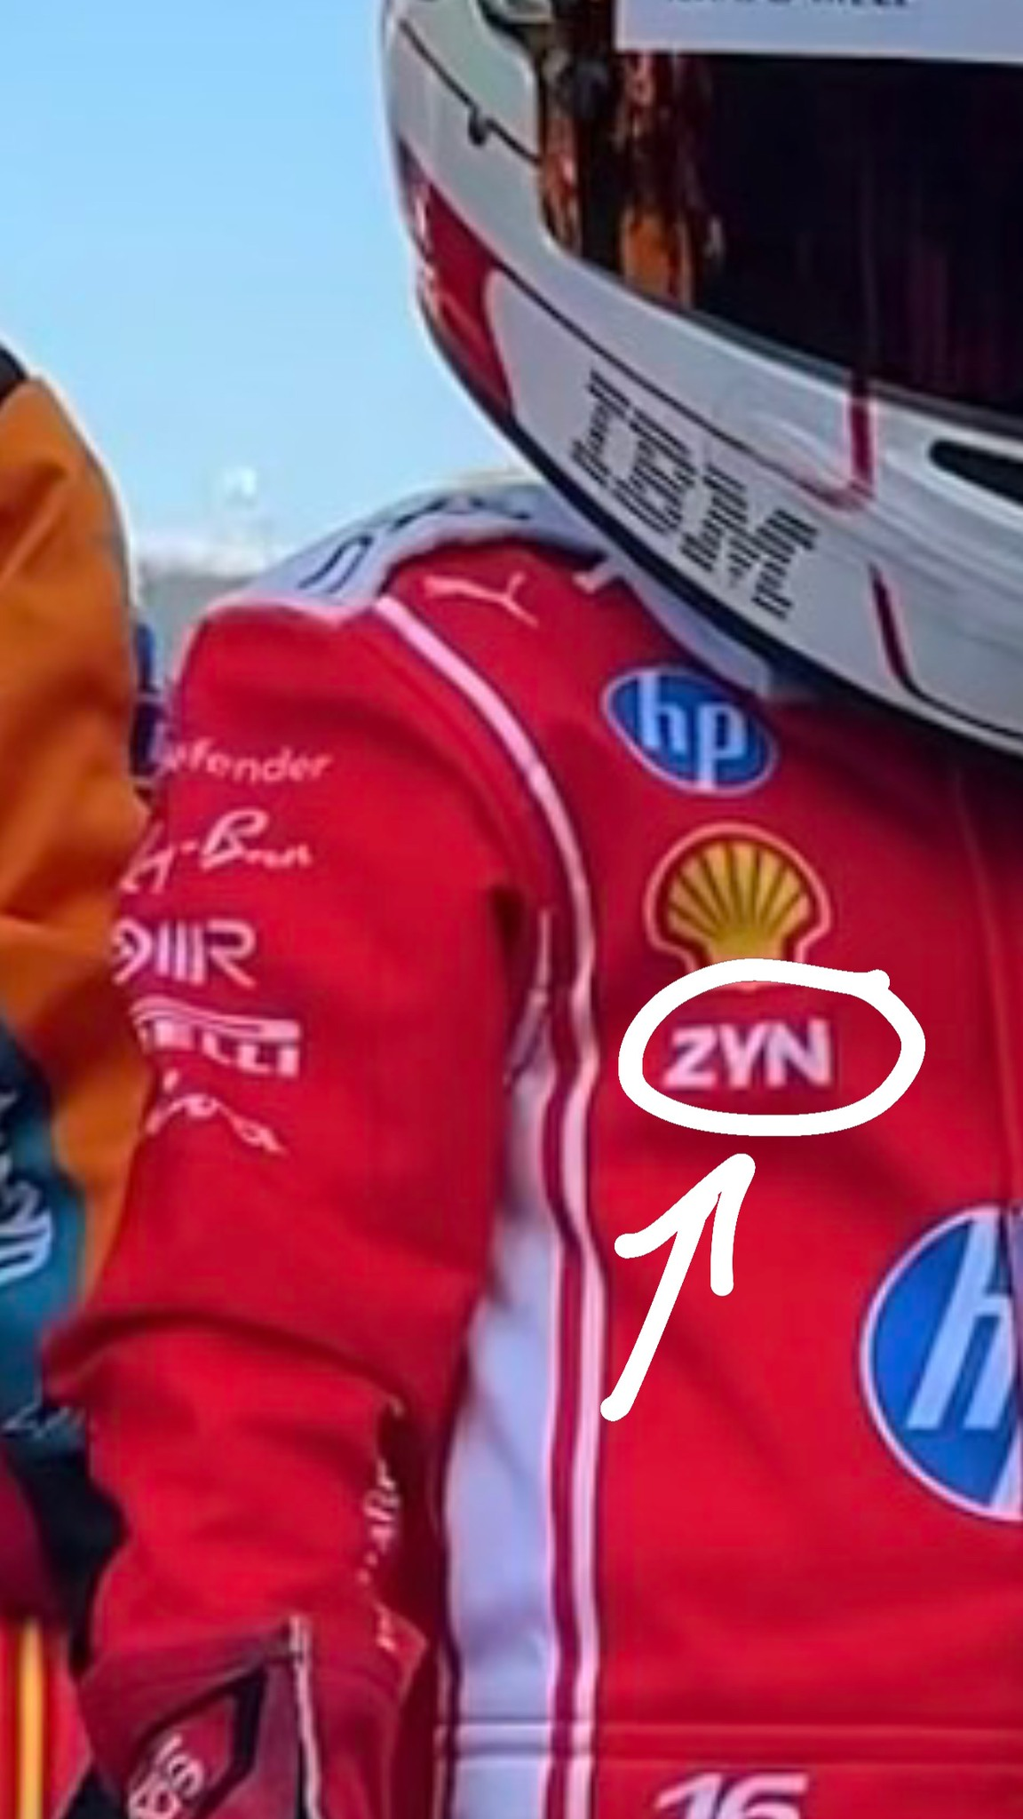
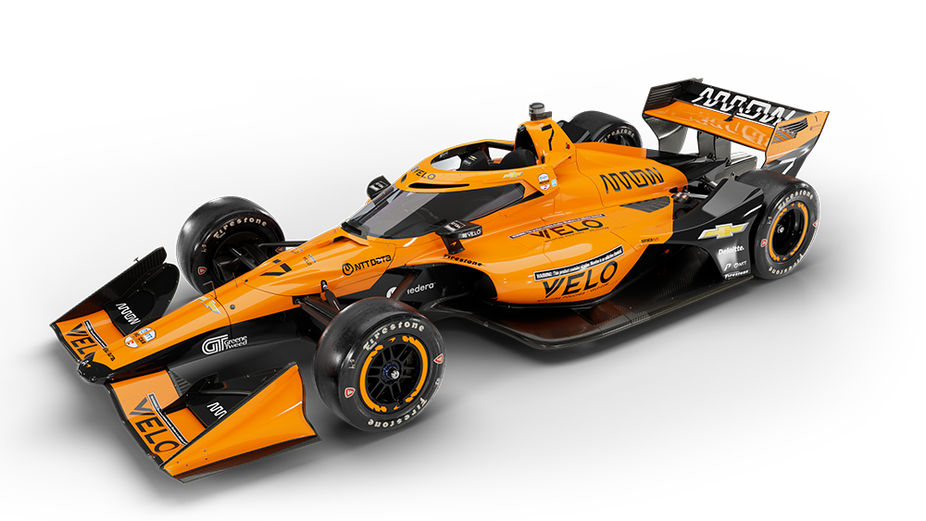
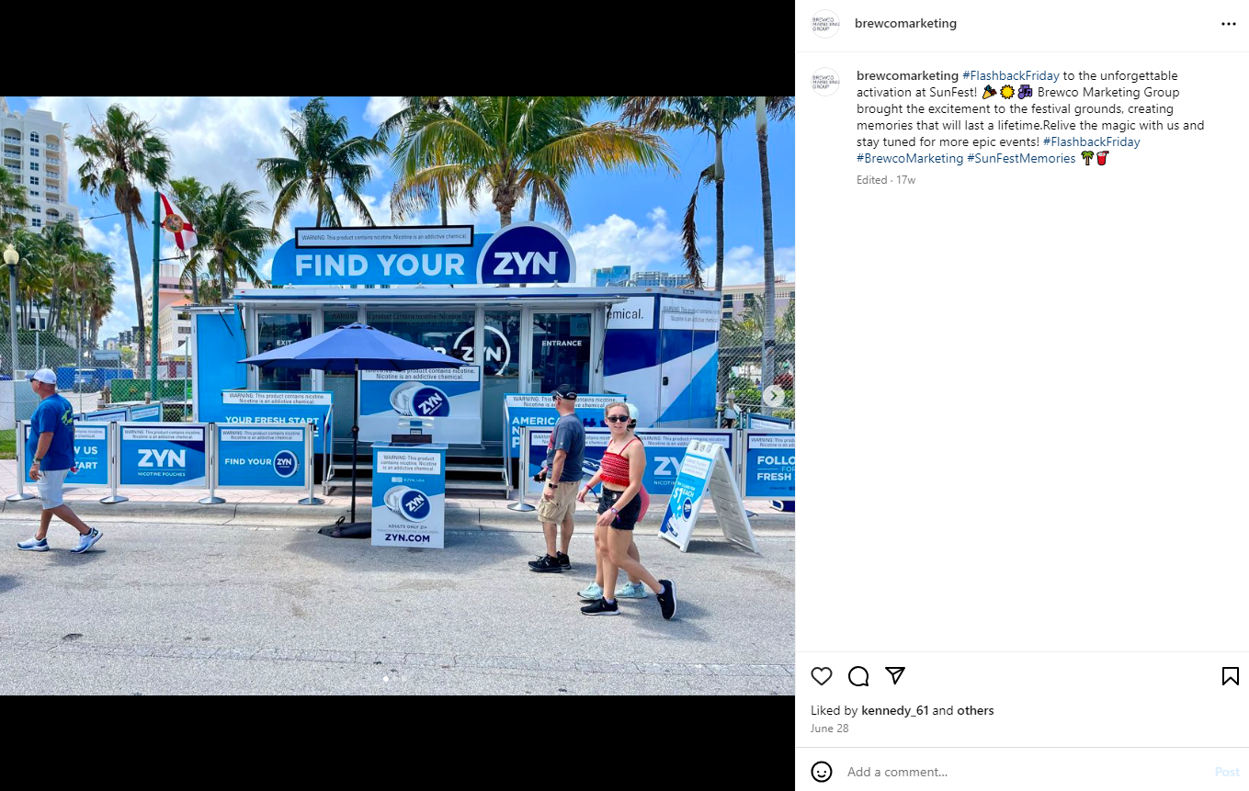
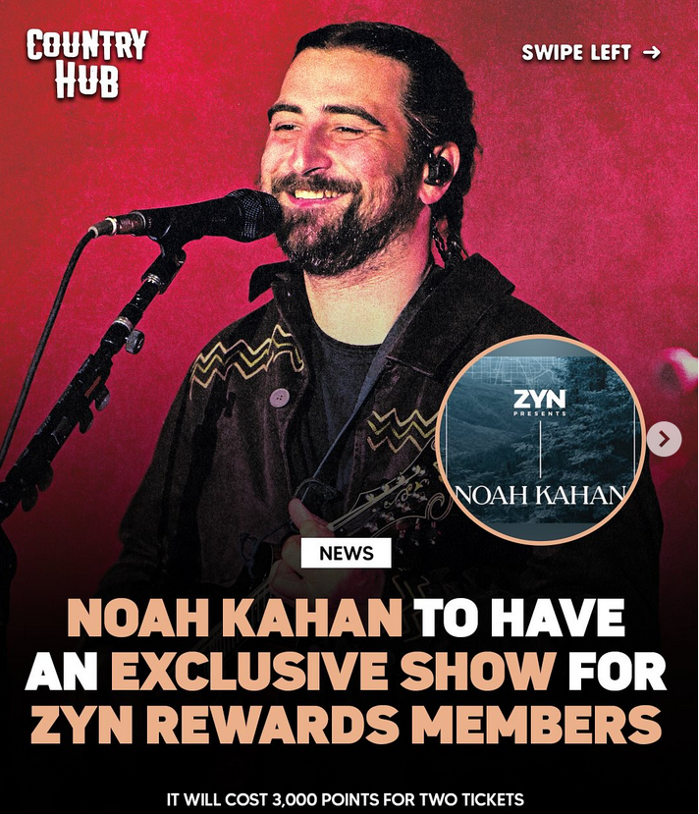

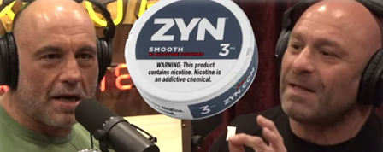
Nicotine Pouch Marketing Targets Young People
Nicotine pouches are widely promoted on social media and in ways that appeal to youth, including music sponsorships, celebrity endorsements, and viral user-generated content.
Notes:
Nicotine pouches are being marketed in ways that appeal to young people, especially young men. For example, social media personalities like Joe Rogan and the Nelk Boys have a history of promoting ZYN on their various platforms and now Tucker Carlson has his own brand of nicotine pouches.
PMI prominently features ZYN branding, logos, and taglines at sponsored music concerts, and gives away ZYN-branded merchandise.
PMI offers a very generous rewards program, allowing people to redeem points acquired from ZYN purchases for items like iPads, Dyson hair stylers, and concert tickets. Last year, ZYN partnered with Noah Kahan to host a small concert in Denver and tickets could only be purchased by redeeming reward points amounting to at least 200 tins of ZYN purchases.
Nicotine pouch makers also sponsor sports, including car and motorcycle racing, boxing, and rodeos/bull riding competitions and teams.

Slide 16
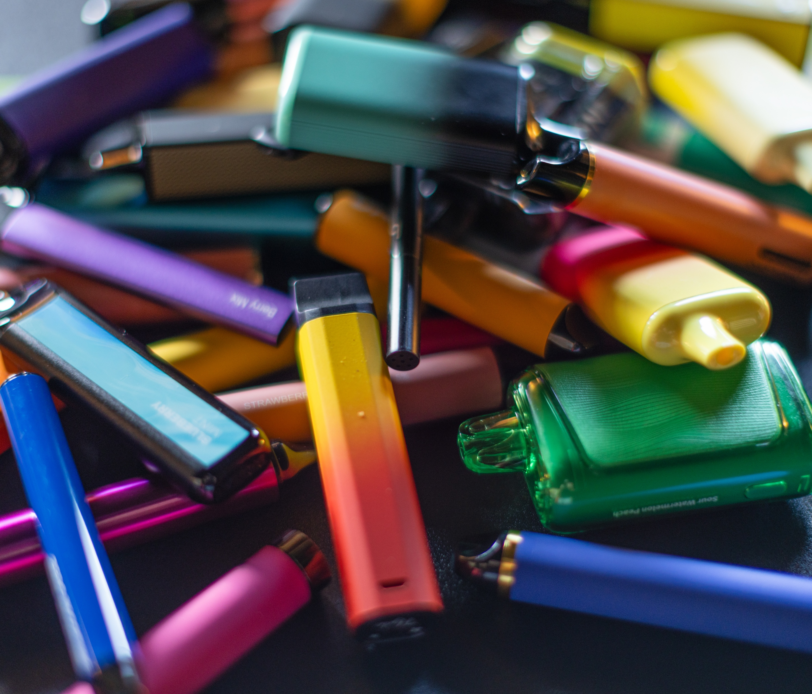
The Evolution of E-Cigarettes

Slide 17
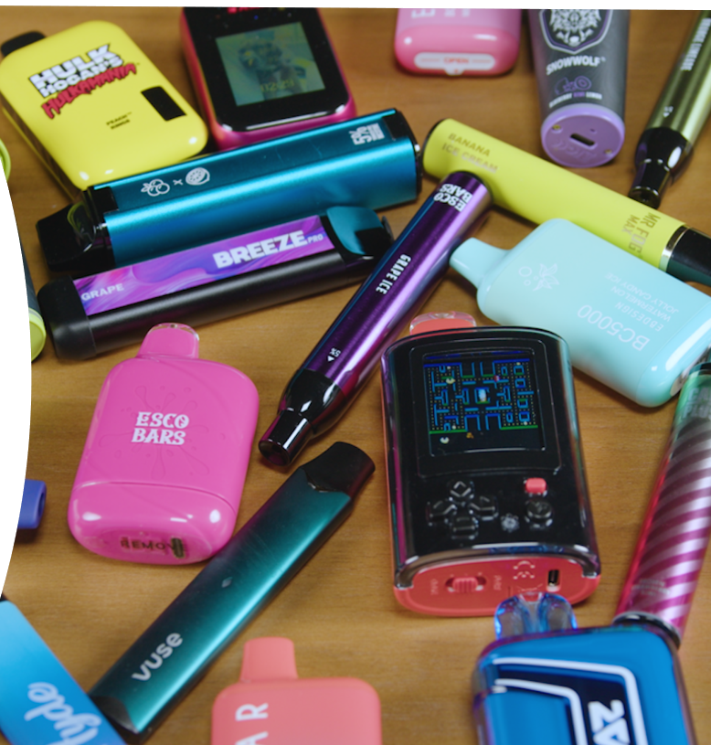
Flavored E-Cigarettes Hook Kids
9 out of 10 youth e-cigarette users use flavored products
Nearly all (92.5%) youth who have ever tried an e-cigarette started with a flavored product
43% HS e-cigarette users use frequently; 30% use daily
Source: NYTS & TEEN+

Slide 18
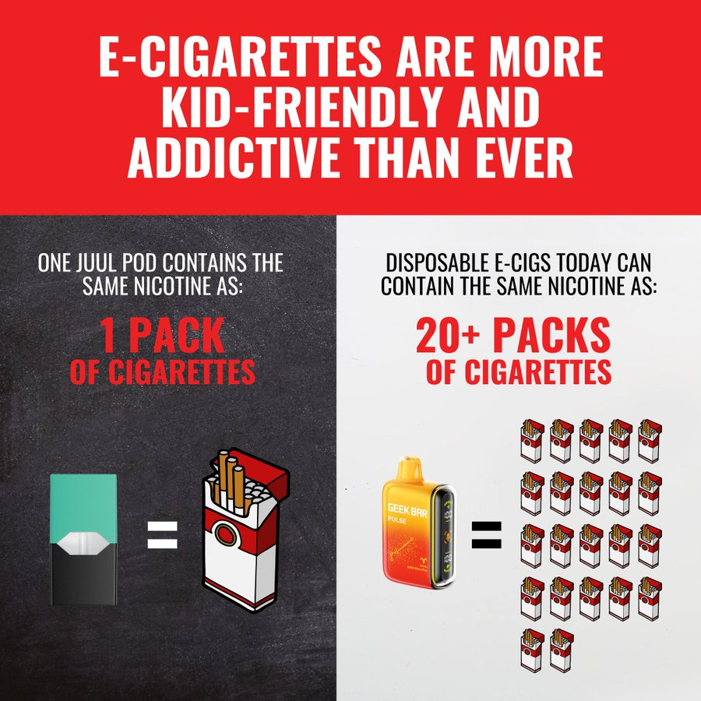
Disposable
E-Cigarettes:
Bigger, Stronger
& Cheaper
Notes:
Research shows that today’s e-cigarettes—especially disposable e-cigarettes—contain massive doses of nicotine at an even cheaper price, increasing their appeal and addiction potential to young people. Some of today’s e-cigarettes can contain as much or more nicotine as 20 packs of cigarettes.
From January 2017 through September 2022, disposable e-cigarettes nearly tripled in average nicotine strength.
The average e-liquid volume in disposable e-cigarettes increased more than seven-fold from February 2020 to June 2024.
From January 2017 through September 2022, disposable e-cigarettes decreased threefold in price per milliliter of e-liquid, making them more affordable to price-sensitive youth

Slide 19



Risks of Nicotine to Young People
Nicotine is highly addictive
Nicotine can harm the developing adolescent brain
Nicotine can prime the brain for addiction to other drugs

Slide 20
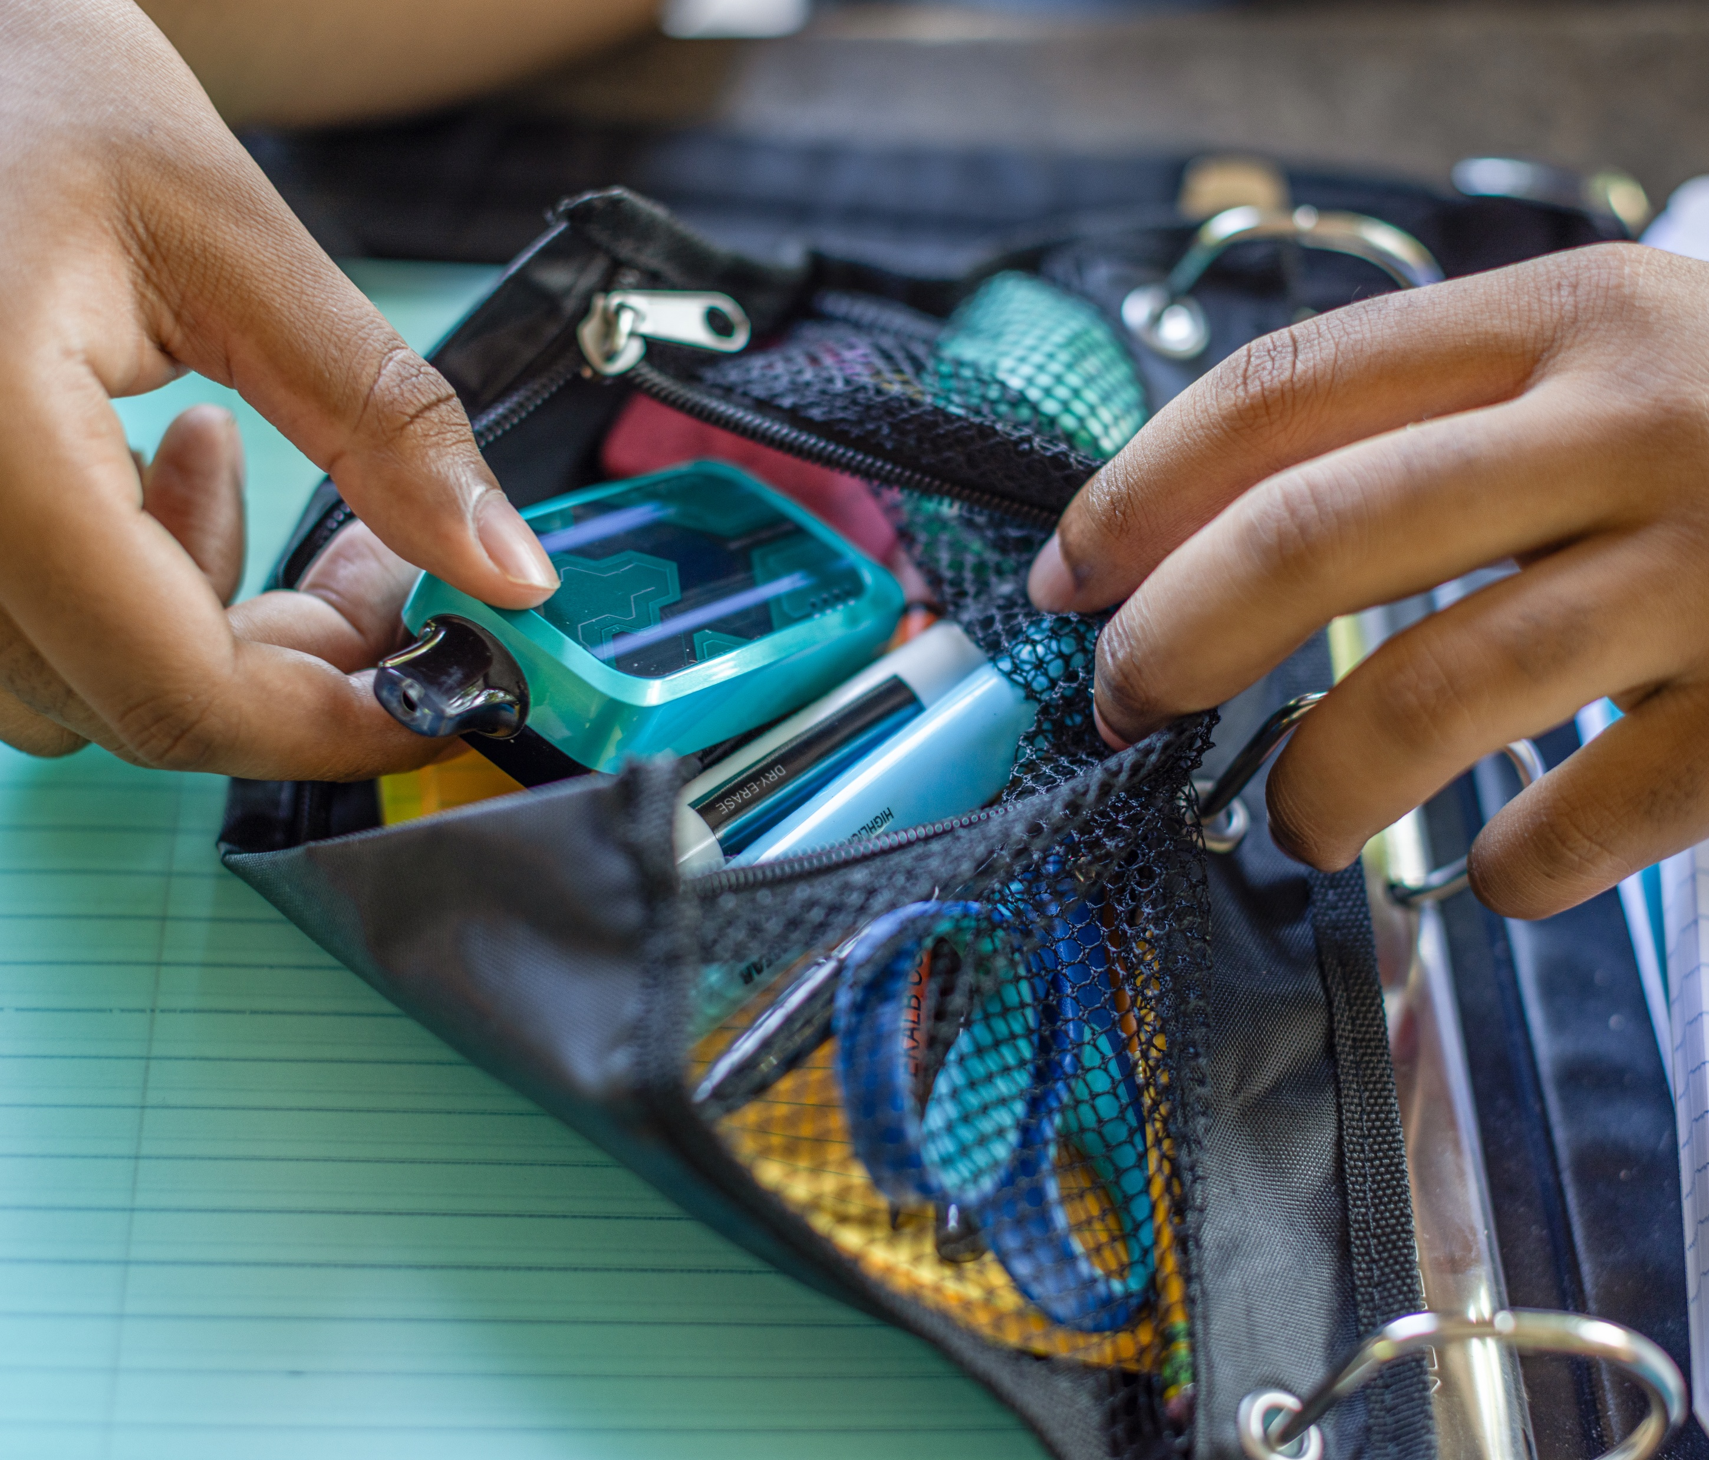
The Next Generation of E-Cigarettes: “Smart Vapes”

Slide 21
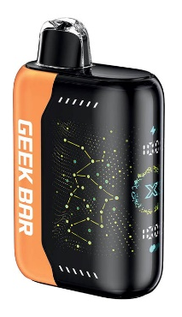
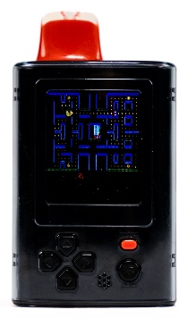
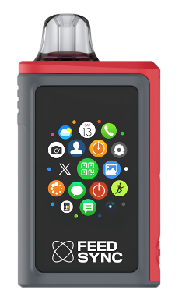
Anatomy of Addictive Technology:
“Smart Vapes”
WARNING: The next generation of e-cigarettes delivers addictive levels of nicotine with animation, games and Bluetooth capabilities in a pocket-sized, affordable device.
Digital screen with animations and graphics that can be customized.
Some products have a “Boost” mode to increase battery power and allow for bigger puffs and greater nicotine delivery.
“Smart vapes” are used by more than four out of ten (42.9%) youth e-cigarette users.
Geek Bar, a “smart vape,” is the most popular e-cigarette brand among youth.
According to the Office of the Surgeon General, the gamification of vaping “accelerates the risk of nicotine addiction combining the behavioral addiction of both nicotine and gaming.”
Devices can mimic small gaming devices, making them easy to hide in plain sight.
Bluetooth connectivity enables the e-cigarette to act like a smart accessory, providing notifications for phone calls, text messages, social media activities, and other actions.
Notes:
Devices usually have a nicotine concentration of 5%. With up to 20 mL of nicotine liquid, some can contain as much nicotine as 25 packs of cigarettes or more.
Some products have a “Boost” mode to increase battery power and allow for bigger puffs and greater nicotine delivery.
Games can keep people on the device for long periods. Some devices require users to take puffs to maintain game play.
Devices can cost between $12 and $20 each. Though disposable, devices can be recharged for use until the e-liquid is gone.
Some devices have speakers to play music from connected phones.

Slide 22
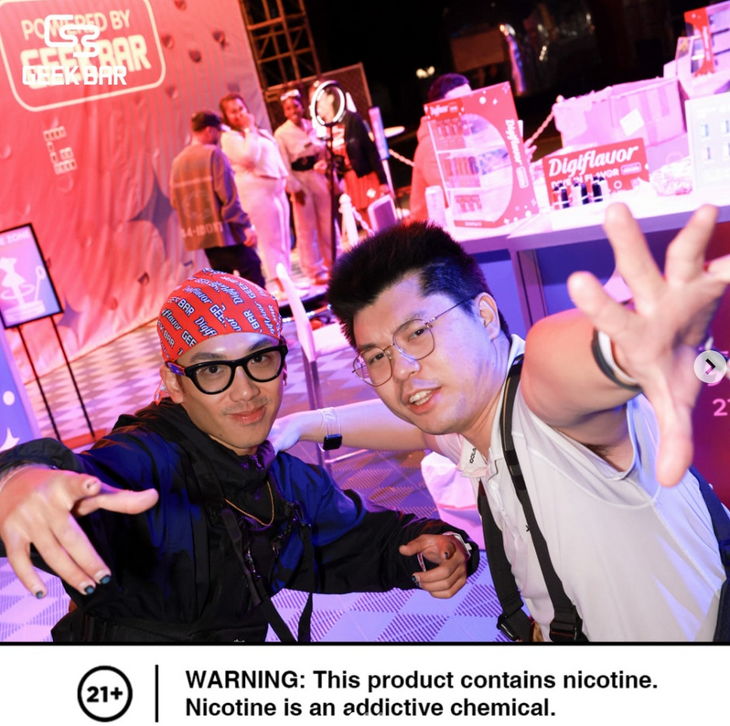
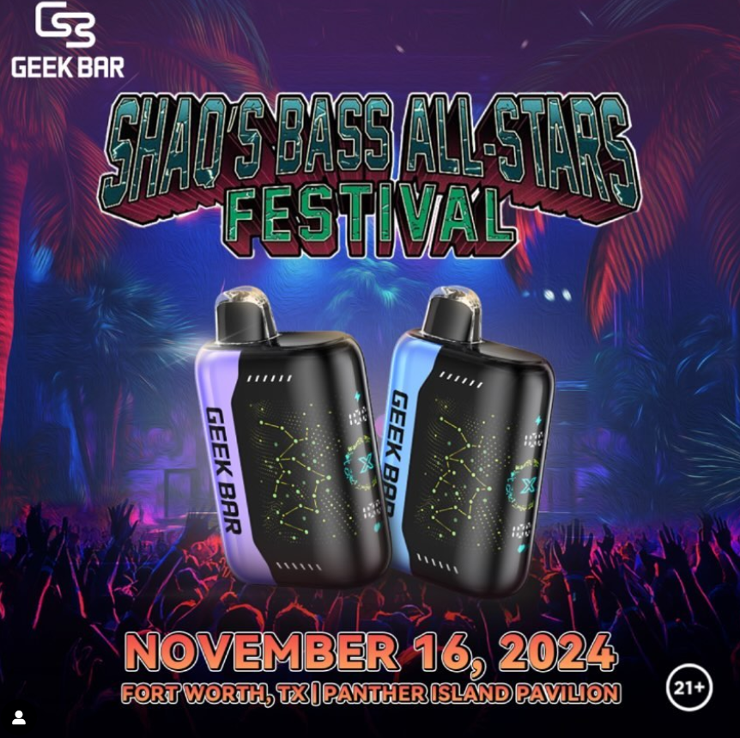
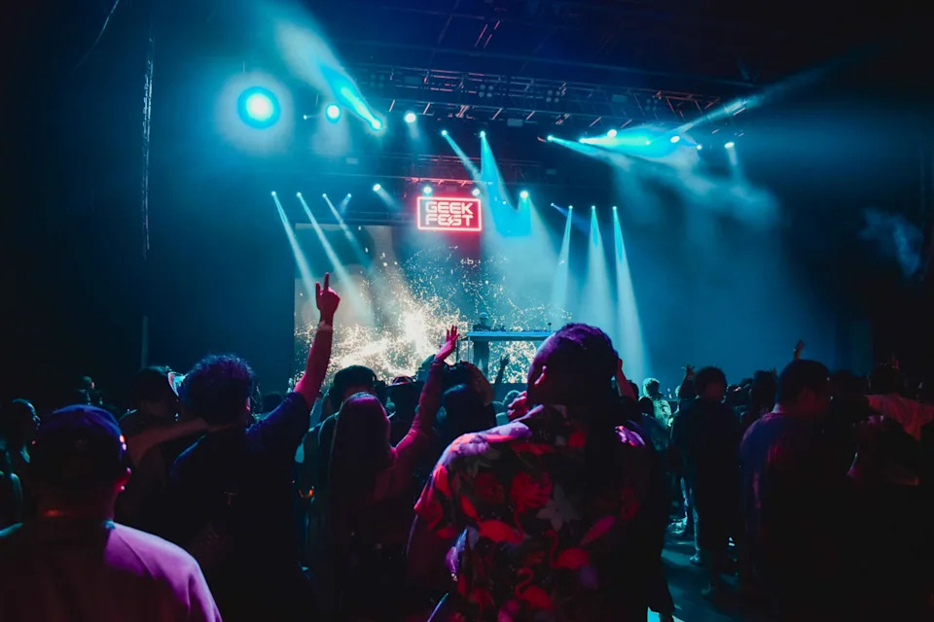
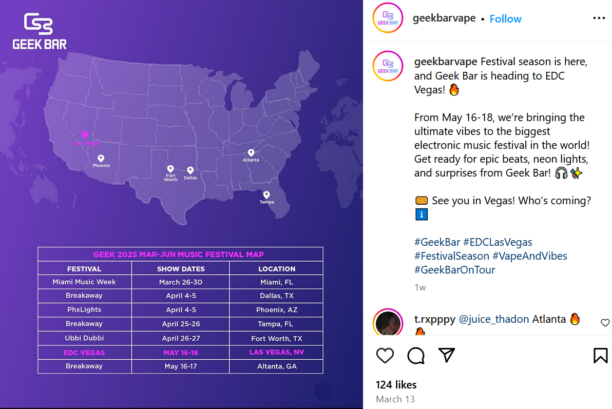
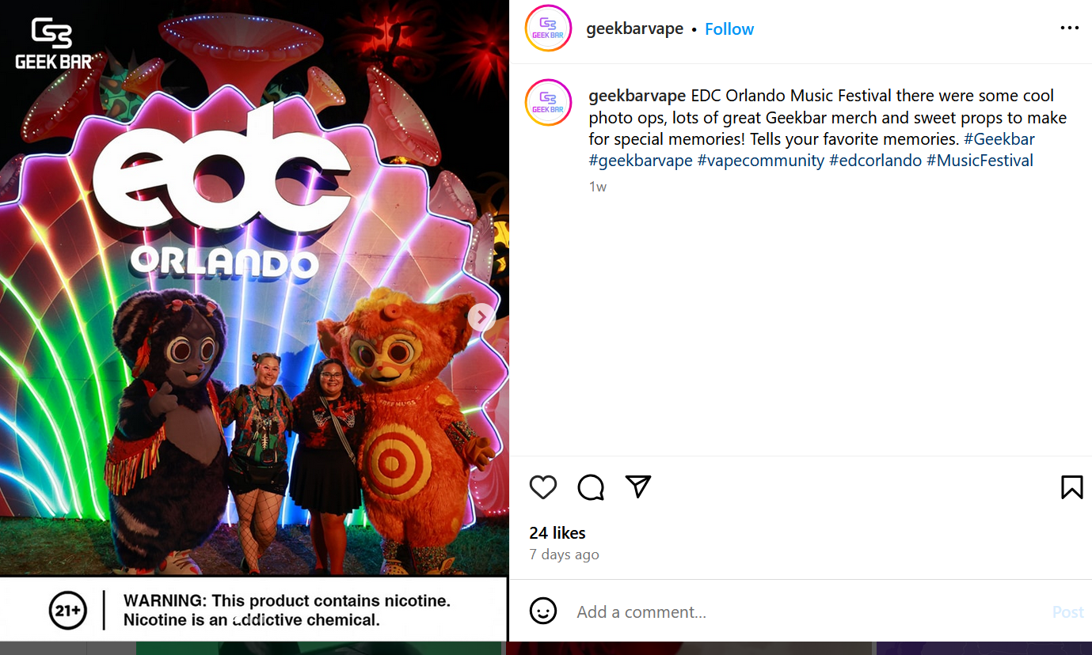
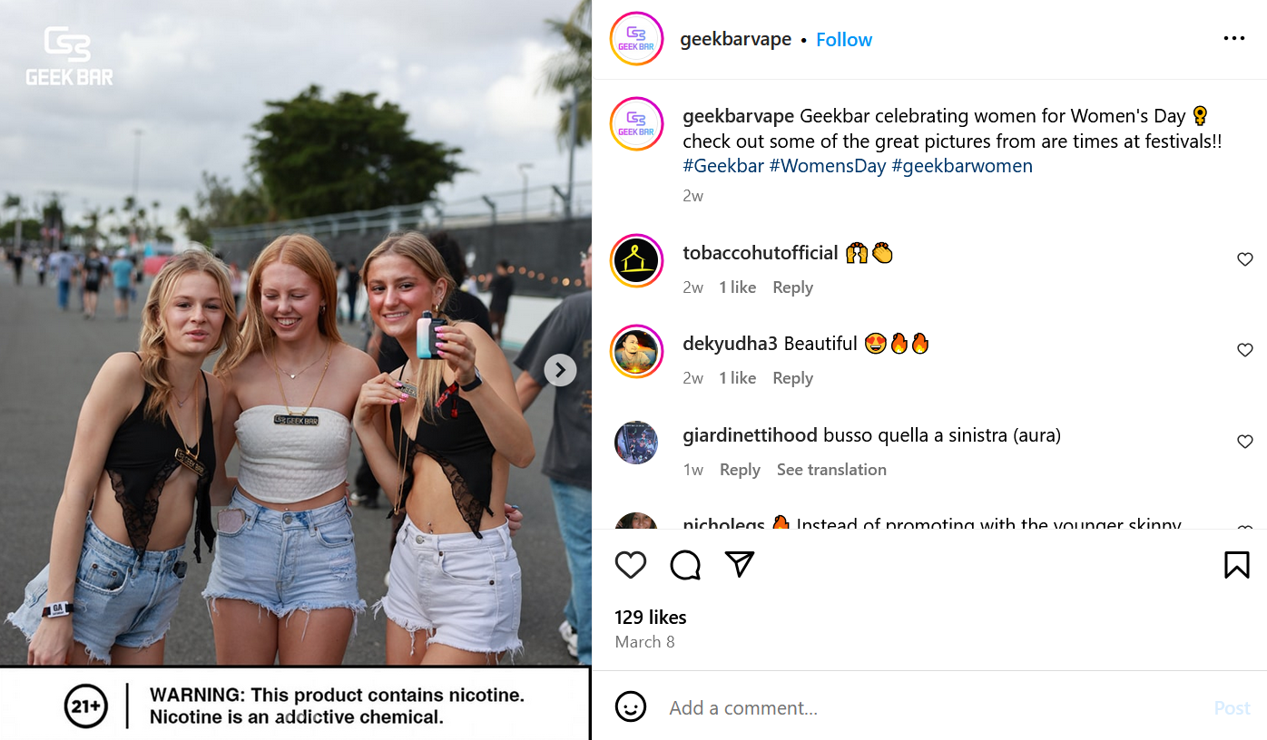
“Smart Vape” Marketing Targets Young People
Notes:
E-cigarette companies use tactics like targeted social media marketing and sponsorships to attract young consumers.
One popular marketing tactic is sponsoring music festivals and concerts.
From June to November 2024, 39% of Geek Bar’s Instagram posts were about music festivals.
Geek Bar had its own festival called “GeekFest,” an EDM event in Dallas created and hosted by Geek Bar, described as ‘a symphony of Vapes and Vibes’.
Even Shaquille O’Neal is jumping on board with smart vapes at his Bass All Stars Festival. Geek Bar was present there in 2026 as well.

Slide 23
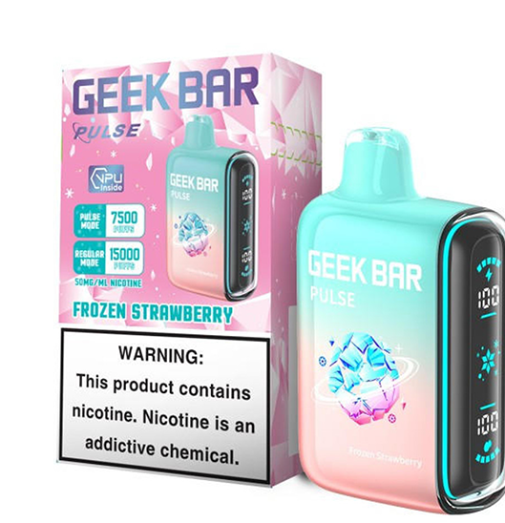
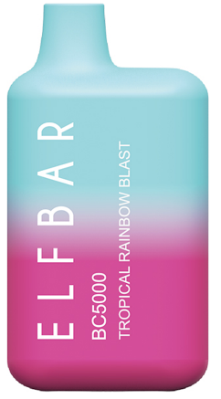
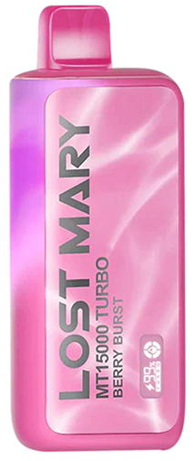
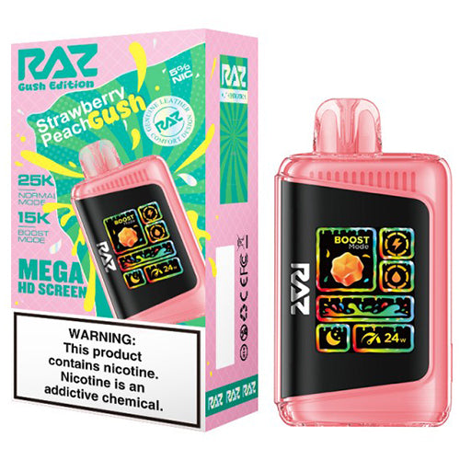
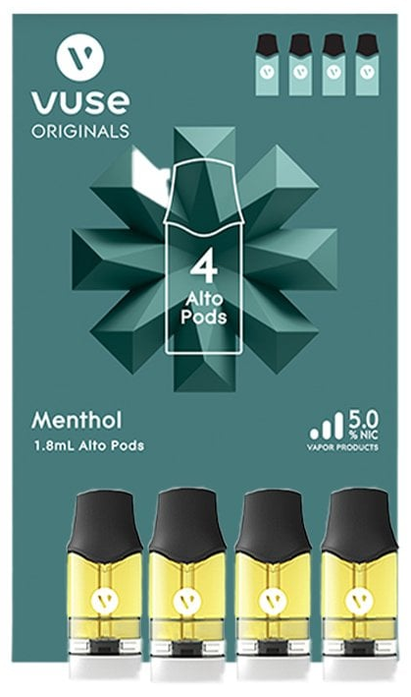
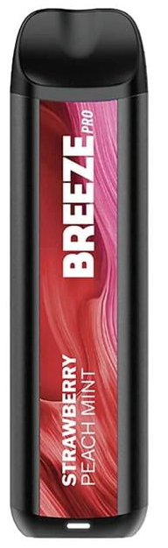
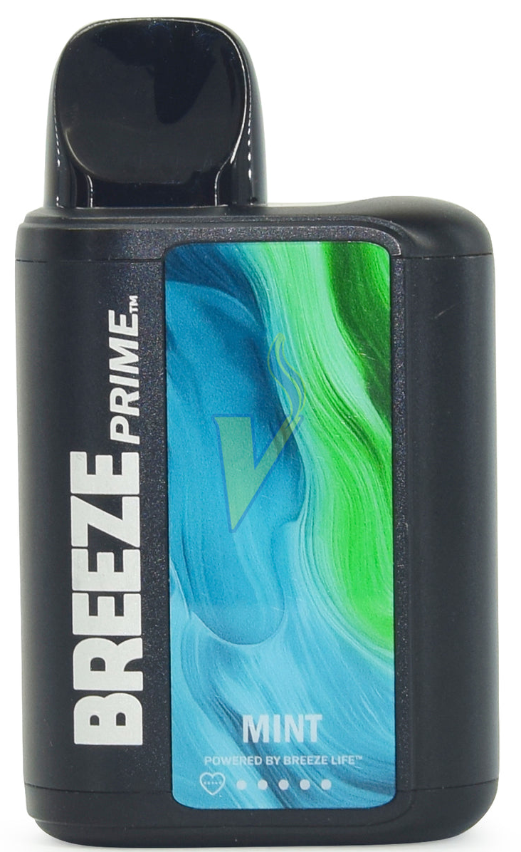
Most Popular E-Cigarette Brands Among Middle & High School Users, 2025
Geek Bar (61.1%)
2. Elf Bar (20.0%)
3. Lost Mary (18.5%)
4. RAZ (18.0%)
5. Vuse (14.6%)
6. Breeze (13.2%)
Source: CDC, National Youth Tobacco Survey (NYTS), data represents any use of a brand in the last 30 days
Notes:
The most popular products among youth have changed greatly year to year, reflecting market shifts as well as changes in FDA regulation and enforcement priorities.
These popular youth brands are also among the top-selling brands nationally. The top 10 brands during the period spanning July 13, 2025, through September 7, 2025, were (in descending order of dollar sales) Vuse, JUUL, Geek Bar Pulse, Breeze Smoke, RAZ, NJOY, Breeze Prime, HQD, Loon Maxx and Lava Plus.
All of these products, except Vuse’s tobacco-flavored products, are unauthorized and on the market illegally and despite being subject to many FDA enforcement actions, continue to be widely available.

Slide 24
Where We Are
Industry Playbook

Slide 25
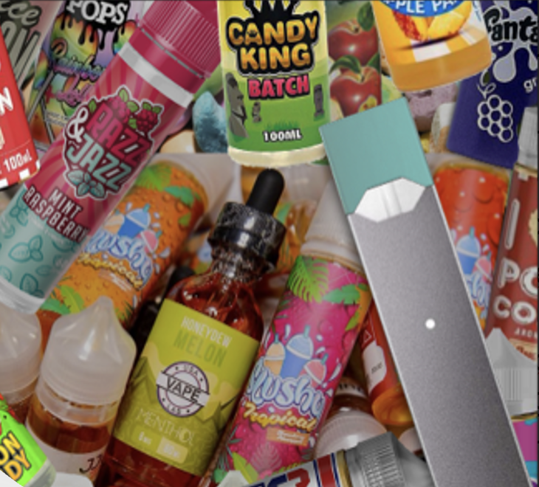





Industry Strategies
Targeting Youth
Political Donations
Front Groups
Image Rebranding
Litigation
Weak Proposals

Slide 26
Where We Are
Federal Landscape

Slide 27







April 2025

Slide 28





Food and Drug Administration (FDA)
Regulates the manufacture, marketing, and sale of tobacco products

Slide 29
Where We Are
State Landscape

Slide 30
Making Progress
Tobacco tax increases: IN, ME; WA state (nic pouches)
Program Funding: MT, TN and WV; OK fought off threat to TSET
Smokefree – Knoxville, TN – passed first reading
Local flavors: MN and CO
TRL: SD, KY, VA; local CO
Defeat Preemption: MO (legal victories in OH and OR)
Defeat bad registry/directory bills

Slide 31
Where We’re Going
How We Get There

Slide 32

Change Doesn’t Require Reinvention
Notes:
Great deal of momentum and innovation, spread of ideas occurs at local level and moves to state and ultimately federal
Innovation occurs at local level
We know what works – luxury of experience – decades or trying to figure out what works

Slide 33

Tobacco Control Vaccine
Source: King A,. King, B. Boosting the Tobacco Control Vaccine, Tobacco Control, 2021;30(2):e162-168.

Slide 34




Youth Voices are Powerful

Slide 35





Partnerships and Community Mobilization

Slide 36





What You Can Do
Be a Spokesperson
Advocate with Legislators
Build and Strengthen Partnerships
Raise awareness
Monitor, Expose and Discredit the Industry

Slide 37



Slide 38





@Campaign for Tobacco Free Kids
@TobaccoFreeKids
mriordan@tobaccofreekids.org
@Campaign for Tobacco Free Kids
@TobaccoFreeKids
@tobaccofreekids.bsky.social
@TobaccoFreeKids

