Slide 1


Cytisine:
A New Frontier in Pharmacotherapy
Amanda Palmer, PhD.
Department of Public Health Sciences
Hollings Cancer Center
Medical University of South Carolina

Slide 2
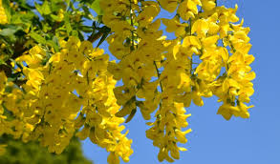
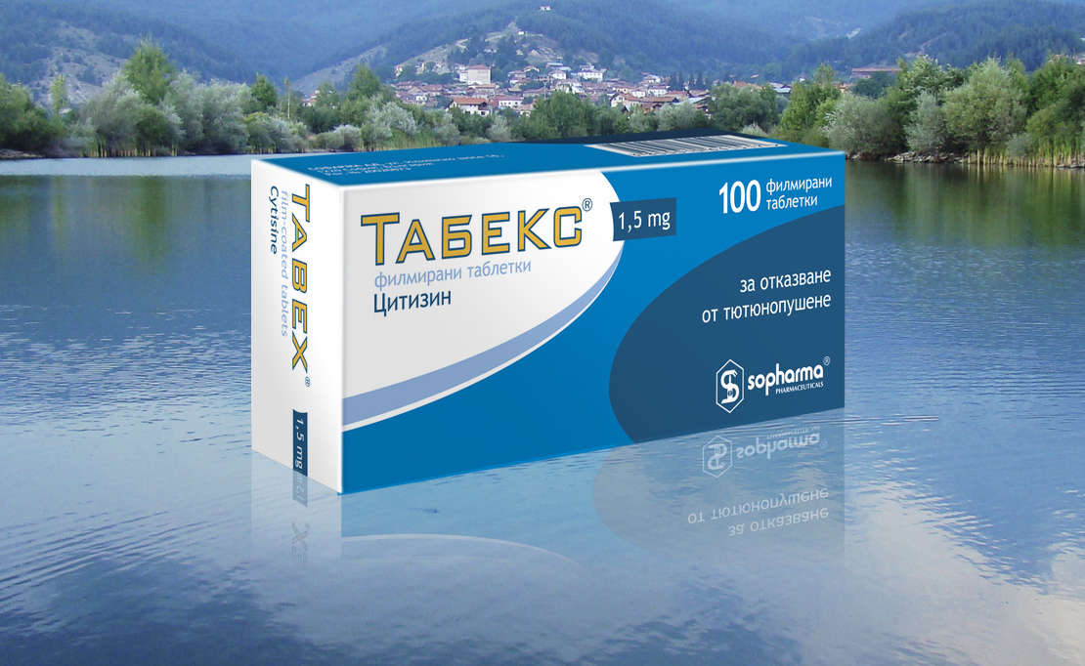
What is Cytisine?
Naturally occurring plant-based alkaloid naturally derived from Laburnum seeds.
Widely used throughout Eastern Europe (e.g., Bulgaria, Poland) as an affordable smoking cessation treatment since the 1960s.
Marketed as “natural” and “plant-based,” which may be highly acceptable for some populations.
Laburnum tree (Laburnum anagyroides)

Slide 3
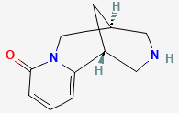
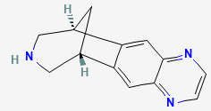
How does it work?
Selectively binds to α4β2 nicotinic acetylcholine receptors which regulate nicotine dependence.
Similar to varenicline (Chantix)
 | Cytisine | Varenicline
Structure
Derived | Plant- source | Synthetic product
Mechanism | Binds weakly to α4β2 receptors, reducing cravings and withdrawal | Stronger binding to α4β2 receptors, blocking nicotine’s effects more effectively

Slide 4
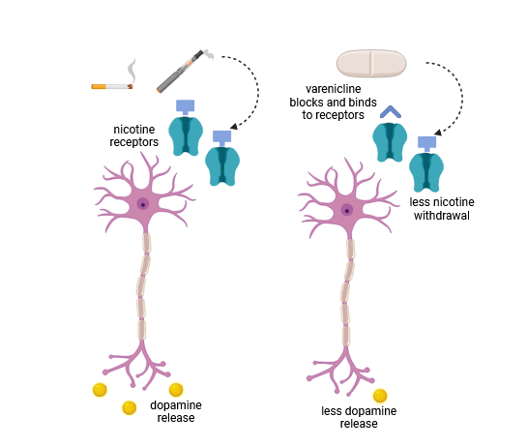

How Partial Agonists Work
hollingscancercenter.musc.edu

Slide 5



International Trials
Etter (2006), Archives of Internal Medicine: Literature review and meta-analysis
West (2011), New England Journal of Medicine: Placebo-Controlled Trial of Cytisine for Smoking Cessation
Walker (2014), New England Journal of Medicine: Cytisine versus Nicotine Replacement Therapy for Smoking Cessation

Slide 6
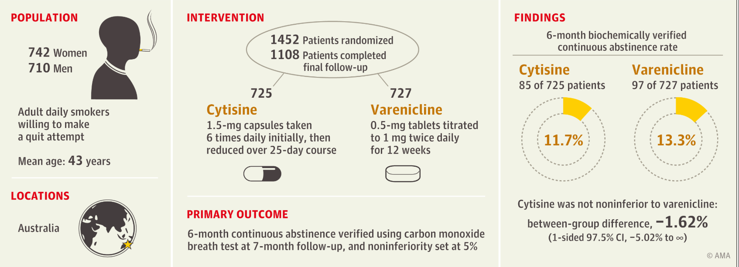

International Trials
Courtney et al. (2021), Journal of the American Medical Association: Cytisine vs Varenicline for Smoking Cessation

Slide 7

Coming to America: Cytisine → Cytisinicline
Achieve Life Sciences working towards FDA approval of a cytisine drug to be named “Cytisinicline”
Goal to submit a New Drug Application for smoking cessation this summer
Received Breakthrough Therapy Designation for e-cigarette cessation

Slide 8
Ongoing Research for Cytisinicline for Addiction (ORCA trials)
Nancy Rigotti – physician at Harvard
ORCA1 (2021): Evaluated dosing schedule and effectiveness (published in Nicotine and Tobacco Research)
ORCA2 (2023): Evaluated a single dose at different timecourses (6- and 12-week) vs placebo (published in Journal of the American Medical Association)
ORCAV1 (2024): Evaluated a single dose for 12-weeks vs placebo for e-cigarette cessation (published in JAMA Internal Medicine)
ORCA3 (2025): Replicated ORCA2 with additional safety data collected (published in JAMA Internal Medicine)

Slide 9
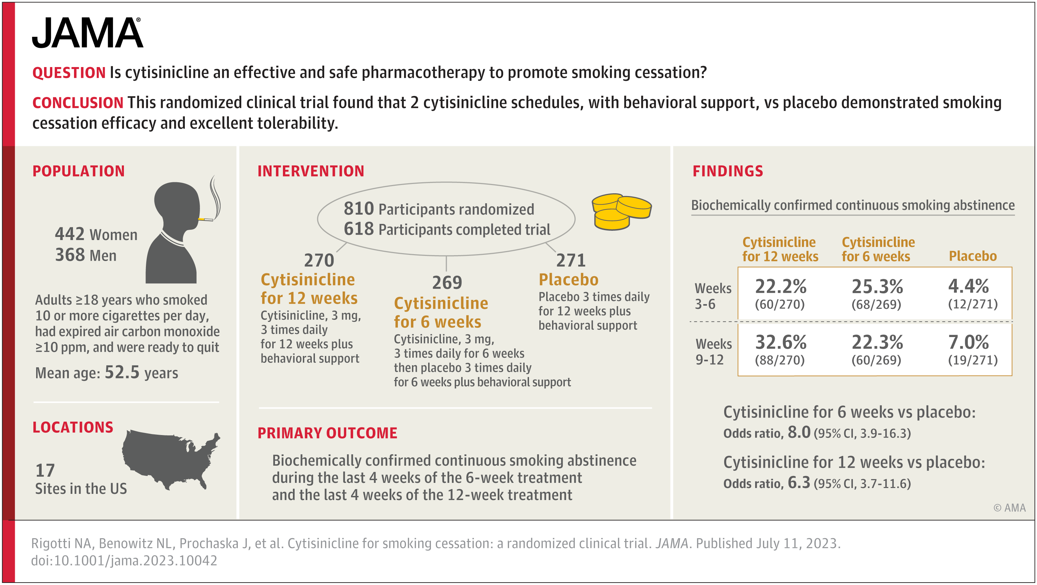
ORCA2 Results

Slide 10
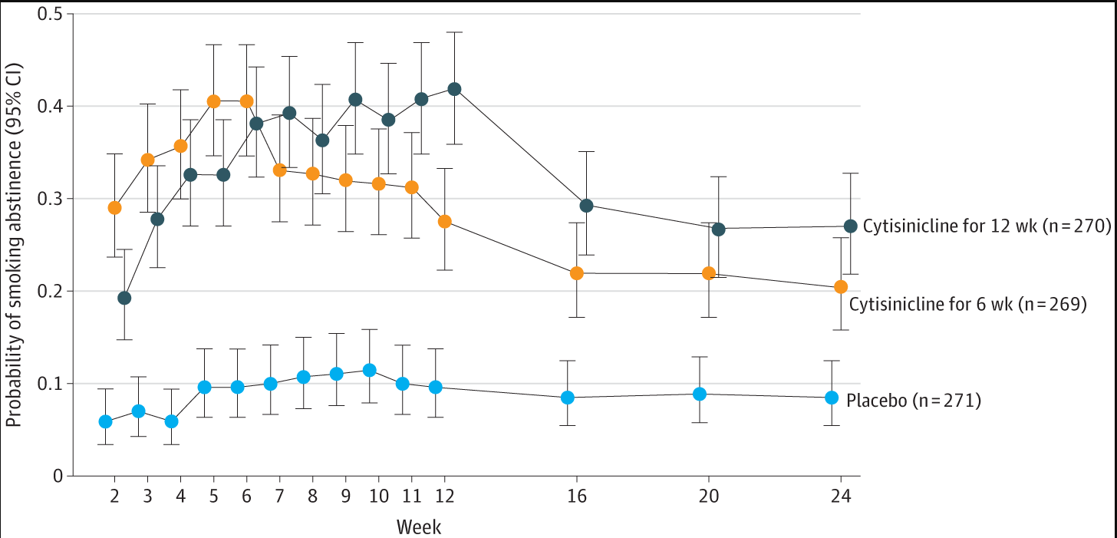
ORCA2 Results

Slide 11
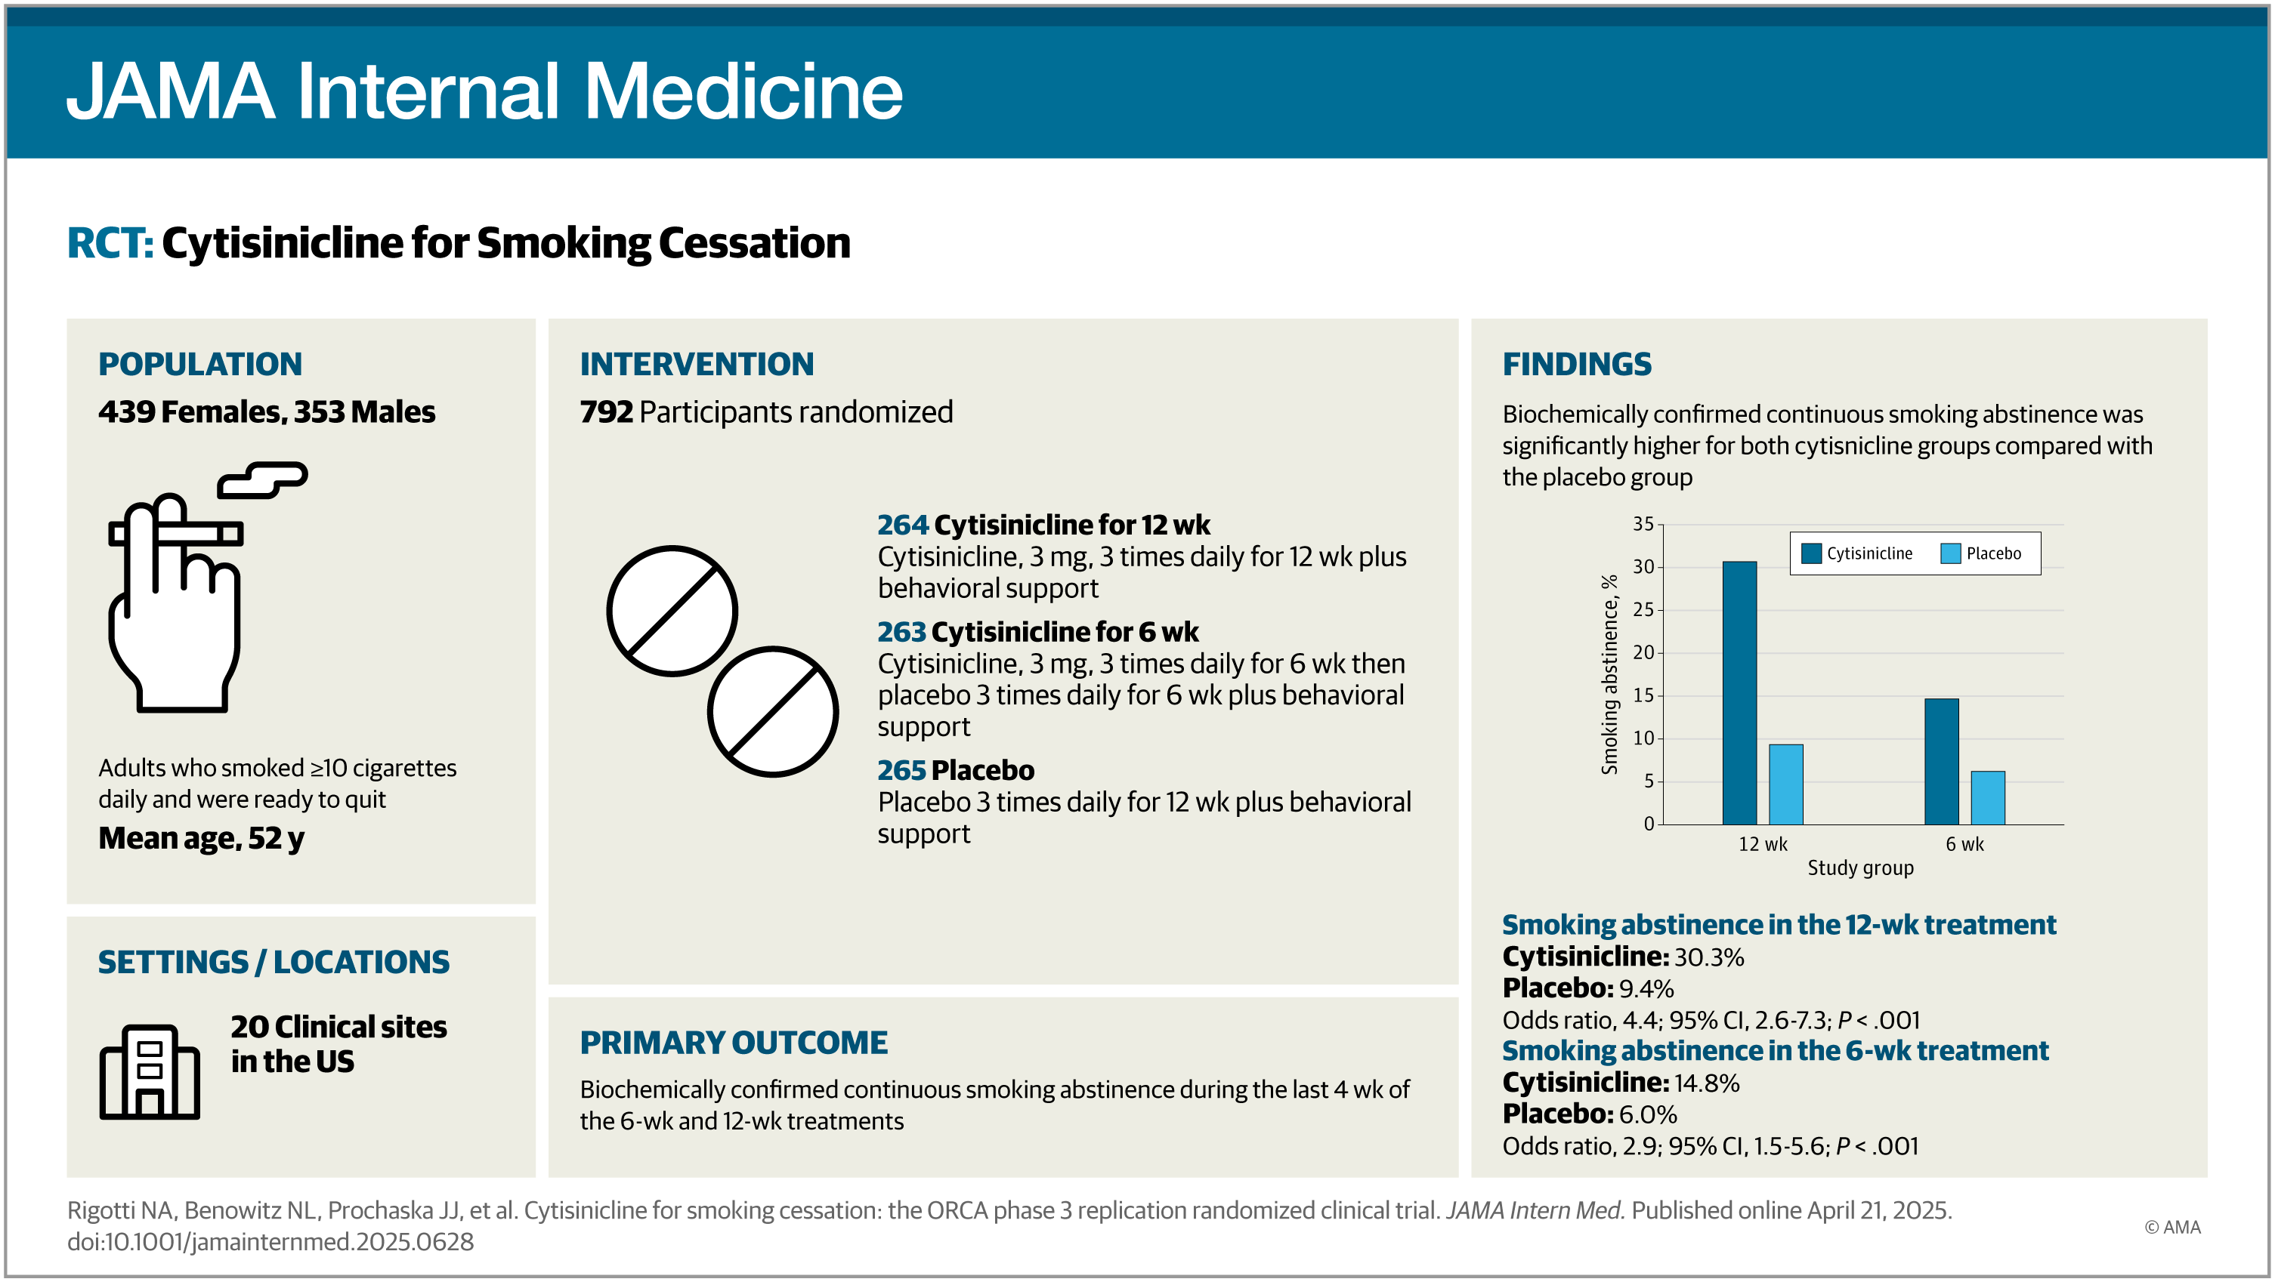
ORCA3 Results

Slide 12
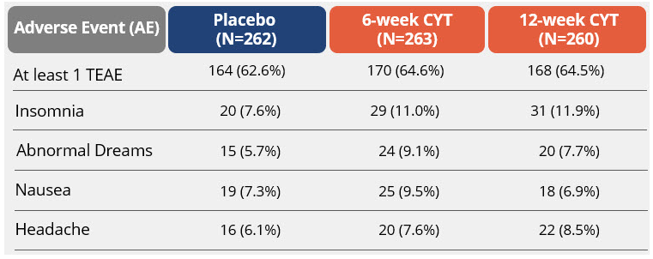
ORCA3 Results

Slide 13
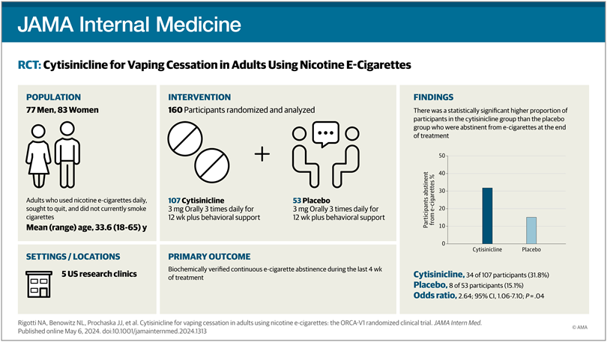
ORCAV1 Results

Slide 14
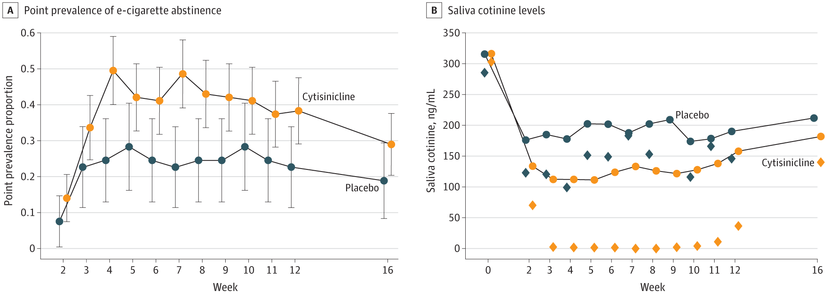
ORCAV1 Results

Slide 15

Proposed Cytisine Prescribing Guidelines
Prescription only for ages 18-65 years
Not appropriate for pregnant or breast-feeding women
Not suitable for individuals with cardiovascular complications like unstable angina, recent heart attack, significant arrythmias, or recent stroke.
Additional contraindications: schizophrenia, pheochromocytoma and malignant hypertension.

Slide 16
Cytisine Recommendations (WHO)
Treatment is initiated while patient is still smoking, because it takes approximately 1 week to reach steady-state
Patient should set a target quit date (ideally by day 5) within the first week from starting the medication
Studies show longer treatment with cytisine to be more effective than shorter durations
Days of treatment | 1st to 3rd | 4th to 12th | 13th to 16th | 17th to 20th | 21st to 25th
Recommended dosing | 1 tablet every 2 hours | 1 tablet every 2.5 hours | 1 tablet every 3 hours | 3 tables every 5 hours | 1-2 tablets a day
Maximum daily dose | 6 tablets | 5 tablets | 4 tablets | 3 tablets | 2 tablets

Slide 17
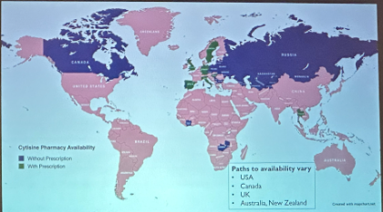
Cost and Availability of Cystine
Country | Cost (25-day treatment) as of 2024
Canada (Cravv) | $ 56.49
Spain (Todacitan) | $126.81
Italy (Cytisine) | $ 65.07
United Kingdom (Tactizen) | $ 238.59
Bulgaria (Tabex) | $ 4.02
United States | ? (will be available as BRAND name only)
Notes:
- It's worth noting that cytisine is available over-the-counter in Canada as a natural health product, which means it can be purchased without a prescription from select pharmacies, health shops, or directly online from the manufacturer
It's important to note that this price represents a significant reduction from its previous cost, as it is now subsidized by the Spanish government.
It's important to note that cytisine is available in Italy as a galenic preparation, which means it's prepared by pharmacists rather than being commercially manufactured
The medication has been available in Bulgaria since 1964 which it produced locally

Slide 18

References
https://orcaprogram.com/
Courtney RJ, McRobbie H, Tutka P, et al. Effect of Cytisine vs Varenicline on Smoking Cessation: A Randomized Clinical Trial. JAMA. 2021;326(1):56–64. doi:10.1001/jama.2021.7621
Etter JF. Cytisine for smoking cessation: a literature review and a meta-analysis. Arch Intern Med. 2006 Aug 14-28;166(15):1553-9. doi: 10.1001/archinte.166.15.1553.
Rigotti NA, Benowitz NL, Prochaska J, et al. Cytisinicline for Smoking Cessation: A Randomized Clinical Trial. JAMA. 2023;330(2):152–160. doi:10.1001/jama.2023.10042
Rigotti, N. A., Benowitz, N. L., Prochaska, J. J., Cain, D. F., Ball, J., Clarke, A., ... & Jacobs, C. (2024). Cytisinicline for vaping cessation in adults using nicotine e-cigarettes: the ORCA-V1 randomized clinical trial. JAMA Internal Medicine, 184(8), 922-930.
Rigotti, N. A., Benowitz, N. L., Prochaska, J. J., Rubinstein, M., Clarke, A., Blumenstein, B., ... & Jacobs, C. (2025). Cytisinicline for Smoking Cessation: The ORCA Phase 3 Replication Randomized Clinical Trial. JAMA Internal Medicine.
Walker N, Howe C, Glover M, et al. Cytisine versus nicotine for smoking cessation. N Engl J Med. 2014;371(25):2353-2362. doi:10.1056/NEJMoa1407764
West, R., Zatonski, W., Cedzynska, M., Lewandowska, D., Pazik, J., Aveyard, P., & Stapleton, J. (2011). Placebo-controlled trial of cytisine for smoking cessation. New England Journal of Medicine, 365(13), 1193-1200.
National Center for Biotechnology Information. PubChem Compound Summary for CID 5310966, Varenicline. https://pubchem.ncbi.nlm.nih.gov/compound/5310966. Accessed Mar. 18, 2025.
National Center for Biotechnology Information. PubChem Compound Summary for CID 10235, Cytisine. https://pubchem.ncbi.nlm.nih.gov/compound/Cytisine. Accessed Mar. 18, 2025.
Come train with us!
Thanks to Dr. Emily Ware for the information presented in these slides!

